Slide 1

Nottingham city dsl network
February 12th 2019

Slide 2


Slide 3



Slide 4
DSL Network
Aims and Purpose
To promote connectivity with the Nottingham City Safeguarding Children Board
Act as a conduit for policy updates
A practice network which demonstrates professional behaviours and mutual support

Slide 5
National updates
Controlling access to school premises guidance https://www.gov.uk/government/publications/controlling-access-to-school-premises/controlling-access-to-school-premises
Mental Health and Behaviour in Schools https://assets.publishing.service.gov.uk/government/uploads/system/uploads/attachment_data/file/755135/Mental_health_and_behaviour_in_schools__.pdf
ACES – Common’s Select Committee – https://www.parliament.uk/business/committees/committees-a-z/commons-select/science-and-technology-committee/inquiries/parliament-2017/evidence-based-early-years-intervention-17-19/
Working Together
Children in Care https://www.gov.uk/government/publications/national-protocol-on-reducing-criminalisation-of-looked-after-children?utm_source=f4d5cc78-4f05-4c05-84ab-ca326a89d7ea&utm_medium=email&utm_campaign=govuk-notifications&utm_content=immediate
Notes:
Access to school premises: Guidance to help schools understand what they should do to remove someone who is on the premises without permission.

Slide 6
National updates
Ofsted update
  Sept 2019 inspection framework
  https://www.gov.uk/government/consultations/education-inspection-framework-2019-inspecting-the-substance-of-education
  https://www.gov.uk/government/consultations/education-inspection-framework-2019-inspecting-the-substance-of-education/education-inspection-framework-2019-inspecting-the-substance-of-education
  https://assets.publishing.service.gov.uk/government/uploads/system/uploads/attachment_data/file/773410/Education_inspection_framework_consultation_-_questionnaire_240119.docx

Slide 7
  Off rolling
Ofsted inspectors will be told to give an "inadequate" judgement to schools that are found to have off-rolled pupils under its new framework, it has been reported.
The inspectorate’s new framework is set to place an increased focus on schools where pupils are removed from school rolls in order to boost exam results.

Slide 8
A Guide to Attachment, How to Create a Positive Future and Looking After Looked After Children.
Sir John Timpson CBE has written three useful little guide books on Attachment, based on 30 years’ experience as a foster carer –
These three books are available FREE from any Timpson, Max Spielmann or Johnsons the Cleaners store.
The books aim to enlighten foster carers, inform educators and engage the wider public about Attachment using simple, jargon-free language and pictures.
https://www.timpson-group.co.uk/alex-timpson-trust/free-books/

Slide 9
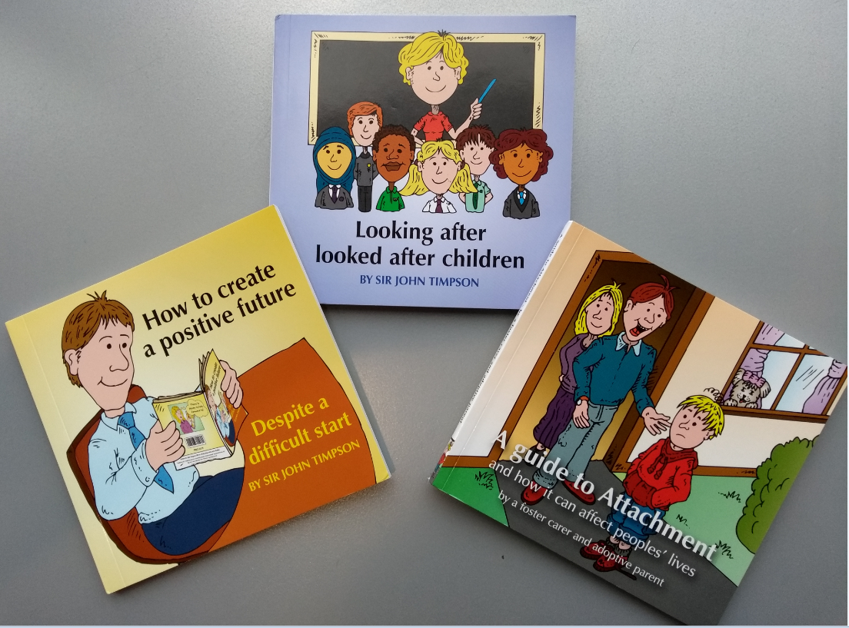

Slide 10
Local updates
DVSA data & Domestic Abuse update
City Hub / Weapon Enabled Violence
Visiting Professionals Guidance
MARF
Transgender Awareness
External Agencies and Events Companies
Family Support Pathway
Escalation
Notes:
Access to school premises: Guidance to help schools understand what they should do to remove someone who is on the premises without permission.

Slide 11
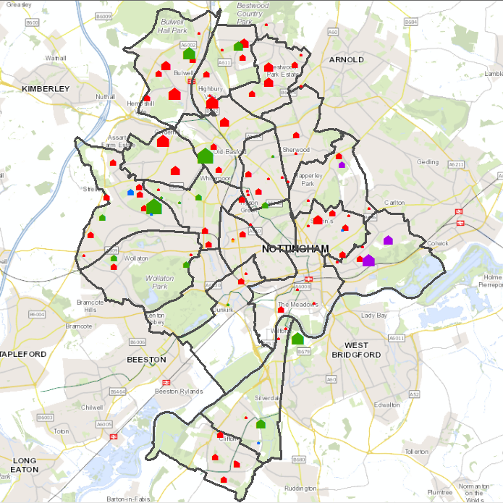
Encompass Data
The Encompass schools database was used to produce the map (left), using total volume of DV referrals to Nottingham City schools from April 2017 to November 2018.
It should be expected that Secondary schools would have a greater volume of referrals when compared with other school types because they have a far larger student body.
Nursery
Primary
Primary & Secondary
Secondary
Special

Slide 12
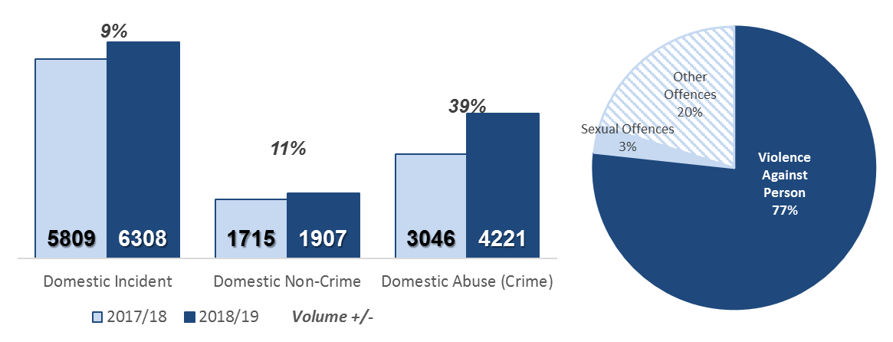
Domestic Abuse
Year on Year Comparison & Crime Type | Q1, Q2 & Q3
Year to date (April - December 2018), there were 6311 domestic incidents recorded in Nottingham, this is a 9% increase (502 more incidents) compared to the same period last year. In the same time period, the number of domestic non-crime occurrences have increased from 1715 in 2017/18, to 1907 in 2018/19.
In this period, Nottinghamshire Police recorded 4221 domestic abuse offences in Nottingham, 39% (1175 offences) more compared to last year.
Violence against the person offences made up the majority (77%) of recorded domestic abuse in that time period.
Domestic Incidents have been extracted from Vision (Incident Recording System); comprises of occurrences where the Incident has been closed as a “Domestic”.
Domestic Non-Crimes are incidents which did not meet the threshold of crime but were recorded to monitor vulnerability and repeat victimisation.

Slide 13
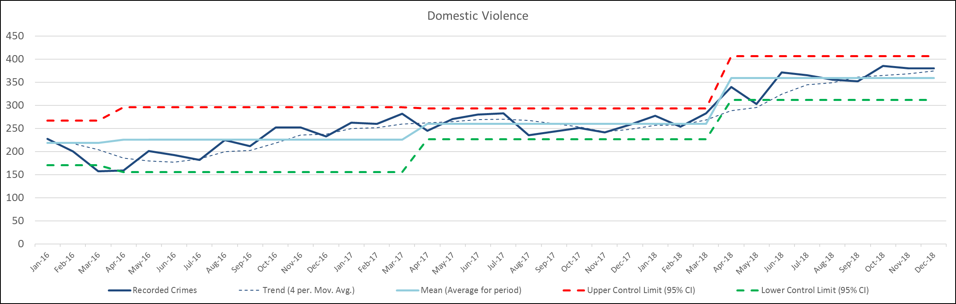
Trend in Domestic Violence
Jan’16 – Dec’18
Niche | Violence Against Person (DV) | Jan’16-Dec’18 | Recorded Crime
2018/19
In the first three quarters of 2018/19 there were 3231 violence against the person offences classed as domestic abuse (domestic violence), which is a 40% increase (925 more offences), when compared to 2017/18.
October was the month with the highest volume of offences (385), the largest year on year increase was in July (36%, 101 more offences).
Domestic Violence (Crimes) are offences within Violence Against the Person category, which have been classed as Domestic Abuse.

Slide 14
Ward Recorded Figures
Incidents, Crimes | 2018/19
Aspley was the ward with the highest volume of recorded domestic violence crimes in 2018/19 (258 offences), followed by Bulwell (257 offences) and then Bestwood & St. Ann’s (217 offences each).
The three of the same wards also experienced the highest volume of domestic incidents. Bestwood experienced the highest number of domestic incidents (533), followed by Aspley (531) and Bulwell (497).
Niche | Violence Against the Person | Apr’18 – Dec’18;
Vision | closing code ‘Domestic’ | Apr’18 – Dec’18

Slide 15
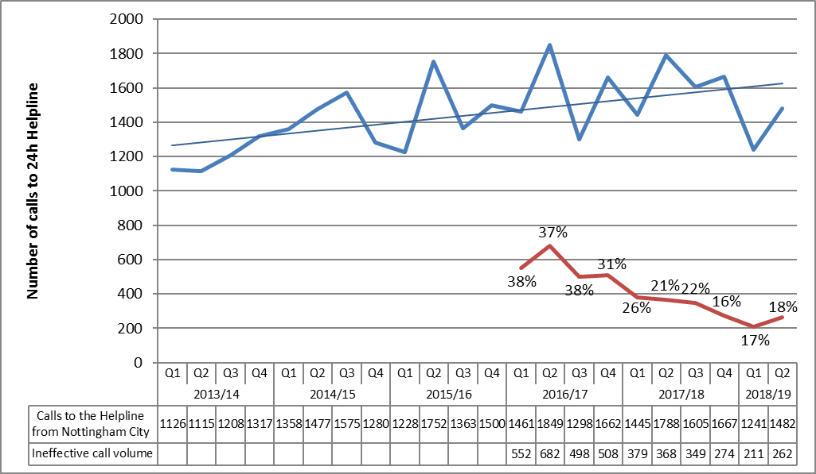
WAIS 24 Hour Helpline
Quarterly Calls
The WAIS 24 hour helpline received 1482 calls from Nottingham city in Q2 of 2018/19.
Calls from elsewhere were not available at the time of writing.
The chart shows the number of ineffective calls and the percentage of Nottingham city known calls. The volume of ineffective calls in Q1 & Q2 decreased by 37% (274 fewer calls) when compared with the same period in 2017/18.

Slide 16
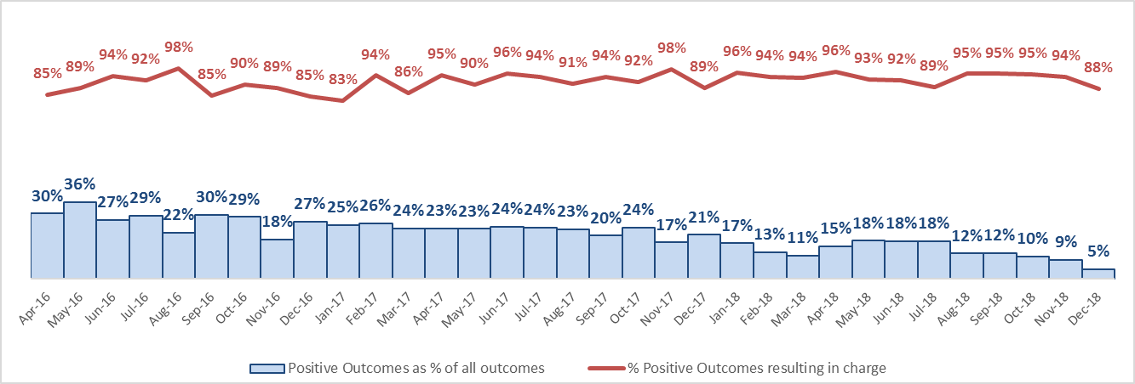
Positive Outcomes
Domestic Violence
Niche | Violence Against the Person | Apr’16-Dec’18 | Classification Status
Niche | Violence against the person (Domestic Abuse) | excluding ‘UU unresolved’ (live investigations)
Positive Outcomes (Outcomes 1 to 8, excl. 5)

Slide 17
Summary
Domestic Violence & Abuse
Year to date (April - December 2018), there were 6308 domestic incidents recorded in Nottingham, this is a 9% increase (499 more incidents) compared to the same period last year. In the same time period, the number of domestic non-crime occurrences have increased from 1715 in 2017/18, to 1907 in 2018/19.
In this period Nottinghamshire Police recorded 4221 domestic abuse offences in Nottingham, 39% (1175 offences) more compared to last year.
Violence against the person offences made up the majority (77%) of recorded domestic abuse in that time period.
In the first three quarters of 2018/19 there were 3231 violence against the person offences classed as domestic abuse (domestic violence), which is a 40% increase (925 more offences), when compared to 2017/18.
October was the month with the highest volume of offences (385), the largest year on year increase was in July (36%, 101 more offences).
Aspley was the ward with the highest volume of recorded domestic violence crimes in 2018/19 (258 offences), followed by Bulwell (257 offences) and then Bestwood & St. Ann’s (217 offences each).
Three of the same wards also experienced the highest volume of domestic incidents. Bestwood experienced the highest number of domestic incidents (533), followed by Aspley (531) and Bulwell (497).
The WAIS 24 hour helpline received 1482 calls from Nottingham city in Q2 of 2018/19.

Slide 19

Children and Families Direct
Update from Sam Danyluk

Slide 20
Transgender Awareness
Trans awareness e learning
External agencies and events companies
Update of referrals in areas of the city

Slide 21
Family Support Pathway

Slide 22
Family Support Pathway (FSP)
This is a partnership document
It sets out the threshold for access to support and services for professionals working with children and families
Nottingham City’s threshold for support and safeguarding

Slide 23

Background - Family Support Pathway
Launched in 2011, guidance for practitioners, ‘earlier support, stronger families’
Refreshed 2014, 2016 and 2018 to account for new legislation, serious case reviews and local arrangements
Created with multi-agency consultation /coproduction through the Safeguarding Board
Framework to provide a pathway to identify the right help at the right time for children and families

Slide 24
Purpose
It sets out the threshold for access to support and services for professionals working with children and families, to promote welfare, safeguard and achieve positive outcomes, so that children and young people are safe from harm, inside their home, outside their home and online.
It is a framework to provide a pathway and practice guidance to ensure children and families receive the right help at the right time.

Slide 25
Vision and Principles
Our vision is a city where every child and young person can enjoy their childhood in a warm and supporting environment, free from poverty and safe from harm; a city where every child grows up to achieve their full potential
Nottingham City Children & Young People’s Plan 2016/2020
Principles:
Ensure the right children, get the right help, at the right time
Talking and listening to children, families and professionals
Help families to help themselves

Slide 26
Updates
Revised the Introduction and Key Developments
Reworking of the Model of prevention, early help & specialist services (windscreen)
Reviewed the Access to support & decision making – opportunities to talk
Aligned health tiers of support as part of 0-5 Public Health and Early Help alignment
Update to Children & Families Direct Multi-Agency Safeguarding Hub
Updates to Early help assessment and immediate responsive protection indicators
Updates to the Family Support Pathway levels of need and indicators

Slide 27
Introduction and key developments
Updates include:
New Safeguarding Children Partnership arrangements which commence on 1st April 2019
Giving Children the Best Start in Life 0-5 arrangements
Contextualised Safeguarding
Special Educational Needs and Disabilities

Slide 28
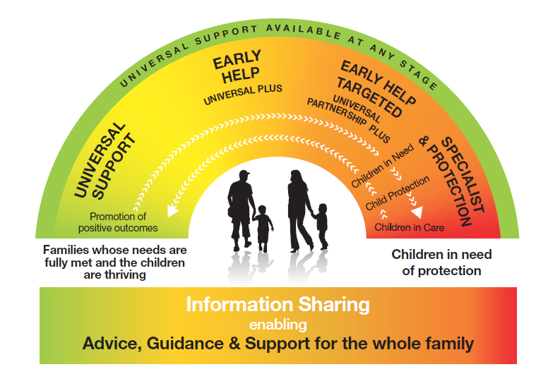
Nottingham City’s Model for Prevention, Early Help and Specialist Services

Slide 29
Children & Families Direct
Multi-Agency Safeguarding Hub
MASH – multi-agency
Multi-Agency Request Form (MARF)
Links to key websites for further information

Slide 30
Access to Support and Decision Making

Slide 31
Indicators of need
Updates include:
Early help assessment
Responsive immediate protection indicators
Family Support Pathway levels of need and indicators

Slide 32

Impact of the Child’s Lived Experience
Escalation –Share your worries- make a difference
Helen Blackman- Director of CIS – January 2019
Tracey Nurse- Head of Social work

Slide 33
Use your voice- escalation is a conversation where you make a difference
If you have worries that the child’s needs are not being addressed or risks are not identified or well understood – what should you do ?
If you are worried that something is wrong you must do something. This is not conflict it is helping everyone connect their information. Provide your evidence, challenge and energy
Escalating your concerns , firstly to the person who is the lead professional, then their manager and ultimately a senior manager and your own manager too, helps highlight the issue and should lead to reflection
Is this an opportunity for you to learn more, to be helped to protect this child more
You are the only person some of these children have in their whole life who will see them, fight for them, care for them. Do a good job, work together, be open, use your voice effectively

Slide 34
ADSL- validation
Eligibility Criteria
A minimum of two years’ experience as a DSL.
Experience of middle or senior leadership role and able to demonstrate outstanding practice.
Evidence based commitment to excellence.

Slide 35
Effective experience in multi-agency practice.
Understanding of how to implement safeguarding policy in order to ensure effective safeguarding outcomes/arrangements across the organisation
A successful track record as an advocate to improve safeguarding practice at a strategic level and for individual children.

Slide 36
Application forms or questions available from: ADSLLeader@nottinghamcity.gov.uk

Slide 37
Table discussion- Protective Ethos
Working together 2018
Section 11 Children’s Act 2004 – Working together 2018 pg 57 ‘creating a culture of safety, equality and protection within the services they provide’
Safeguarding audit
2.3 | Protective ethos requirements | WorkTogether OfSTED | Displays, website, brochure, stationary, adverts.

Slide 38
What does ‘Protective Ethos’ look like in a school/setting?
How can you evidence the ‘Protective Ethos’ ?
(e.g Pastoral arrangements, partnership work, common goals)
Please make notes and we will collate and upload onto the DSL web page

Slide 39


Slide 40
Red Thread Service Update

Slide 41
Safeguarding Children from Criminal Exploitation
(Including County Lines Activity)
Notes:
Standard introduction to training

Slide 42

Ground Rules
Respect confidentiality
No interrupting
Contribute in an anti-discriminatory way
Challenge Respectfully
Keep to timings
Notes:
Standard Ground rules

Slide 43

Aim
To consider the issues pertaining to the criminal exploitation of children and young people
Participants will gain the confidence and knowledge in being introduced to local procedures pertaining to the exploitation of children and young people.
Notes:
Self explanatory

Slide 44

Objectives
Participants will gain an understanding of the meaning of Child Criminal Exploitation (CCE).
Gain knowledge of the different ways and means by which children and young people can be subject to criminal exploitation.
Understanding of the groups of children who are most vulnerable and why.
Develop an awareness of possible signs and indicators of criminal exploitation.
Understand the role and responsibilities pertaining to the management of children/young people who are/may be subject to criminal exploitation.
Notes:
Refer to Nottingham City and what we are trying to do to disrupt activity.
The training is designed to explain this harm, recognise it’s signs and respond appropriately.

Slide 45
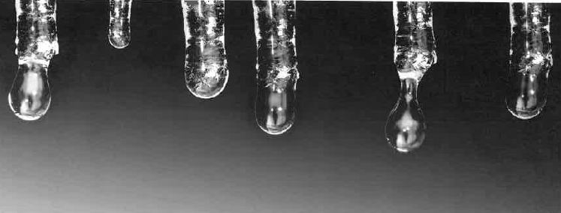
Ice Breaker
Discuss with the person next to you one thing you wish to gain from the course and share one thing about yourself that no-one else knows (that you are prepared to)
Notes:
Ask participants to introduce each other.
If you prefer other ice breakers then please use.

Slide 46
What is criminal exploitation?
Criminal exploitation interlinks with a number of multiple vulnerabilities and offences including the child being exposed to and/or victim of physical and emotional violence, neglect, sexual abuse and exploitation, modern day slavery and human trafficking, domestic abuse and missing episodes. (Children's Society 2017)
Notes:
Criminal exploitation of children and vulnerable adults is a geographically widespread form of harm which is relatively little known about or recognised by those best placed to spot it’s potential victims.

Slide 47
County Lines
The term County Lines is becoming more widely recognised and used to describe situations where young people may be internally trafficked for the purposes of criminal exploitation.
‘County Lines’ is a term used by government departments, law enforcement, local authorities and partner agencies to describe the use of mobile phone ‘lines’ by gangs looking to extend their drug dealing activities into locations outside of their metropolitan home areas. (NCA 2015).
Notes:
County Lines is the Police term for urban gangs supplying drugs to suburban areas and market and coastal towns using dedicated mobile phone lines or “deal lines”.
Gangs use children and vulnerable people to package and move drugs and money.
Gangs establish a base in the market location typically by taking over the homes of local vulnerable adults by force or coercion, this is referred to as “cuckooing”
Please emphasise the need to refer should you as a professional identify homes of vulnerable people being frequented by young people

Slide 48
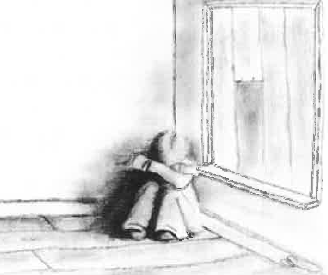
Vulnerability Factors
Having a prior experience of neglect, physical and/or sexual abuse.
Lack of a safe/stable home environment, now or in the past(domestic abuse or parental substance misuse, mental health ussies or criminality, for example);
Social isolation or social difficulties;
Economic vulnerability;
Homelessness or insecure accommodation status;
Connections with other people involved in gangs;
Having a physical or learning disability
Having mental health or substance misuse issues;
Being in care (particularly those in residential care and those with interrupted care histories).
Notes:
The following vulnerabilities are types of things children can experience that might make them more susceptible to child criminal exploitation.
Not all children and young people with these vulnerabilities will experience child criminal exploitation.
Child criminal exploitation can also occur without any of these vulnerabilities being present.
These vulnerabilities increase the risk of such children and young people being groomed for sexual and criminal exploitation.

Slide 49

Lower Level Indicators
Change in behaviour; more secretive/withdrawn/isolated from peers or not mixing with usual friends.
Expressions around invincibility or not caring about what happens to them.
Possession of hotel keys/cards or keys to unknown premises.
Entering or leaving vehicles cars with unknown adults.
New peer groups and/or relationships.
Leaving home/care without explanation.
Significant decline in school results/performance.
Sudden loss of interest in school or change in behaviour. Decline in attendance or academic achievement (although it should be noted that some gang members will maintain a good attendance record to avoid coming to notice).
Sudden change in appearance – dressing in a particular style or 'uniform' similar to that of other young people they hang around with, including a particular colour.
Dropping out of positive activities.
Breaking off with old friends and hanging around with one group of people.
Starting to adopt certain codes of group behavior e.g. New nickname, ways of talking and hand signs, Graffiti style 'tags' on possessions, school books, walls.
Notes:
Practitioners should remain open to the fact that CCE can occur without any of these risk indicators being obviously present. It is also important to remember that some risk assessments only capture risks at the point of assessment and that levels of risk vary over time and that the presence of these indicators may be explained by other forms of vulnerability rather than CCE.
All children and young people should be provided with basic information that will enable them to develop an awareness of the risks that can lead to a situation in which they may exposed to exploitation.

Slide 50

Medium Level Indicators
Increased interest in making money. Increasing use of drugs or alcohol.
Unexplained absences from, or not engaged in school/ college/ training/ work.
Returned from missing episodes with injuries, or disheveled.
Disclosure/ Suspicion of sexual/ physical assault/ unexplained injuries, followed by withdrawal of allegation.
Self-harm or significant changes in emotional well-being.
Agencies unable to engage.
Parental concerns.
Repeated STI‟s and/or pregnancy.
Increase referrals to agencies for other known peers.
Staying out unusually late without reason, or breaking parental rules consistently.
Constantly talking about another young person who seems to have a lot of influence over them.
Associating with known or suspected gang members, closeness to siblings or adults in the family who are gang members.
Expressing aggressive or intimidating views towards other groups of young people, some of whom may have been friends in the past.
Notes:
Risk indicators should be regularly reassessed on an ongoing basis.
Any significant changes should be communicated to the multi agency team around the child.

Slide 51

High Level Indicators
Frequent missing episodes and been found out of area.
Found with large quantities of drugs and carrying weapons.
Abduction or forced imprisonment.
Unexplained amounts of money, mobiles, credit, clothing, jewellery, new hair cut or other items/gifts. Receiving rewards of money or goods for introducing peers.
Increasingly disruptive, hostile or physically aggressive at home or school, including use of sexualised language and language in relation to drug dealing and/or violence.
Fear of reprisal from “gang‟ members or violence from young people or adults.
Reports being taken to parties, people’s houses, unknown areas, hotels, nightclubs, takeaways or out of area by unknown adults.
Gang association or isolation from peers or social networks.
Child seems to withdraw from family life/emotionally 'switched off', but also containing frustration / rage.
Being scared when entering certain areas and concerned by the presence of unknown youths in their neighborhoods.
Having multiple mobile phones, sim cards or use of a phone that causes
concern - multiple callers or more texts /pings than usual.
Notes:
Children and young people are likely to have multiple vulnerabilities present as well as one or more indicators of risk.
If the case is not open to Children’s Social Care a referral should be made to Children and Families Direct and a strategy meeting should take place.
This is the forum for health, police, YOT, Children’s Social Care and other agency involved with the young person/family to discuss all information and decide on the next course of action.

Slide 52
Impact of CCE on Children/Young People and Families/Carers
Children/Young People
Families/Carers
Every aspect of a child/young persons life
Physical health
Mental health
Education and training
Family relationships
Friends and social relationships
Behavioural changes
Unable to trust or engage with professionals
Physical health
Mental health
Work life
Family cohesion
Economic stability
Social life
Despair
Limiting their capacity to respond to the needs of their children
Notes:
These are the descriptors of the impact criminal exploitation can have on both the child/young person their family/carer/.

Slide 53

Cycles of risk
LOWER RISK
HIGH RISK
MEDIUM
RISK
Notes:
The strategy meeting will categorise the meeting as low, medium or high.
Risks need to be regularly assessed as part of the planned work with the child/young person.

Slide 54
Assessing risk and harm levels
If a referral is appropriate, use the presenting indicators as a measure of risk/harm refer to risk assessment tool
If a referral does not appear to be the best course, consider the following:
  Consult Nottingham City’s Safeguarding board procedures
  Arrange a professionals meeting to facilitate information sharing
  Consider how to raise awareness of and support young person
  Take action where there is reluctance to engage either by young person or other professionals
  Consult line manager/Designated safeguarding manager
  Monitor and review
Notes:
A signs of safety model will be used to determine harm.
In light of the complex and hidden nature of this form of exploitation which children and young people rarely disclose, it is important to work on the basis of concerns and not rely on a hard evidence basis.

Slide 55

Responding effectively to CCE scenarios
TASK
Notes:
Split the participants into three or four groups, dependent on size, case studies attached which are self explanatory.

Slide 56
Child Criminal Exploitation Pathway
Identified CCE concerns/Young Person makes disclosure
(immediate risk to self, others – call emergency services)
Check agency records, inform your line manager.
Complete CCE profiling toolkit. (include siblings if relevant).
Not an open case
Open case to social care/YOT
Refer to Children & Families Direct – 0115 8764800
Contact allocated worker
Send completed CCE toolkit to:
Service Manager – Duty/CFD/Mash & Principal Manager of IRO team (Samantha.Danyluk@nottinghamcity.gov.uk)
(Evelyn.Hailwood@nottinghamcity.gov.uk)
Strategy meeting agreed
Strategy meeting not agreed
Arrange via diary.manager@nottinghamcity.gov.uk
Invite all relevant professionals (including police).
Monitor case. Resubmit toolkit if appropriate.
Strategy meeting to decide risk levels (Low/Medium/High) Referral to NRM to be considered. Safety plan for the child to be developed.

Slide 57

Safeguarding
Safeguarding children from Criminal Exploitation is everyone's responsibility
Whoever comes into contact with children and young people in a professional capacity has a duty of care to that child
The Children's Act 2004 reinforced the message that all organisations that work with children and families share a commitment to safeguard and promote their welfare.

Slide 58

RESOURCES
Criminal exploitation of children and vulnerable adults: County Lines guidance Home Office July 2017
NCA National Crime Agency: County Lines Gang Violence, Exploitation and Drug Supply November 2016.
The Children's Society: Criminal exploitation and County Lines December 2017.

Slide 59
REVIEW (QUESTIONS)

Slide 60
Change Grow Live (CGL) Service Update

Slide 61
Fire Setter Intervention Programme

Slide 62
Networking Opportunity
A number of clusters have planned to meet so please stay to discuss local issues.

Slide 63
Next DSL Network: Tuesday 21st May
NCFC – conferencing
Room booked 12-1pm for DSL Networking and Local Cluster Networking
Modern Slavery Workshop starts at 1.45 pm

Slide 64


