Slide 1

Nottingham city dsl network
21st May 2019

Slide 2


Slide 3


Slide 4
DSL Network
Aims and Purpose
To promote connectivity with the Nottingham City Safeguarding Children Board/Partnership
Act as a conduit for policy updates
A practice network which demonstrates professional behaviours and mutual support

Slide 5
National Updates:
Knife crime and safeguarding children and young people
Research and analysis
Knife crime: safeguarding children and young people in education
.
https://www.gov.uk/government/publications/knife-crime-safeguarding-children-and-young-people-in-education
Notes:
Ofsted carried out a research project on knife crime in education. This report sets out our findings and recommendations

Slide 6
Elective Home Education Guidance –updated 2nd April
https://www.gov.uk/government/publications/elective-home-education
Isolation units
Article linked to use of isolation rooms in schools/academies and link to poor mental health
….
https://www.theguardian.com/education/2019/apr/03/isolation-of-children-at-academies-prompts-legal-action
https://www.bbc.co.uk/news/education-47898657

Slide 7
Education inspection framework
This framework sets out Ofsted's inspection principles and the main judgements that inspectors make. It applies from September 2019.
https://www.gov.uk/government/publications/education-inspection-framework?utm_source=8b7add30-a7f7-4d2a-9ace-c93468865b97&utm_medium=email&utm_campaign=govuk-notifications&utm_content=immediate
School inspection handbook (EIF)
Ofsted guidance on inspecting maintained schools and academies in England under the education inspection framework, for use from September 2019.
https://www.gov.uk/government/publications/school-inspection-handbook-eif?utm_source=1ead7286-3ecd-4a66-aec0-ab46ff3d0e8f&utm_medium=email&utm_campaign=govuk-notifications&utm_content=immediate

Slide 8
Inspecting safeguarding in early years, education and skills
Guidance for Ofsted inspectors to use when inspecting safeguarding under the common inspection framework.
https://www.gov.uk/government/publications/inspecting-safeguarding-in-early-years-education-and-skills-from-september-2015
The handbook sets out what inspectors must consider when inspecting safeguarding. It outlines the evidence that inspectors will look for during inspections and sets out the judgements they will make.
It needs to be read alongside the ‘Common inspection framework: education, skills and early years’ and the individual inspection remit handbooks.
Notes:
Updated 14th May 19

Slide 9
Local updates
EPAS(Early Police Alert to Schools)
Safeguarding partnership
Social Care
Private Fostering
Escalation Processes and staff
EVR Hub(Exploitation and Violence Reduction Hub)
WE Day Nottingham
https://www.we.org/gb/we-movement/

Slide 10

Knife Crime and Serious Youth Violence
Early Police Alert to Schools
Lead – DCI Liz Rogers

Slide 11
What is it?
A similar process to Operation Encompass
The Designated Safeguarding Lead will receive daily alerts from police based within the Youth Justice Service if a young person attending their school has been named as connected to a knife related or serious violence incident in the previous 24 hours
Initial roll out will be confined to those young people named as either the victim or offender until we understand the demand

Slide 12
Why?
We understand schools and alternative provision are often the first professionals to have contact with a young person after their involvement in an incident.
We know that there are sometimes repercussions and reprisals that spill over into schools that need to be managed
We want schools/AP to share information and intelligence about incidents with the police
Whether victim or offender the young people will be in need support and safeguarding
We know educational settings are key to a Contextual Safeguarding approach to the issue

Slide 13
How?
Police Officers/Staff based within the Youth Justice Team will review all relevant police incidents at the start of the working day.
They will identify the school attended and DSL via direct access to database.
The EPAS form will be completed and emailed directly to the DSL, SEIO and officer in the case that day.
The DSL or deputy will be required to monitor their inbox and then contact the officer in the case and SEIO for further detail.
Action thereafter will have to be determined on a case by case basis

Slide 14
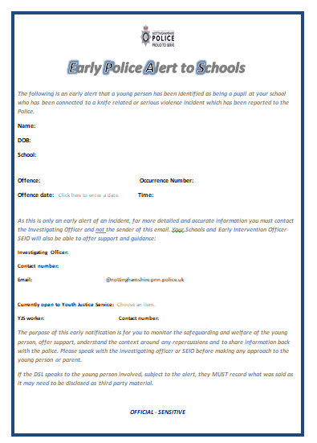
The EPAS Form

Slide 15
Developing the Process
It will take time to embed and develop a process that works for all.
We considered and discounted telephone contact (as Op. Encompass), as Youth Justice team will not have the full information at the time of the alert and the officer in the case will need to be part of the discussion about how to manage the case and contact with the young person, particularly if the offender is outstanding and evidence could be lost or destroyed.
We will not specify whether the young person is named as a victim or offender as part of the alert, this will form part of the subsequent discussions.

Slide 16
When?
Daily Monday to Friday
On a Monday morning all weekend incidents will be sent
Nottingham City Youth Justice will commence sending alerts with effect from Monday June 3th 2019 after the mid term break

Slide 17
Feedback and Review
It will be work in progress
Please send any urgent feedback before go live to PS Gareth Collins or DCI Liz Rogers (gareth.collins@nottinghamshire.pnn.police.uk elizabeth.rogers@nottinghamshire.pnn.police.uk)
We know school roll records and DSL contacts may not always be up to date, so we will make best endeavours in each case.
We will be keen to take feedback and review the process including value added, and will do this formally at the end of Summer term 2018/19.

Slide 18
Helen Blackman
Director
Tajinder Madahar
Head of Children’s Duty & Targeted Services
Tracey Nurse
Head of Children’s Social Work
Clive Chambers
Head of Children in Care
Shelley Nicholls & Wilf Fearon
Joint Heads of Early Help Services & Youth Justice
Nottingham City Council Directorate for Children’s Integrated Services
Sophie Russell
Strategy & Improvement
0115 8763423
John Matravers
Strategic Safeguarding Lead and NCSCP
0115 8765367
Email format: firstname.surname@nottinghamcity.gov.uk

Slide 19
Duty & Targeted Services
Tajinder Madahar
Head of Children’s Duty & Targeted Services
0115 8765027
Corina Ioannou
Service Manager – Targeted Family Support Teams
0115 8762137
Sam Danyluk
Service Manager – Children & Families Direct Hub, Children’s Duty Teams and Emergency Duty Team
0115 8762905
Debbie Richards
Service Manager – Housing Aid
0115 8761138
Team Managers:
Ben Thurley – 0115 8764887
Trudy Sanders – 0115 8833655
Sandra Oakley-Goodall – 0115 8839783
Lisa Ash – 0115 8764966
Kirsty Davison – 0115 8839652
Team Managers:
Caroline Hose, CFD – 0115 8762690
Suzanne Eastwood, CFD – 0115 8762875
Claire Wakeman – 0115 8761605
Matt Shand – 0115 8762878
Caroline Barton – 0115 8765464

Slide 20
Children’s Social Work
Tracey Nurse
Head of Children’s Social Work
0115 8764524
Bernice Walters
Agency Service Manager – North
Locality
0115 8761808
Team Managers:
Sarah Price – 0115 8786311
Kathryn McGovern – 0115 8765361
Belinda Rose – 0115 8765386
Karen Unwin – 0115 8786315
Team Managers:
Will Hose – 0115 8834317
Laura Cresci 0115 8833553
Ailsa Pearce – 0115 8833720
Thomas Beesley – 0115 8833586
Edge of Care Panel
Multi-Systemic Therapy (MST) Team
MST CAN
Edge of Care Hub
Tracy Hayden
Service Manager – South
Locality
0115 8761089
Team Managers:
Vanessa Kokott – 0115 8838268
Julie French – 0115 8761218
Caroline Vallelly – 0115 8762995
Sally Charlton – 0115 8838265
Nicole Harris
Temporary Service Manager – Central
Locality
0115 8761808
Contact Service

Slide 21
Children in Care
Clive Chambers
Head of Children in Care
0115 8764373
Alison Wakefield
Service Manager - Children in Care & Leaving Care Teams
0115 8764528
Audrey Taylor
Service Manager - Fostering & Adoption Teams
0115 8762575
Kay Sutt
Service Manager - Children’s Residential
0115 8765667
Sharon Clarke
Service Manager - Children’s Residential Expansion Programme
0115 8765032
Team Managers:
Clare Hewitson – 0115 8765548
Treza Mann – 0115 8762503
Saira Shahid – 0115 8762059
Sam Deakin – 0115 8833723

Slide 22
Early Help Services
Shelley Nicholls & Wilf Fearon
Joint Head of Early Help Services
0115 8765671/0115 8761179
Julia Bramble
Service Manager – Early Help Teams
0115 8764746
Anna Masding
Service Manager – Child & Adolescent Mental Health Services
0115 8764000
Wilf Fearon
Service Manager – Youth Justice
0115 8761179

Slide 23
Current Situation
Pressures/Gaps
Children’s Duty service has 30 social workers, there are 5 uncovered gaps
Fieldwork has 84 social workers, there are 17 gaps
Agency social workers
Escalation pathways
Support networks
Cluster meetings
Locality hub meetings
Family support offer to schools

Slide 24

Private Fostering-
SOMEBODY ELSE’S CHILD ?

Slide 25
WHAT IS PRIVATE FOSTERING?
A private arrangement between a parent and a carer
For a child who is under 16 (under 18 if disabled)
What is Private Fostering?
For 28 Days or more
To live away from home and be cared for by someone who isn’t a parent, a person with PR or a ‘close relative’
Legally defined as; Step parent, (by marriage or civil partnership), Grandparent, Sister, Brother, Aunt or Uncle

Slide 26
OVERVIEW
VULNERABLE CHILDREN
Privately Fostered children are not the same as fostered children. Children subject to PF regs are not deemed as CiC.
Privately Fostered children are potentially vulnerable.
By law parents and carers must notify the Local Authority of these arrangements – most don’t and there are various reasons for this.
Many Privately Fostered children don’t receive the services and protection they are entitled to because they are not known to the local authority.

Slide 27
OVERVIEW
WHY CHILDREN BECOME PRIVATLEY FOSTERED
WHY CHILDREN BECOME PRIVATELY FOSTERED
Parental illness
Substance misuse
Mental health issues
Parent in Prison
Family crisis
Row with parents
Parents gone over seas
Or working elsewhere in the UK

Slide 28
OVERVIEW
OTHER CIRCUMSTANCES
OTHER CIRCUMSTANCES
To complete education.
Attending a Language School
During Boarding School holidays
Sent to the UK “for a better life”
Parent from overseas studying in the UK.
Trafficked into the UK.

Slide 29
ROLES AND RESPONSIBILITYS
ROLES AND RESPONSIBILITIES
Those working with children and families play a key role in identifying children who are Privately Fostered.
It is the responsibility of everyone that works with children and families to make sure the local authority know about any Private Fostering arrangement.

Slide 30
TRAINERS NOTES
WE ALL HAVE A RESPONSIBILITY
WE ALL HAVE A RESPONSIBILITY
If you think you may have identified a Private Fostering Arrangement please act on it!!
Speak to the parent or carer to make sure they are aware of their duty to notify the Local Authority.
Follow up and let the Local Authority know if you have reason to believe that they have not been notified.

Slide 31
WHO TO NOTIFY
WHO TO NOTIFY
Contact Children and Families Direct 0115 8764800
OR
Kathryn McGovern – Team Manager Lead - Private Fostering
Email: kathryn.mcGovern@nottinghamcity.gov.uk
Telephone: 0115 876 5361
Rachel Morris - Private Fostering Coordinator
Email: rachel.morris@nottinghamcity.gov.uk
Telephone: 0115 883 6311 Mobile: 07507881249
Duty and Screening Telephone: 0115 876 4745

Slide 32
Exploitation and Violence Reduction Hub

Slide 33
Health in Mind’- An integrated partnership approach to supporting healthy young minds:
Child and Young People’s Mental Health- A strategic picture, MH2K & local services

Slide 34
CYP Mental Health Agenda
Future in Mind 2015
Five year forward view for Mental Health 2016
Government’s Green paper ‘Transforming Children and Young People’s Mental Health Provision December 2017
The NHS Long Term Plan – January 2019

Slide 35
What does a Programme Lead for Children and Young People’s Mental Health do?
Joint funded post from Local Authority’s and CCG’s
Cover City and County
Oversees the development and delivery of Local Transformation Plan for Children and Young People’s Mental Health

Slide 36

Future in Mind Local Transformation Plan
Published on CCG websites
https://www.mansfieldandashfieldccg.nhs.uk/MANewsItem?id=5598
Five key themes
Promoting resilience, prevention and early intervention
Improving access to effective support
Care for the most vulnerable
Accountability and transparency
Developing the workforce
Refreshed annually
Action plan is key to monitoring improve
Notes:
Government initiative to aiming to transform the way we deliver C and YP Mental Health services by working system wide with a wide range of partners , including children, young people and parents.
LTPs were first published in 2015, with 123 plans covering the whole of England. They set out how local services will invest resources to improve children and young people’s mental health across the “whole system”. These plans are ‘living documents’ and local areas are asked to refresh, and CCGs to republish them, on CCG websites every year.
Agreed locally with a wide range of partners, they include a declaration of of current and planned investment in C and YP mental health, demonstrate service transformation by providing a clear description of existing services the local area offers and a choice of improved support they provicder
Monitor improvement via the action plan
The plan is now in its it third year and was last refreshed in October 2018. Many of you in the room will have contributed to this refreshed plan. The action plan we develop today is informed by the refresh and all that has been achieved so far.
Workforce in bold – least developed area of transformation plans – underpins everything

Slide 37
Which local services does the Transformation Plan relate to?
The Emotional Health and Resilience Charter and Mental Health First Aid training (Nottingham City Council)
Behavioural Emotional Health Team (Citycare)
KOOTH on-line and face to face counselling (Voluntary sector)
Base 51 face to face counselling service (Voluntary sector)
Targeted CAMHS and SHARP (Self-harm awareness and invention project) Nottingham City Council
Community CAMHS including the Crisis Team and inpatient care (Nottingham Health Care Trust NHS)
Services can be accessed via the Behavioural emotional mental health pathway at: http://www.bemhnottingham.co.uk/
Notes:
These teams are going to each talk through their offer today, and how they can support city schools

Slide 38

MH:2K: What do our young people tell us?
MH:2K is a pioneering youth-led model for engaging young people in conversations about mental health in their local area.
Notes:
The project enabled young people to develop key priorities and recommendations for us around their mental health needs, including Stigma and Public Awareness;
Treatment and Therapies; Education and Prevention; Cultures, Genders and Minorities; Family, Friends and Carers. The project has been recommissioned to continue to ensure that we have children and young people's voice in taking our stragtegic plans forward. To find out more about MH2K please get in touch…..

Slide 39

Five Year Forward View
Providing more high-quality mental health services for children and young people, so that at least 32% of children with a diagnosable condition are able to access evidence-based services by 2019, including all areas being part of Children and Young People Improving Access to Psychological Therapies (CYP-IAPT) by 2018
Expanding capacity so that more than 53% of people experiencing a first episode of psychosis begin treatment with a NICE recommended package of care within two weeks of referral
Commissioning community eating disorder teams so that 95% of children and young people receive treatment within four weeks of referral for routine cases; and one week for urgent cases
Ensuring delivery of the mental health access and quality standards including 24/7 access to community crisis resolution teams and home treatment teams and mental health liaison services in acute hospitals.

Slide 40
Green Paper Implementation
Overarching Aim: Improving Access and early intervention
Incentivise every school and college to identify a Designated Senior Lead for Mental Health to oversee the approach to mental health and wellbeing. This will provide rapid advice, consultation and signposting to wider services.
Fund new Mental Health Support Teams to provide specific extra capacity for early intervention and ongoing help. These teams will be linked to groups of primary and secondary schools and to colleges, providing interventions to support those with mild to moderate needs and supporting the promotion of good mental health and wellbeing.
Trial a four week waiting time for access to specialist NHS children and young people’s mental health services. This builds on the expansion of specialist NHS services already underway.

Slide 41

The NHS Long Term Plan
Funding for CYP MH will grow faster than both overall NHS funding and total MH spending. CYP MH services will grow as a proportion of all mental health services.
Green Paper MHSTs to be trained on supporting young people more likely to face mental health issues-e.g. how to support LGBT+ individuals and children in care
Expanding access to community-based mental health services via NHS funded MH services and Mental Health Support Teams working in schools and colleges to cover ¼ of the country by 2023…100% of CYP who need specialist care can access it ‘over the coming decade.’
New waiting time standards for eating disorder services by 2020/21
Testing approaches to feasibly deliver 4 week waiting times for access to NHS support, ahead of new national standard

Slide 42
Develop new services for children with complex needs. For 6,000 highly vulnerable children with complex trauma, this will provide consultation, advice, assessment, treatment and transition into integrated services.
Extend current MH services to create comprehensive offer for 0-25 year olds
Expanding timely, age-appropriate crisis services(via NHS 111, A&E, paediatric, ambulance services)

Slide 43
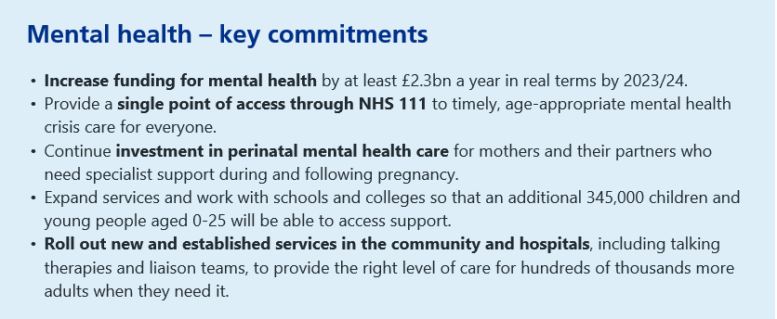

Slide 44
Coffee Break

Slide 45
Health in Mind’- An integrated partnership approach to supporting healthy young minds:
Emotional Health and Resilience and MHFA
SHARP & Targeted CAMHS: Prevention is better than cure!
KOOTH, BASE 51 & BEH: Alternative ways for CYP to access help
Community CAMHS & Crisis: What is mental health crisis and how can schools support CYP at risk?

Slide 46
‘Thrive emotionally to thrive academically’
The Emotional Health and Resilience Charter
Mental Health First Aid
Claire Trott
EHWB Consultant
Nottingham City Council
claire.trott@nottinghamcity.gov.uk

Slide 47

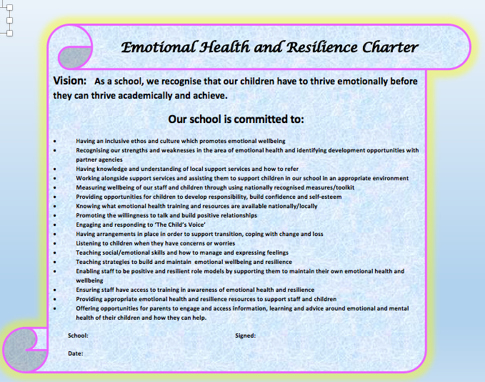
Is your school signed up to the charter?
Henry Whipple Primary School
http://www.nottinghamschools.org.uk/teaching-and-learning-support/emotional-health-and-wellbeing/

Slide 48
A Whole School Approach
Leadership and Management
Ethos Culture and Environment
Policy
Participation and Engagement
Curriculum and Learning
Assessment, Recording and Evaluation
CPD and Staff Wellbeing
Support
Home/School Partnerships

Slide 49
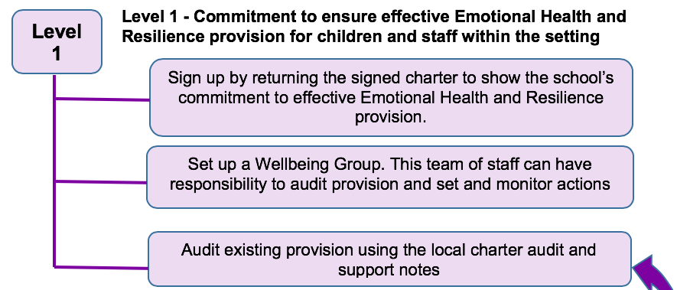
An ongoing process

Slide 50
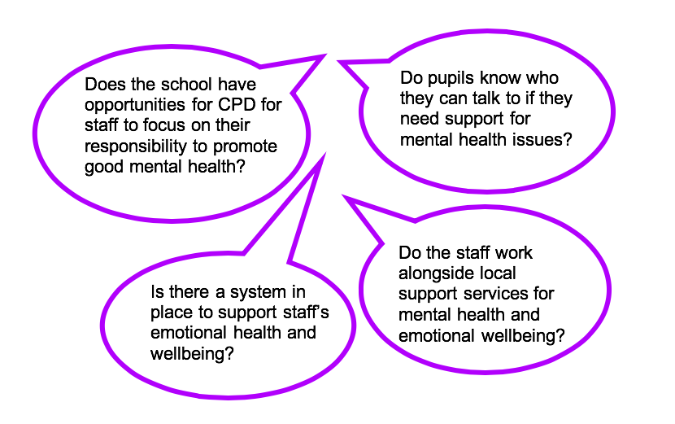

Slide 51
Mental Health First Aid
MHFA England have created a range of youth courses tailored for people who teach, work, live with & care for young people aged 8 to 18
Delivered by quality assured instructors
Mental Health First Aider (2 day)
‘Excellent Course, extremely informative, relaxed and calm throughout’.
‘The course has given me a thorough insight into MH …’
Mental Health Champion (1 day)
‘Excellent course, well delivered, provided new information and techniques to take to school and utilise, very worthwhile.’

Slide 52
Places on our MHFA courses are advertised in Scene and more information and application forms can be downloaded from the Nottingham Schools website
http://www.nottinghamschools.org.uk/teaching-and-learning-support/emotional-health-and-wellbeing/
Mental Health Awareness (half-day available through Workforce Development)

Slide 53
Ofsted – New Framework and Handbooks
Published on the 14th of May 2019
Developing pupils’ confidence, resilience and knowledge so that they can keep themselves mentally healthy
https://www.gov.uk/government/collections/education-inspection-framework

Slide 54
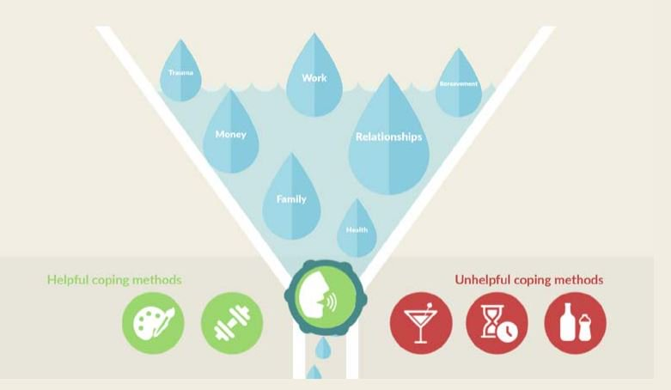
…and don’t forget your Emotional Health and Wellbeing
Remember your own personal safety
‘Sometimes things touch us deeply when we least expect’
Take care of yourself - ‘How full is your stress container?’
https://mhfaengland.kokodigital.co.uk/frame_content.php
Where do you get your support?
Find your own emotional health ‘5-a-day’.
https://www.mind.org.uk/workplace/mental-health-at-work/taking-care-of-yourself/five-ways-to-wellbeing/

Slide 55

Prevention is BETTER than Cure

Slide 56
Time to Change:
https://www.youtube.com/watch?v=wziaKWe9oZ4

Slide 57
Targeted Citywide CAMHS offer for all city Secondary and Primary Schools
Link worker
CAMHS consultations
Universal services worker
Time 4 Me sessions in school
Me Source
Amazing Me
Training / Assemblies
Parents Evenings
Notes:
Link worker – point of contact
Universal services worker - The role of the CAMHS Universal Services practitioners is to offer support to professionals and schools who are supporting the child or young person following a referral to the Single Point Access. This gives the current professionals involved with the young people, an opportunity to explore and discuss concerns around the child or young person’s emotional and mental health and consider what support can be offered.
Me:Source – 6 week group work program for KS3 students delivered in partnership with shool.

Slide 58
Consultations
‘Supporting the Supporters’
Opportunity to discuss concerns
Support for the network
Early intervention
Taking account of young person’s needs
Notes:
Offer support, guidance and resources to any professional working with a CYP who presents with self-harm or suicidal behaviours
Facilitate reflective space to ensure CYP needs, strengths and risks are harnessed and appropriate support is offered – use Signs of Safety model
Targeted CAMHS and SHARP (focused around self-harm and/or suicidality)

Slide 59
Time 4 Me
Sessions are for young people aged 11-17 who are registered with a City GP only
Early intervention
Time4Me provides the young person with a short, speedy and accessible session in school: where there are concerns regarding a student’s emotional wellbeing/mental health, or parental mental health
Notes:
Time4Me – monthly sessions run in collaboration with school
not an alternative to accessing support via the usual BEHM Pathway when concerns are at a higher level.
The sessions may provide take away support, signposting or recommendations.
The session provides slots for up to 5 young people (and family if they wish to attend.

Slide 60

Amazing Me
Evidence-based interventions for primary aged children…
How do I feel good about myself?
How do I share my feelings?
How do I control big feelings?

Slide 62
SHARP Free Training
Under the Skin (Self-harm)
Suicide Everybody’s Business
Understanding Girls who Self-harm
Breaking the Silence (Males and Suicide)
I’m Trans Get Used to It
A to Z of Your Head
One Bad Choice (drugs)
If Toys Could Talk (exploring harmful behaviours in primary)
Exam Stress-LESS (workshop)
Camhs.Sharp@nottinghamcity.gov.uk
Notes:
NICE guidelines highlight the importance of all healthcare professionals (clinical and non clinical) accessing training to equip them to understand and care for people for have self-harmed (NICE 2004).
Self-harm and suicide are complex issues which arouse difficult and distressing emotions both within people who hurt themselves and adults caring for them. Professionals can often feel confused and overwhelmed. SHARP training sessions aim raise awareness and build confidence.
Module training 3.5hours
Bitesize sessions between 1-2hours

Slide 63
SHARP School Clinics
Identifying self-harm early and preventing escalation
SHARP offer self-harm clinics in 18 Secondary Schools including Alternative Education across Nottingham City every month
Who are they for?
  Students who are seen by staff to have low-medium risk of
  self-harm and/ or suicidality
  Students not currently open to CAMHS
  Students who have been identified as a concern regarding
  self-harm
What do they provide?
  Clinics provide brief intervention to students to support them in making positive changes in relation to self-harm and suicidality, whilst assessing risk. They will give schools recommendations for further support to be put in place if necessary
Notes:
ED

Slide 64
Referrals for additional support:
Pathway for children and young people with Behavioural, Emotional or Mental Health Needs
http://www.bemhnottingham.co.uk/
Notes:
Who’s on the pathway?
How to access support from CAMHS. Note Community CAMHS sit on the pathway.

Slide 65



KOOTH, BASE 51 & Behavioural Emotional Health Team (BET):

Slide 66

www.bemhnottingham.co.uk
- NEURODEVELOPMENTAL DISORDERS
Seeking paediatric assessment
Parenting/ Behaviour management support
Sleep support
POST DIAGNOSIS
Cygnet
1-1 Partnership
Signpost

Slide 67
- REFERRALS; made by GP, professionals, Schools, Parents/carers.
- Registered with a NOTTINGHAM CITY GP
- Support and EVIDENCE for assessment or BEHT involvement;
School routes to inclusion
Universal
services
Environmental/ specific support
Evidence

Slide 68

A Counselling service for Children and Young People

Slide 69
Online counselling
www.kooth.com
Free, safe and anonymous
CYP 11-24 years old.
Lives in Nottingham City
CYP can refer to the face to face team from the Kooth website
Notes:
Encourage CYP to access for emotional support, everyone can access it, they do not need to have an issue, it is preventative to have a place to go and talk.
Register and be assigned a counsellor and access lots of helpful articles.
CYP 11-18 years old.
Need to be registered with a Nottingham City GP.
CYP can refer to the face to face team from the Kooth website.
Lots of presenting issues - anxiety, depression, exam stress, difficulties with friendships, family difficulties, self harm, bullying etc.

Slide 70
Face to Face Counselling
www.koothf2f.com
CYP 8-25 years old
Registered with a Nottingham City GP
Referrals can be made by parents/carers, schools, GPs.
Notes:
CYP 8-25 years old
Registered with a Nottingham City GP
Referrals can be made by parents/carers, schools, GPs.
Complete the form and then one of our counsellors will come and complete an assessment.
Aim for an assessment to be completed within 2 weeks of referral.
Aim to start working with the CYP within 10-12 weeks of assessment.
Offer 6 sessions of face to face counselling.

Slide 71

Base 51
Counselling service for Nottingham’s young people
Free service
Working with young people aged 12-25 years
Face to face counselling on a one – to – one basis
Art therapy available
Self referrals, referrals from parents/carers, GP, schools, other, SPA
Drop in sessions : Tuesdays 5pm & 6pm
Wednesdays 6pm & 7pm
Thursdays 5pm & 6pm
Wider youth facility and service on site, linking holistically with a wider programme of health and wellbeing services.
Address: Base 51, NGY myplace, 29-31 Castle Gate, Nottingham, NG1 7AR
Telephone: 0115 952 5040
Email: counselling@base51.org.uk
Website: www.base51.org.uk

Slide 72

CRHT Team Profile
Rebecca Keating (CNS / Advanced Practitioner Trainee/ Substantive Team Manager)
Sarah Grainger (CNS / EMDR Trainee/ Acting Team Manager)
Amanda Forster (CNS / CBT Therapist)
Kate Pearson (CNS / Non – Medical Prescriber/ Responsible Clinician Trainee)
Janine Smith (CNS / Dialectical Behavioural Informed Practitioner)
Mick Tye (Specialist Practitioner / RMN)
Alice Derwent (Specialist Practitioner / RMN / Systemic Family Practice Practitioner)
Sarah Hynes (Specialist Practitioner / RMN)
Kaye Weaver (Specialist Practitioner / RMN)
Melissa Beadling (Specialist Practitioner / RMN)
x3 Vacancy
Hayley Wildig (Healthcare Assistant)
Tracy Duke (Peer Support Worker)
Debbie Rowley (Admin Team Lead)
Hollie Osborne – Etches (Medical Secretary)
Dr Bala Nambi (Locum Consultant Psychiatrist)

Slide 73
CRHT and Liaison Hours of Working
The CRHT Team functions 365 days per year.
We operates between 8-8pm Mon –Fri. 8pm-10pm is covered remotely by phone.
The Team works 10-6pm at weekends and bank holidays.
We operate a Red, Amber Green (RAG) system which allows the Team to have a shared understanding of the level and AMBER, we then agree a plan of care.

Slide 74
Case Example
16 YO M
Taken to A&E following an attempted electrocution. He threw a toaster into the bath.
History of an ‘alleged accidental overdose’ in 2018. Xanax.
No direct triggers for this current attempt.
Two weeks prior there was evidence of prior researching of methods.
He waited for Family to leave the house, and re-entered the home.
He left suicide notes for his Family members.
There was lots of evidence of preparation. He gathered an extension lead, toaster, and ran a bath.
He threw the toaster into the bath and this allegedly tripped the fuses in the home. Therefore no harm done physically.
YP called his Mum directly following the incident.
He was regretful, and denied any immediate thoughts or plans to end his life. Limited evidence of strong protective factors, and nil future planning.
Evidence of symptoms possibly consistent with ASD or Attachment, requiring additional assessment. Daily cannabis misuse. Young person understands the risks associated with this, and ambivalent about stopping.

Slide 75
Case example cont..
The CRHT Team was able to get a Second Opinion for the YP prior to discharge from the CAMHS Registrar, as the information from the Police/ YP/ Parent did not all correlate. We therefore considered that there may still be elevates risk levels.
Placed on RED after discharge. This means he was seen daily.
CRHT Team completed assessment of symptoms and monitored risks.
Referral made to the CAMHS Head to Head Team, due to the level of cannabis misuse, and mental health symptoms present. Handover complete.

Slide 76
Case Example 2
12 YO F
Admitted to overdose of 6 x Paracetamol.
Taken at School.
Accessed Medication from Mum’s bag.
Wanted to die. Thought that the tablets might end her life.
No suicide notes left.
No efforts made to prevent discovery.
Took the tablets whilst at School, and told the Teacher straight after.
Trigger: Mum implementing boundaries at home leading to an argument.
No treatment required.
Regrets taking the overdose.
Denied having any current thoughts or plans to end her life.
Future plans to attend ballet at the weekend and a Family Holiday in the Summer 2019.

Slide 77
Case example 2 cont..
YP was offered a standardised 14 day follow up appointment. This forum is used to review mental health and levels of risk.
CAMHS offered the parent a course called Non-Violent Resistance. This is an attachment based 10 week programme.
The parent was offered safety advice about the importance of locking medications away, this is to minimise some the risks if impulsivity occurred once again.
The parents were given the details of Services such as Kooth. This is a Free online counselling Service for young people locally.
Family were advised to call the CRHT if there is an immediate threat to life.
Family also advised that there can contact A&E if there is any immediate threat to life outside of Crisis Team hours.
During the follow up appointment we were able to establish that there wasn’t any evidence of mental illness and risks to self or others were low. We therefore liaised with School Counsellor to offer some intervention focusing on distress tolerance/ regulation of emotion. In cases where there aren’t school counsellors we liaise directly with the lead person in school for that pupil who knows them best. We also have close links with other voluntary agencies who offer similar services such as NGY (Base 51)

Slide 78
CRHT and Community CAMHS
CRHT and Community CAMHS work closely together:
We work with young people until they are seen by community CAMHS, so there is a safety net and they are not lost in a transition process between one team to another.
We now offer a health and wellbeing group for young people that may not need Community CAMHS as an alternative
Peer support can be offered to ‘bridge the gap’ between CRHT and Community CAMHS.
Community CAMHS offer a variety of groups that we can access so that young people have different types of interventions and so they don’t have to wait so long for an intervention.
Community CAMHS work in partnership with Targeted CAMHS to ensure smooth transitions for CYP who may need further specialist mental health treatment, such as clinical psychology or psychiatry, or other specialist interventions

Slide 79
ACTION PLANS
Thank you all for listening to our presentations this morning
We are now moving on to the table top discussions and your action plans
On your table you should have a copy of:
  The emotional health resilience charter
  An action plan to complete
Colleagues from the pathway and services will come around to your tables to support with our discussions and with your action plans

