Slide 1
DSL Network 11th October 2022

Slide 2
Overview of network content
Carousel of 3 seminars each lasting 30 minutes with question and answer opportunity built in:
Bowden Room (Seminar A): Additional duties and Vulnerable Learner Support pathway- Jasmin Howell
Hooley Room (Seminar B): Working together to improve school attendance- Karen McAndrews and Tracey Cross
Kilpin Room (Seminar C): Improvement Journey- Sam Danyluk and David Goldsworthy

Slide 3
Agency representatives
Please note that there will be the following agency representatives in the foyer area available from 08:30-09:25am and again at the end of the network, 11.55-12:15 for you to network should you find of use:
Prevent- Louise Cox, Prevent Education Officer (PEO) and Amy Goulden, Prevent Coordinator
Change Grow Live (CGL)- Habib Akhtar, Service Manager
School and Early Intervention Officers- PS Kerry Hall
Attendance – Karen McAndrews, Service Manager and Tracey Cross, Team manager

Slide 4
Local Updates

Slide 5
Content
Section 175/157 Safeguarding Audit
Prevent offer
Safeguarding in Education training programme
ADSL support
KCSIE 2022

Slide 6
Section 175/157 safeguarding audit
Background and Introduction
Section 175 of the 2002 Education Act requires local education authorities and the governing bodies of maintained schools and FE colleges to make arrangements to ensure that their functions are carried out with a view to safeguarding and promoting the welfare of children. Section 157 of the 2002 Education Act and the Independent School Regulations 2003 convey the same responsibilities on all other non-maintained settings.
It is vital to ensure that Nottingham City Schools and Colleges can demonstrate that they are meeting key statutory duties and following safeguarding children and young people guidance. All settings are being asked to complete the Section 175/157 safeguarding audit online, enabling them to provide information to the Nottingham City Safeguarding Children Partnership (NCSCP) on how they discharge their duties and help to keep children and young people safe in Nottingham City.

Slide 7
2022 Audit Submission:
The Nottingham City safeguarding audit process involves two elements:
Annual completion of an online self-audit tool
Ten sample schools will be chosen each year to take part in a face to face audit review upon completion of the online audit
Notes:
Why have we changed our approach?
It is our aim that the audit will have a greater impact on the safeguarding practices of schools as well as the local authority.
Schools:
• Provide schools with a comprehensive self-review of their safeguarding practices.
• Produce a safeguarding action plan which will enable schools to identify strengths, areas for development as well as detailing progress made towards addressing identified actions.
• The system allows the audit information to be saved at any time and returned to when convenient. This is better suited to a school-working environment.
• The audit does not need to be completed by one person. Schools can provide access to a number of staff members. Schools have ownership of this.
Local Authority:
• Provide rich data which the local authority will analyse on a school and district level.
• The data will provide the local authority with more detailed and accurate information and assist them in providing general support and advice to schools and colleges.
• The findings will support the local authority in undertaking school safeguarding visits, undertaking audits as well as responding to Ofsted complaints
• The Schools and Education Safeguarding Officer will analyse the audit information and use this information to plan training, DSL network content and support for schools/colleges for the next academic year.
• The findings will also form part of an annual report to the Nottingham City Safeguarding Children Partnership.
Accessing the Audit:
• The link will be sent to Headteachers on Wednesday 12th October 2022.
• It is the responsibility of schools/colleges to inform the LA of any changes to staff/contact details. Local Authority contact information was last updated on Thursday 08th September 2022.
• As soon as the Headteacher receives the audit link, they should register online.
• We recommend that the Headteacher adds additional users including the DSL. That decision can be made on a school/college basis.

Slide 8
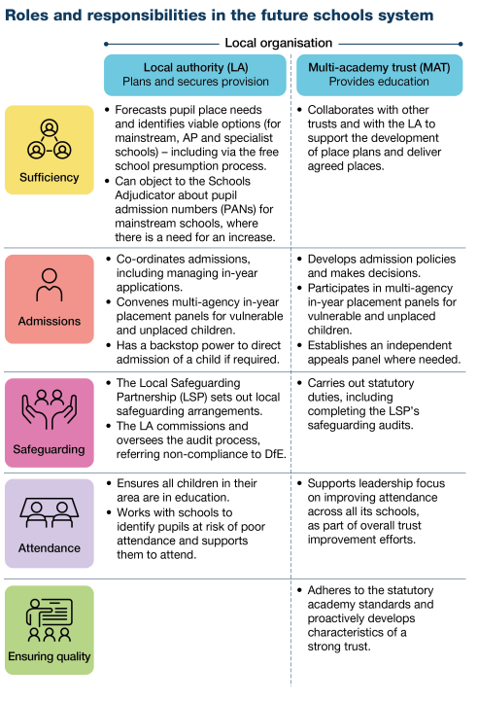
Who is this for?
This audit applies to all ‘schools’ and ‘colleges’ (in Nottingham City) as defined by the DfE in Keeping Children Safe in Education 2022
The audit should be submitted by the Headteacher and completed in collaboration with the Designated Safeguarding Lead consulting with all other relevant stakeholders, for example the safeguarding governor and trustees
Completion of this audit will be an annual expectation
Schools are encouraged to see this as an excellent opportunity to undertake an annual audit of safeguarding across the setting, identifying any areas that the setting may decide to develop further and be included in wider school development or improvement plans
Notes:
White Paper (March 2022) indicates the continuing roles of the Local Safeguarding Partnership (LSP) and schools which makes clear ‘the Local Safeguarding Partnership sets out the local safeguarding arrangements. The LA commissions and oversees the audit process’.
Multi academy trusts/educational settings ‘carries out statutory duties schools including completing the local safeguarding partnerships safeguarding audits.

Slide 9
Annual completion of an online self-audit tool
Further detailed guidance about the Section 175/157 audit process will be sent out to all Headteachers tomorrow along with a ‘support and guidance’ document that should answer any questions to help with the completion of the audit and understanding the wider process.
The annual statutory Section 175/157 safeguarding audit will open on Wednesday 12th October 2022 via the Headteacher accessing an email sent directly from the commissioning service, Phew. The submission date for all audits to be complete and submitted online is by Friday 16th December 2022.
• Provides schools with a comprehensive self-review of their safeguarding practices
• Produces a safeguarding action plan which will enable schools to identify strengths, areas for development as well as detailing progress made towards addressing identified actions
• The system allows the audit information to be saved at any time and returned to when convenient. This is better suited to a school-working environment
• The audit does not need to be completed by one person. Schools can provide access to a number of staff members. Schools have ownership of this

Slide 10
2. Face to face Audit Review:
Annually 10 schools will be selected for a face to face audit as part of the quality assurance process after the submission window closes. Quality assurance feedback will be reported through to the NCSCP Quality Assurance Subgroup. The identified schools will be sent a letter detailing opportunity for a 2-hour face to face meeting conducted at the school setting with representatives of the NCSCP. The face to face element of the audit process will include:
Policy compliance through school website
The culture of safeguarding within the school
Redacted safeguarding file review
Review of your completed online audit
Following the face to face audit you can expect a post visit summary including any agreed action plan.

Slide 11
Next steps
We have attempted to ensure that the audit is as accessible as possible to reduce the time and resources required to complete your submission
Please ensure when completing the audit that you provide as much detail as possible
It is expected practice that the completed audit, along with any action plan be shared with the full governing body/trustees/proprietors, discussed and minuted during the same year of completion
We recommend that Keeping Children Safe in Education 2022 (KCSIE 2022) is at hand whilst completing the audit.
Two virtual support sessions via MS TEAMS are being held on Thursday 13th October 2022 4pm-4.30pm and Thursday 17th November, 4pm-4.30pm to support professionals with completion of the audit (further information about the virtual support session will be included in the email to Headteachers)
An email containing a username and instructions on how to create a password will be sent to Headteachers on Wednesday 12th October 2022 directly from Phew (the company hosting the online platform for audit- please ask your Headteacher to check their junk box should they not see this tomorrow)
Each Headteacher has the ability to add users themselves
Should there be any questions connected to log on, passwords, users etc then please do ensure to read all detailed documents before contacting safeguardingineducation@nottinghamcity.gov.uk
Notes:
Sign up to a virtual support session asap if required once read email and support and guidance document for your ease with completion of the audit for your setting.

Slide 12
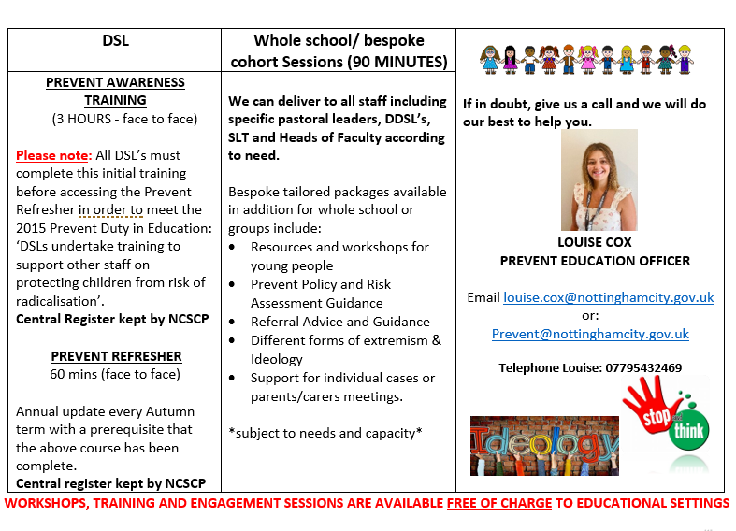
Prevent Offer for Education Settings 2022-2023
Notes:
The NCSCP offer will be that all DSL’s will be trained this term/early spring similar to the 2016 WRAP training that some of you may remember. Annual refresher to be offered over time depending on funding and does not remove any need for follow up training to your wider staff team on this safeguarding topic- staff training is available also however priority roll out is DSL training initially.

Slide 13
Notes:
Please sign up asap

Slide 14
Safeguarding in Education training offer
We have a range of courses available through the partnership safeguarding in education training programme pathway including Introduction to Safeguarding and Child Protection and a 2-day Designated Safeguarding Lead course also for all professionals new to the role or requiring renewal of their previous validation. Please do visit the NCSCP website for all course dates and be sure to book in advance as courses fill up very fast. All courses are free and available to staff working within our city settings only.
Safeguarding Training - Nottingham City Council
*A reminder that it is the staff/settings responsibility to maintain an accurate training record for all staff and ensure that it is in date
**We offer a Train the Trainer course which we recommend a minimum of 2 professionals from each setting complete to receive annual training material from the partnership for internal use only by the approved person- see our programme for further information
Notes:
The NCSCP/NCC Safeguarding in Education training programme can be found on the NCSCP website – it is the schools responsibility to maintain an accurate training record and ensure all staff’s training is maintained and kept up to date
Please do contact safeguardingineducation@nottinghamcity.gov.uk for any queries re training and certificates

Slide 15
ADSL support
There are eleven ADSLs in the City of Nottingham who are available to support Designated Safeguarding Leads and school/academy leaders.
What do they do?
The Advanced Designated Safeguarding Lead can:
Offer advice and guidance on policy and procedure
Support newly appointed DSLs during induction
Act as a forum for communication and consultation in particular between schools and the Safeguarding Partnership but also with other partnership bodies
Support the functioning of the DSL Network
Develop and share evidence based good practice
Support training and development
Support the NCSCP and schools to undertake audit activity
A range of other tasks for the NCSCP that strengthen safeguarding practices across the education directorate
The ADSL team has a range of skills and experiences to support DSLs in schools and academies.
You might consider requesting support for example if you have a new or recently appointed DSL, for advice on processes and record keeping or a deep dive into a particular area of safeguarding practice. Each individual request for support should be complete by filling in the Request for Support form and once complete sent to the Schools and Education Safeguarding Coordinator claire.maclean@nottinghamcity.gov.uk, who leads the team, and will considered each request and allocate the appropriate ADSL to begin planning further the task that is requested.
Notes:
The request for support form can be found on the partnership website- Advanced Designated Safeguarding Leads (nottinghamschools.org.uk)

Slide 16
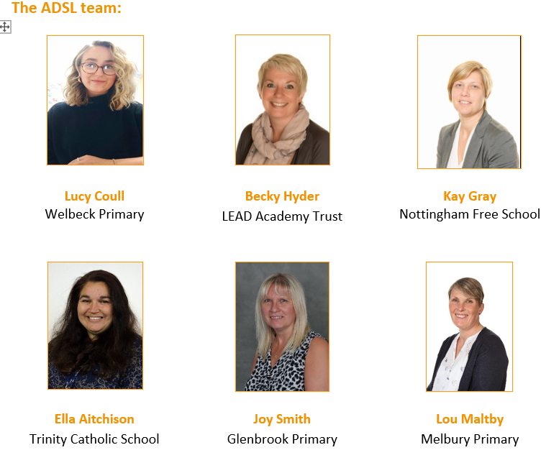
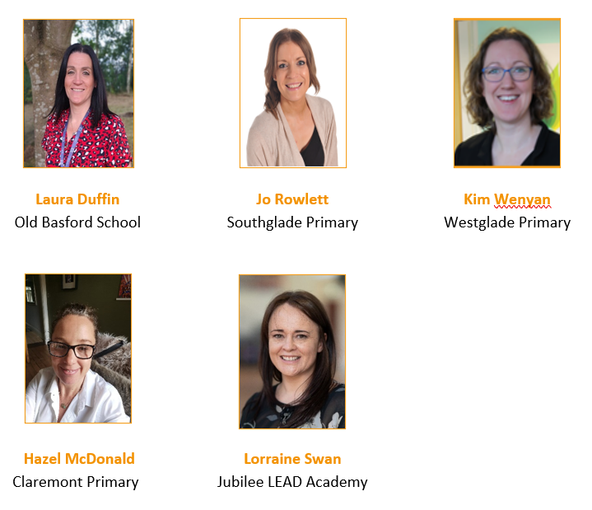
ADSL’s
Notes:
Advanced Designated Safeguarding Leads (nottinghamschools.org.uk)
Any requests must be in advance through the ‘request for support form’ sent directly to Claire Maclean/Safeguarding in Education for review and approval.

Slide 17
KCSIE 2022
A polite reminder at this busy start to the academic year to ensure that all of your policies and documents reflect guidance contained within KCSIE 2022 and are up to date on all platforms.

Slide 18
Dates for upcoming DSL Networks to be held virtually:
Tuesday February 07th 9.30-12
Tuesday May 23rd 9.30-12
A reminder that all delegates must register in advance through Eventbrite link sent through central email or by visiting the partnership website for all networks
Virtual networks do not have a limit on the number of professionals attending from each setting
Attendance at 2 or more DSL networks per year constitutes ‘DSL Update training’ and we will certificate accordingly each summer term
Notes:
Please sign up to each event as soon as booking is live- this is usually 3-4 weeks in advance of the course date and an email will be sent to all settings with agenda and booking link once live.

Slide 19
Carousel order for the morning
Surnames A to F
10:05: Seminar A (Bowden Room)
10:45: Seminar B (Hooley Room)
11:25: Seminar C (Kilpin Room)
Surnames G to O
10:05: Seminar B (Hooley Room)
10:45: Seminar C (Kilpin Room)
11:25: Seminar A (Bowden Room)
Surnames P to Z
10:05: Seminar C (Kilpin Room)
10:45: Seminar A (Bowden Room)
11:25: Seminar B (Hooley Room)

Slide 20
Education Welfare & EOTAS Service
Working Together to Improve School Attendance
Notes:
Karen McAndrews and Tracey Cross

Slide 21
Overview
On the 6th May 2022 the DfE released new non-statutory guidance ‘Working Together to Improve School Attendance’. The aim of the document is to help schools, trusts, governing bodies, and local authorities maintain high levels of school attendance and improve consistency of support.
To do this, the guidance focuses on managing attendance by:
Preventing patterns of absence from developing by promoting good attendance
Intervening Early by using data to spot patterns of absence before they become persistent and working with families to remove the barriers to attendance
Targeting Support for persistent and severe absentees with all local partners working together to reengage pupils
From September 2022, Working together to improve school attendance, will replace all previous guidance on school attendance for maintained schools, academies, independent schools and local authorities. Subject to Parliament, the Secretary of State has committed to this guidance becoming statutory, no sooner than September 2023.

Slide 22
What does this guidance cover?
The guidance is split into 8 main sections
The importance of school attendance
Expectations of schools
Expectations of academy trust boards and governing bodies of maintained schools
Expectations of local authorities
Persistent and severe absence
Attendance legal intervention
Contents of the admissions register (the schools roll)
Contents of the attendance register

Slide 23
What does this mean for schools?
Every school will be required to:
Have a Senior Attendance Champion in the leadership team
Have a clear school attendance policy published on their website
Have robust day to day processes for recording, monitoring and following up attendance
Analyse their data regularly and prioritise families to work with to understand and address the reasons for absence, including any in-school barriers to attendance
Work with local partners to remove out of school barriers and act as the lead professional where they are the best placed service
Work jointly with the local authority on an agreed approach/plan for every severely absent pupil
Develop strategies for cohorts of pupils with poorer attendance than their peers (including groups of vulnerability)
Inform a pupil’s social worker if they have an unexplained absence or leave the school roll
Work with their LA to formalise support where voluntary help hasn’t been effective, through use of parenting contracts or other forms of legal intervention
Share data electronically with the department and continue to inform the LA of pupils not attending regularly or being added to or removed from the roll

Slide 24
What does this mean for local authorities?
Local authorities are expected to:
Rigorously track local attendance data to devise a strategic approach to attendance
Have a School Attendance Support Team which provides core functions free of charge to all schools (regardless of type)
Provide each school with a named point of contact in the School Attendance Support Team who can support with queries and advice
Offer opportunities for all schools in the area to share effective practice
Hold a termly conversation with every school to identify, discuss and signpost or provide access to services for pupils who are PA (Persistently absent) (10%), Severely absent (50%) or at risk of becoming so
Facilitate Formal Attendance Support Meetings
Access to early help assessments and other statutory and voluntary services
Work jointly with schools to provide formal support options including parenting contracts
Monitor and improve the through their virtual school attendance of children with a social worker

Slide 25
Education Welfare & EOTAS Service ‘The School Attendance Support Team’
The Education Welfare & EOTAS Service are be responsible for The School Attendance Support Team.
The DfE has directed 4 core functions of the team
Communication and advice
Targeting Support Meetings
Multi-disciplinary support for families
Legal intervention

Slide 26
Elective Home Education (EHE)
Elective home education is a term used to describe a choice by parents to provide education for their children at home
Parents who choose to educate a child in these ways rather than sending the child to school full-time take on financial responsibility for the cost of doing so
Parents have a right to educate their children at home (Section 7 of the Education Act 1996). Most parents who take up the weighty responsibility of home education do a great job, and many children benefit from being educated at home
Where it is evident that a child is not receiving suitable education at home - the local authority should be ready to use its safeguarding powers of implementing an Education Supervision Order (ESO). The overriding objective in these cases is to ensure that the child’s development is protected from significant harm. Unsuitable or inadequate education can impair a child’s intellectual, emotional, social or behavioral development, and may therefore bring child protection duties into play.
Schools refer all potential EHE enquires/requests to the EW & EOTAS Service by contacting your named Education Welfare Officer (EWO). The EWO will arrange a meeting with school, parent and the young person if age appropriate. This is known as the 3-way meeting.
Education is assessed annually by a qualified teacher. This period is brought forward should concerns be raised

Slide 27
Children Missing Education (CME)
Children missing education are children of compulsory school age who are not registered pupils at a school and are not receiving suitable education otherwise than at a school. Children missing education are at significant risk of underachieving, being victims of harm, exploitation or radicalisation, and becoming NEET (not in education, employment or training) later in life.
All children, regardless of their circumstances, are entitled to an efficient, full-time education which is suitable to their age, ability, aptitude and any special educational needs they may have.
Children missing education are children of compulsory school age who are not registered pupils at a school and are not receiving suitable education otherwise than at a school. Children missing education are at significant risk of underachieving, being victims of harm, exploitation or radicalisation, and becoming NEET (not in education, employment or training) later in life.
Effective information sharing between parents, schools and local authorities is critical to ensuring that all children of compulsory school age are safe and receiving suitable education. Local authorities should focus their resources effectively in intervening early in the lives of vulnerable children to help prevent poor outcomes.
The EW & EOTAS Service have a dedicated CME Team. Referrals to the team are made directly via the online referral form.
When the pupil leaves without notification
Check that the accommodation has been vacated, remember they are not missing if they are still living at the same address, they are non-attenders.
Collect and collate all the known information about the family and forward with the completed CME referral form by secure email to the CME email; CME.EducationWelfare@nottinghamcity.gov.uk ,as soon as possible
Include especially the last day they attended school and / or last day that school had contact with the child or their parents / carer.

Slide 28
The big changes
Clarity of expectations: Schools, trusts and local authorities will all have clearly defined statutory roles for the first time, set out in a clear table of responsibilities
Earlier intervention: Schools will have legal responsibilities to proactively improve attendance for the first time (beyond existing requirements to record accurately) underpinned by timelier sharing of attendance data
Support first: All pupils and parents no matter where they live in the country will have clear expectations from their school, be informed about their child’s attendance and have access to early intervention and support first before any legal action if it becomes problematic
Targeted whole family support: Attendance teams in LAs will work in tandem with early help to provide a whole-family response with a single assessment plan and lead practitioner
Independent schools: data will be collected for the first time, and will receive the same support from LAs (which currently happens in some LAs but not others)

Slide 29
What is happening now?
8 EWOs/2 EW Specialists/1 Team Manager
EWOs working in geographical clusters based on the NST cluster model
Initial ‘meet and greet’ meeting in all schools
Devising a toolkit for practitioners
Analysing data – WONDE (60 schools currently signed up)
Reinforcing the message – ‘School attendance is everyone’s business’

Slide 30
Who to contact
Tracey Cross – Education Welfare Team Manager tracey.cross@nottinghamcity.gov.uk
James MacLean – Children Missing Education Manager james.maclean@nottinghamcity.gov.uk
Karen McAndrew – Education Welfare & EOTAS Service Manager karen.mcandrew@nottinghamcity.gov.uk
EW & EOTAS Enquiries admin.educationwelfare@nottinghamcity.gov.uk

Slide 31
Useful links and contacts
ATTEND training for schools – 15th November 2022. Dr Maddi Popoola, Educational Psychologist. Mental Health Support Team Service Manager.
DfE – Working together to improve school attendance
DfE - Elective home education: guidance for local authorities
DfE – Children missing education: statutory guidance for local authorities
NCC - Threshold of needs document
EWO contact list
CME referral – https://myaccount.nottinghamcity.gov.uk/service/children_missing_education_referral
https://assets.publishing.service.gov.uk/government/uploads/system/uploads/attachment_data/file/550416/Children_Missing_Education_-_statutory_guidance.pdf

Slide 32
Children Services
Improvement Journey 2022
Samantha Danyluk – MASH/Duty/Housing Aid – Head of Service
David Goldsworthy – MASH/EDT – Service Manager

Slide 33
OFSTED Inspection 2022
Ofsted inspected our children’s services between 04th July- 22nd July 2022. The imspection tool account of progress since the last graded inspection (2018) and the 2 fovused visits (2020 and 2021) as well as undertaking a full review of the quality of practice and impact of services for children of the work of the service now.
The inspection considers 3 domains and our overall effectiveness
Impact of leaders on practice
Help and protection
Children in care and care leavers

Slide 34
OFSTED Outcome
Impact of leaders on social work practice with children and families - Requires Improvement to be good.
The experiences and progress of children who need help and protection – Inadequate
The experiences and progress of are children in care and care leavers - Requires Improvement to be good.
OVERALL EFFECTIVENESS - Inadequate

Slide 35
Eight specific areas for improvement
Effectiveness and timeliness of responses to children’s needs when first presented to the multi-agency safeguarding hub (MASH).
Management oversight and direction of front-line work and the local authority designated officer (LADO).
Social work capacity so that social workers and first-line managers can respond effectively to children in need of help and protection, and that children in care have greater consistency of social worker.
Placement sufficiency for children in care and those with complex needs.
The service response to care leavers aged 21 and over.
The service response to young people who are aged 16/17 years who present as homeless.
The quality and timeliness of return home interviews.
Oversight of children missing from education and those who are electively home educated

Slide 36
Concerns specific to MASH.
Timeliness of MASH Screenings and decisions.
Application of Thresholds.
Parental consent not obtained by partner agencies.
Complicated systems within the MASH.
Partners Agencies do not response to request for information in a timely way.
A significant number of children experience repeated contacts and referrals before they get the help they need.
Where allegations of significant harm are first presented, decision-making within the MASH is not as timely as it needs to be.

Slide 37
Improvement/developments within MASH
One referral pathway, new eform, rebranding of C&Fdirect to MASH
Introduction of the RAG rating system –
Reds – Contact to be authorised within 4hrs. These should be cases that meet the Threshold that the Children are in Need of Protection/Child is Suffering or likely to suffer significant harm.
Amber – Contact to be Authorised within 24 Hours. These should be cases that meet the Threshold that the Child and family are experiencing a range of increasing problems that require intensive multi- agency support to meet the needs of the whole family and crisis is likely to be prevented.
Green - Contact to be authorised within 5 working days. These should be cases that meet the Threshold that the Child and family are experiencing problems requiring universal services to work together with other support services to prevent problems increasing.

Slide 38
Improvement/developments within MASH
Re-launch/awareness raising/training in respect of the ‘Thresholds of Needs’ guidance document. nottingham-city-threshold-of-needs-2022.pdf (nottinghamcity.gov.uk)
Awareness/training in respect of Parental and child consent.
Increased numbers of staff within the MASH.

Slide 39
What happens next?
The Department for Education will consider the inspection outcome and determine what level of intervention is required to support the improvement work.
We already have a children’s improvement board, this will remain, will be independently chaired and will meet more frequently (4-6 weekly as opposed to bi-monthly)
We will develop an updated improvement plan which will clearly set out how we will address the areas identified in the inspection –has to be submitted to Ofsted within 70 days of publication
We will enter a period of additional monitoring from Ofsted through regular monitoring visits –these are usually every 3-4 months until our next full inspection –the first monitoring visit will be approximately 6 months after the publication of the inspection report
We work together as a service to ensure that we are focused on getting things right for children and their families, we support each other and also challenge each other to ensure that our focus and attention is on the right things –we work as a TEAM to build on the solid platform already in place to ensure positive progress is made. Our clear ambition as a service is to consistently and confidently demonstrate that we are achieving good impact and outcomes for children in Nottingham.

Slide 40
Nottingham City Virtual School
Promoting the Education of Children with a Social Worker- additional duties of Virtual School Heads
Notes:
Jasmin Howell

Slide 41
Context:
Non-statutory guidance from the DfE
Poor education outcomes for children with a social worker-children facing significant barriers to education
Strategic role of Virtual School Heads
Responsibilities for all schools and staff designated to support the education outcomes of vulnerable children
Basis within the Children in Need Review (2019)

Slide 42
1.6 million children needed a social worker between 2012-13 (3 children in every class)
Children with a social worker do worse than their peers at every stage of their education.
3 times more likely to be persistently absent.
2-4 times more likely to be permanently excluded.
Children in Need Review 2019

Slide 43
Additional Duties- Children with a social worker
National Guidance Overview:
September 2021 VSHs became strategic leaders in championing the educational outcomes of children with a social worker and those who have previously had a social worker (children in need and children on child protection plans).
Children with a social worker and who have previously had a social worker identified as a group of children who face significant barriers to education, due to experiences of adversity and trauma.
The responsibility of Virtual School Heads does not consist of work with individual children and families, tracking and monitoring educational progress of individual children or providing academic or other interventions.
Virtual School Head Responsibilities:
Make visible the disadvantages children with a social worker can experience.
-
Enhance partnerships between education settings and local authorities to support the educational needs of children with a social worker.
-
Promote practice that supports children with a social worker to engage in
education, in order to narrow the attainment gap.

Slide 44
Additional Duties- Offer

Slide 45
Vulnerable Learner Service
Vulnerable Learner Coordinator
Education Advisor
Data Officer
Lead by Nottingham City Virtual School Head

Slide 46
Asks:
What are the current challenges in supporting vulnerable learners in schools?
Is there anything additional you would like to see in the VLSP to support you in your duties?
Do you see a role for DSL/ADSL on the VLSP board?
What are effective methods of creating and embedding a common culture of inclusion in our schools?
What methods should we use to communicate and launch the VLSP?

Slide 47
Recruitment to the service
Sign off of the Pathway.
Establishing work stream groups with TORs and objectives.
Launching the Pathway
Securing membership to work stream groups.

Slide 48
Notes:
Fill in training evaluation forms

