Slide 1
Nottingham city dsl network 11th February 2020

Slide 4
Follow Nottingham City Safeguarding Children's Partnership
https://www.nottinghamcity.gov.uk/ncscp
https://twitter.com/NottinghamCSCP

Slide 5
DSL Network Aims and Purpose
To promote connectivity with the Nottingham City Safeguarding Children Partnership
Act as a conduit for policy updates
A practice network which demonstrates professional behaviours and mutual support

Slide 6
National Updates
Safer Internet Day Videos
Freedom of Information request to police
Neglect
Child Safeguarding National Practice Panel Review
Child-friendly policies
Period products for schools (DfE)
Data
Notes:
Ofsted carried out a research project on knife crime in education. This report sets out our findings and recommendations

Slide 7
Safer Internet Day Videos
Safer Internet Day is today, Tuesday 11th February 2020.
The UK Safer Internet Centre have released a series of films to be used as discussion starters. The films are:
• #freetobe
• What does my avatar say about me?
• Are you #freetobe yourself online
• How can parents talk to children about their online lives?
The videos are also available with British Sign Language (BSL) interpretation.
The films can be here: https://www.saferinternet.org.uk/sid-films
A really useful can be found below.
https://www.nspcc.org.uk/keeping-children-safe/online-safety/

Slide 8
Freedom of Information request to Police
A Freedom of Information request to police forces in England and Wales shows there were at least 4,373 offences of sexual communication with a child recorded in the year to April 2019 compared with 3,217 in the previous year1.
The data revealed:
• Where age was provided, 1 in 5 victims were aged just 11 or younger
• The number of recorded instances of the use of Instagram was more than double that of the previous year.
In the last 2 years, Facebook-owned apps (Facebook, Messenger, Instagram and WhatsApp) and Snapchat were used in more than 70% of the instances where police recorded and provided the communication method

Slide 9
Neglect
“We must be ambitious for all our children”
Is deprivation now seen as the “new norm”? There are implications for recognition of neglect and what constitutes ‘good enough care’.
Neglect is the ongoing failure to meet a child's basic needs and the most common form of child abuse. A child might be left hungry or dirty, or without proper clothing, shelter, supervision or health care. This can put children and young people in danger. And it can also have long term effects on their physical and mental wellbeing.
Physical neglect a child's basic needs, such as food, clothing or shelter, are not met or they aren’t properly supervised or kept safe.
Educational neglect a parent doesn't ensure their child is given an education.
Emotional neglect a child doesn't get the nurture and stimulation they need. This could be through ignoring, humiliating, intimidating or isolating them.
Medical neglect a child isn't given proper health care. This includes dental care and refusing or ignoring medical recommendations.
https://www.nspcc.org.uk/what-is-child-abuse/types-of-abuse/neglect/

Slide 10
Child Safeguarding National Practice Panel Review
The National Panel is undertaking a review of Sudden Unexpected Death in Infancy. Nottingham City has been a part of this review due to the SUDI of a child in July 2018.
There are between 300-400 incidences of SUDI each year.
https://www.nottinghamcity.gov.uk/information-for-residents/children-and-families/nottingham-city-safeguarding-children-board/safeguarding-training/free-e-learning/
Child-friendly policies Many of the schools here involved the children and young people in the process
https://www.safeguardinginschools.co.uk/child-friendly-safeguarding-policies/

Slide 11
Period products for schools (DfE)
https://www.gov.uk/government/publications/period-products-in-schools-and-colleges/period-product-scheme-for-schools-and-colleges-in-england The government launched its long-awaited period product scheme for schools and colleges in England on January 20th 2020. The DfE said, 'No-one should be held back from accessing education due to their period. The period product scheme will provide free period products to learners in all state-maintained schools and colleges who need to access period products in their place of learning in order to access education. Although the scheme is for all learners, it is not a universal offer of free period products to everyone under the age of 19. This would be prohibitively costly and would not represent good value for taxpayers’ money.

Slide 12
Data
Finding information about your local context It is important that schools understand their local context, but it is not also easy to find the information. Listed below are a number data sources that might help with this search. Child and Maternal Health Data Area profiles Vulnerable children and young people https://fingertips.phe.org.uk/profile/child-health-profiles/data#page/1/gid/1938133238/pat/6/par/E12000004/ati/102/are/E10000021/iid/90803/age/173/sex/4 Children in care (2018) https://fingertips.phe.org.uk/profile/child-health-profiles/data#page/3/gid/1938133238/pat/6/par/E12000004/ati/102/are/E06000015/iid/90803/age/173/sex/4

Slide 13
Deprivation Local Authority maps Index of Multiple Deprivation https://imd2019.group.shef.ac.uk/ Indices of Deprivation Maps http://dclgapps.communities.gov.uk/imd/iod_index.html Crime Search the crime map for your area https://www.police.uk/search/ Download police data https://data.police.uk/ National Crime Agency Threat Reports https://www.nationalcrimeagency.gov.uk/who-we-are/publications/173-national-strategic-assessment-of-serious-and-organised-crime-2018/file Child Protection Data NSPCC Child Protection Data How safe are our children? 2013 - 2019 https://learning.nspcc.org.uk/research-resources/how-safe-are-our-children/

Slide 14
Young Carers Awareness Training
Presented by
Roz Lynch
Notes:
Welcome everyone, introduce yourself and domestics

Slide 15
What is a Young Carer?
Section 96 of the Children & Families Act 2014 defines a young carer as:
“A person under 18 years old who provides or intends to provide unpaid care for another person who is ill, disabled or misuses substances. The concept of care includes personal, practical or emotional support”.
Care MUST be regular and relied upon

Slide 16
Estimated 1.07%
of the total population are young carers
(BBC 2018)
Population of Nottingham City in 2019 is 306,000
(Nottingham City Council/ Nottingham Insight 2019)
There are 47,900 children age 5-17 living in Nottingham City in 2019
(Nottingham Insight 2019)
Approx
3,274
Young Carers in Nottingham City (census 2011)
This means
7% of children aged
5-17 living in Nottingham City
are Young Carers
(That we know of!)

Slide 17
Why do children become carers?
There are many reasons but may include:
Someone in the family needs care (grow naturally into role);
The nature of the illness, disability or substance misuse;
Perceived stigma associated with condition;
Fear of services / people knowing;
Expected of relatives;
Single parent household/both parents have an illness/condition
Unaware of support services
Not eligible for services (Social care).

Slide 18
Who am I?
I am a Child/Young person looking after a family member who is ill (Parent, Sibling etc)
I am frequently late/absent or do not attend school.
I am often tired and / or struggle to concentrate
I don’t attend out of school activities
I am unable to care for my own personal and emotional needs
I am unable to attend appointments or aware that I have my own appointments
I am constantly feeling overloaded and under pressure
I feel different from my peers
I appear mature for my age
I can display disruptive behaviour
I can have low self-esteem
I am often anxious and / or tearful
My parent(s) don’t engage with school much
Notes:
Play did not attend DVD – serious case review in Nottingham

Slide 19
What might I do?
My Day
https://youtu.be/dQmCfcVmz4Q

Slide 20
The impact
Positives
Challenges
Feel important, valued & included
More confident & able to deal with problems
Learn empathy & to be resilient
Early life skills – looking after the home, managing budgets & booking appointments etc
Feel closer
Peer support / respect for others
Motivation – increased desire to succeed
Doing too much (inappropriate & excessive)
Feeling different (bullied)
Physical health (lifting)
Isolated
Worrying about the future
Struggling with / missing school
Lack of self-care
Low self-esteem & self-worth
Increased maturity!

Slide 21
School Support Package
Invite to half yearly Young Carers Education network meeting
Free Young Carer Awareness training for staff members in school
Delivery of Young Carer Awareness Assemblies to all years
Support in school to set up Young Carer groups
Option for AYC to offer drop-in sessions in school/link in with parents evenings
Provide free Education Pack to all schools working in partnership with AYC
Information and advice to schools re Young Carers
Support in developing a YC register in school

Slide 22
The Rights of Young Carers
Children & Families Act 2014
The right to be identified
The right to be assessed
Care Act 2014
The right to be assessed and supported through a ‘Think Family’ approach
The right to a transition assessment if likely to have support needs once turned 18 years old (to help them plan).
Working Together to safeguard children 2018

Slide 23
Action for Young Carers Service
Assessment of needs
Young Carer groups (primary and secondary age)
Activities during school half terms.
Young carers groups (term time)
1:1 face to face support
Young Carer consultations.
Access to Young Carer App.
Young Carer ID Cards.
Speak to people on behalf of both parents and

Slide 24
Young Carers 'Top Ten Tips' for Schools
1. Listen to us / talk to us.
2. Allow us to phone home to check that the person we look after is ok!
3. Allow us to have some breakfast at tutor time / first lesson.
4. Give us extensions to complete our course / homework.
5. Allow us some time out of lessons if we are upset.
6. Tell us our rights and give us and our parents’ information about what support is available.
7. Encourage us to support each other e.g. to set-up young carer groups, be young carer peer ambassadors.
8. Don’t punish us if we are late and look at our Young Carer ID: Card and take us seriously.
9. Hold an annual ‘Bright Day’ to celebrate what young carers do.
10. Let AYC train your staff to understand us better, and let us as young carers inspect your school.

Slide 25
Q & A
Carers Federation, Action for Young Carers
0115 9629351 info@carersfederation.co.uk
www.aycnottingham.co.uk
Young Carers Schools Programme
0115 9629351 r.lynch@carersfederation.co.uk
Young Carers Needs Assessment (Full Family Approaches)
Young carers living in Nottingham City (see above)
Young carers living in Nottinghamshire: Tel: 0300 500 80 80

Slide 26
Round table discussion and feedback (25 mins)

Slide 27
Discussion / Networking
How will you respond in you School settings to the information you have heard this morning?
Note down on paper the implications for you locality and the city. (We will use this to inform our future plans)

Slide 28
BREAK (10.20 – 10.50)
MARF Consultation booth

Slide 29
Local updates
DSL Supervision
Child R review
Contextual Safeguarding proposal for October DSL Network
Prevent referral form
Professional vigilance CSE
Best practice for Safeguarding files
Priority Family workshop for parents
Parental Conflict – 2 hour train the trainer session

Slide 32
Child R review

Slide 33
Case Summary
Child R was presented at the hospital Emergency Department with a headache, followed by vomiting and drowsiness, he also had a large number of bruises over his body. On examination he was found to have a life threatening head injury; bleeding in the brain that required urgent neurosurgery. Following surgery and after a short stay in hospital he made a good recovery.
Following a police investigation the boyfriend of child R’s mother was arrested and subsequently convicted of Grievous Bodily Harm for the injuries to Child R.
At the time of the incident Child R was subject to a Children in Need Plan and had an allocated social worker, due to concerns in relation to possible physical abuse. This included several referrals in relation to injuries and bruising to Child R.
The key findings from the review
The review found that:
Section 47 child protection procedures were not followed, there were gaps in the process that led to missed opportunities to recognise earlier assaults.
There were weaknesses in the children’s assessment and evidence of confirmatory bias. Influenced by mothers self-reporting and the child’s positive presentation. Consideration of child R’s lived experiences was inadequate, specifically his experience of thirteen injuries over a period of nine months.
There was an absence of chronologies in case files and to support safeguarding referrals. Both of which could have supported identification of injury patterns earlier.

Slide 34
Learning
Compliance with Child Protection procedures
Compliance with procedures is a reoccurring theme from local serious cases reviews. It is essential that workers understand and apply child protection procedures; as per the local interagency guidance. When procedures are not followed it allows for gaps in practice, these gaps can lead to a failure to identify or adequately manage risks.
Strategy meetings play a pivotal role in multi-agency information sharing and decision making. Including decisions about medical examinations and response to the findings.it is critical that these take place in line with interagency procedures.
Safeguarding concern should always be referred to Children and Families Direct MASH, in line with the interagency procedures, regardless of the status of the case. Even if you believe it has recently been assessed and closed.
Ensuring quality of assessments
Assessments of physical injuries must be holistic, take adequate account of the child’s lived experience, the context to any injuries and must not rely on self-reporting by a parent to reach conclusions.
It is important toremember that not all children who are being physically abused will present in distress. Workers should be alert to inconsistences in accounts and robustly explore these.
Workers must remain open to the possibility of abuse until there is clear evidence to discount it.
Managers should actively scrutinise assessments and where appropriate challenge the evidence base of conclusions
Effective use of Chronologies
This review serves as a reminder to the workforce, of the value of chronologies. Considerable work has already been undertaken locally on the use and effectiveness of chronologies to support identification of concerns and support effective case management.
All workers should ensure that chronologies are completed and active for children and young people they are working with.
Chronologies must be used to support safeguarding referrals where there are ongoing concerns in relation to physical injuries.

Slide 35
Contextual safeguarding
Remember, we are still children

Slide 36
Background
During adolescence the nature of the risks faced by young people, and the way that they experience these risks, often differs from earlier childhood – as do their needs.
Specifically, young people may be faced with a new set of complex risks – ones not posed by families, but instead by peers, partners and adults unconnected to their families.

Slide 37
These risks
often manifest in extra-familial environments including schools, public spaces and online platforms
are informed by peer norms and relationships
involve young people perpetrating, as well as experiencing, harm
can present as the result of perceived ‘choices’ a young person has made and/or continues to make despite professional/parental intervention

Slide 38
often feature grooming, coercion, criminality and serious risks of significant sexual and physical harm that create climates of fear and reduce engagement with services
are beyond the control of parents and rarely instigated by parents
can lead to large numbers of relocations including children over-12 coming into care for the first time and following a rapid escalation in risk and/or managed-moves across schools
continue into adulthood and particularly for young people during the 18-25 transitional period

Slide 39
Contextual Safeguarding
Contextual Safeguarding provides a framework for local areas to develop an approach that engages with the extra-familial dynamics of risk in adolescence.
Need to assess and intervene with extra-familial contexts and relationships in order to safeguard young people during adolescence.

Slide 40
Contextual Safeguarding includes (but is not limited to) :
Gang membership / serious youth violence
Child sexual exploitation
Child criminal exploitation
Harmful sexual behaviours
Missing from care, home and education
Radicalisation
Trafficking

Slide 41
New Prevent Referral Form
0115 9670999 Ext: 8002963
Prevent@Nottinghamshire.pnn.police.uk

Slide 43
Child Sexual Exploitation is child abuse
Perpetrators of CSE recognise vulnerability, and develop exploitative relationships; further compounding the child’s vulnerability.
Professional vigilance is needed as:
A child may think they are in a consensual relationship because they get affection, attention or gifts.
Always consider Peer on Peer CSE with gifts as little as Take away food or access to Wi-Fi.
A relationships that appears to be ‘’loving’’ can change significantly, so that the child experiences fear, deception, coercion or violence. They are not in control. They have no choice.
Victims:
Any child of any age
Any background
Any gender or sexual orientation
Any vulnerability

Slide 44
Best Practice for Safeguarding Files
Monitor, review and action your safeguarding system daily.
Risk assess concerns raised and record your rational.
Once action is allocated state name, role, date and time.
Embed weekly safeguarding meetings regarding overarching concerns. If individual children are discussed transfer from minutes into safeguarding system.
Children who are on a Child Protection Plan should have a weekly update from Teacher on their presentation, behaviour and emotional wellbeing. Include positive comments.

Slide 45
When recording do not use emotive language, be as factual as possible. If you express your opinion state that is what it is and make it clear.
When your provision has a number of DSL’s have a rota that clearly states to others who is on duty that day.
Consider using the vulnerability index. This may help staff understand the behaviour of the child.
Anyone who is not a DSL but administrates your safeguarding system must have minimum basic safeguarding training.
Share safeguarding concerns and vulnerabilities with the Teacher. They are the person with them the most they need the information to understand presented behaviour and be able to safeguard the child.
If you have trouble getting the minutes of meetings from the Social Worker let me know I may be able to help.

Slide 46
Priority Family workshop for parents

Slide 47
Paul Martin Priority Families
Reducing Parenting Conflict - training for staff
Trauma and other training for parents/carers

Slide 48
Nottingham Behaviour Support Team Approach Training ltd.
Positive Behaviour Support,
De-escalation and Restrictive Physical Intervention (RPI) Strategies

Slide 49
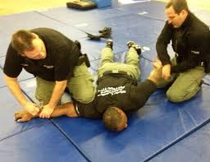
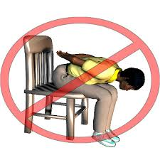
Task True or false? -Only senior management can restrain a CYP. - Teachers and TA’s must restrain if they see a problem arising. - Staff can ‘opt out’ of using physical intervention. - The only time that restraint can be used is when the situation is unsafe. - Parents can refuse to let school staff restrain CYP’s. - there must be a written risk assessment before CYP’s can be restrained.

Slide 50
Nottingham City RPI Team
Caroline Murtagh
Kimberly Butler
Helen Baker
Dan Steane
Jerry Raphael
Ann Compton
Should you require further training, assistance or support in your setting please feel free to contact us. Tel: 0115 876 2438 Email: rpitraining@nottinghamcity.gov.uk Alternatively, you can contact your BST Link Teacher to set up further training or receive support.

Slide 51
Outcomes of an Approach Training day
To have an understanding around the appropriate use of RPI
To be aware of the role of RPI within overall planning
To have practised and be confident to use Approach Training techniques in the context of Positive Behaviour Support

Slide 52
Key Messages regarding Approach Training
BILD accredited
Compliant with relevant legislation
Positive Behaviour Support (PBS) and management
Reduces risk
Complies with code of practice
Meets individual needs
Puts CYP at centre of planning
Is small part of holistic overarching provision

Slide 53
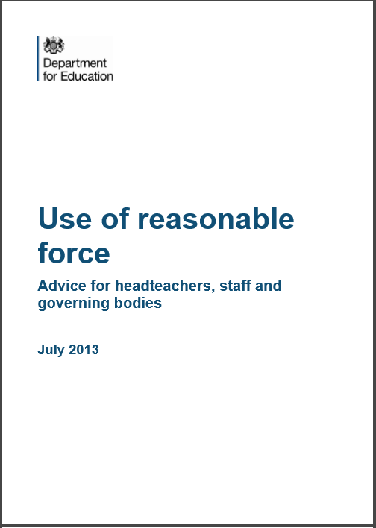
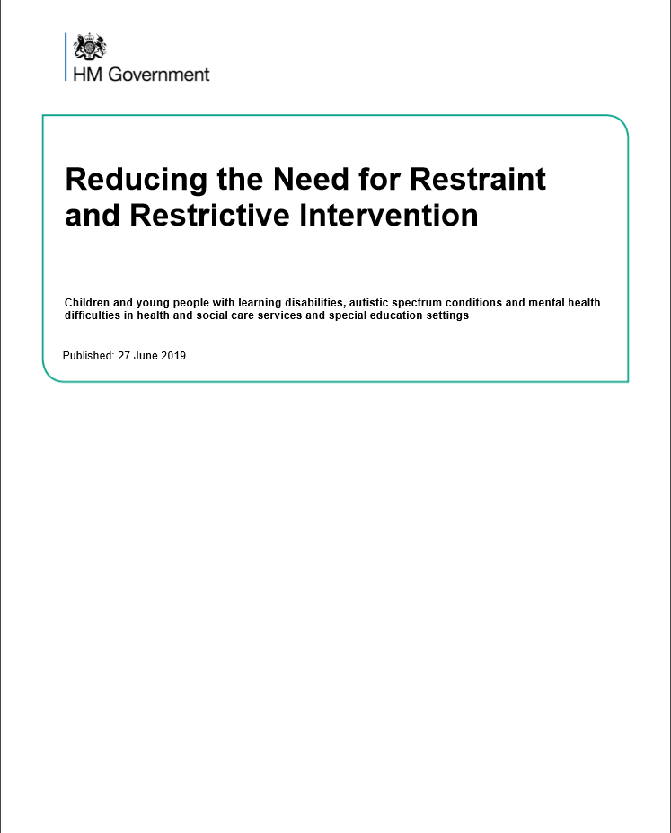
Approach takes guidance from

Slide 54
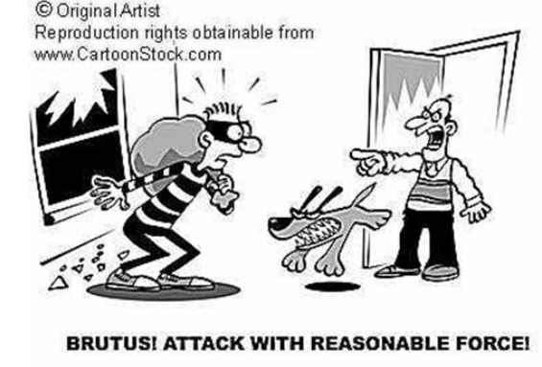
Reasonable Force - DfE Guidance
Staff have the right to use reasonable force
Use of force as a last resort

Slide 55
Task Share an incident in your school - demonstrating effective de escalation - where a physical intervention was used either effectively or ineffectively

Slide 56
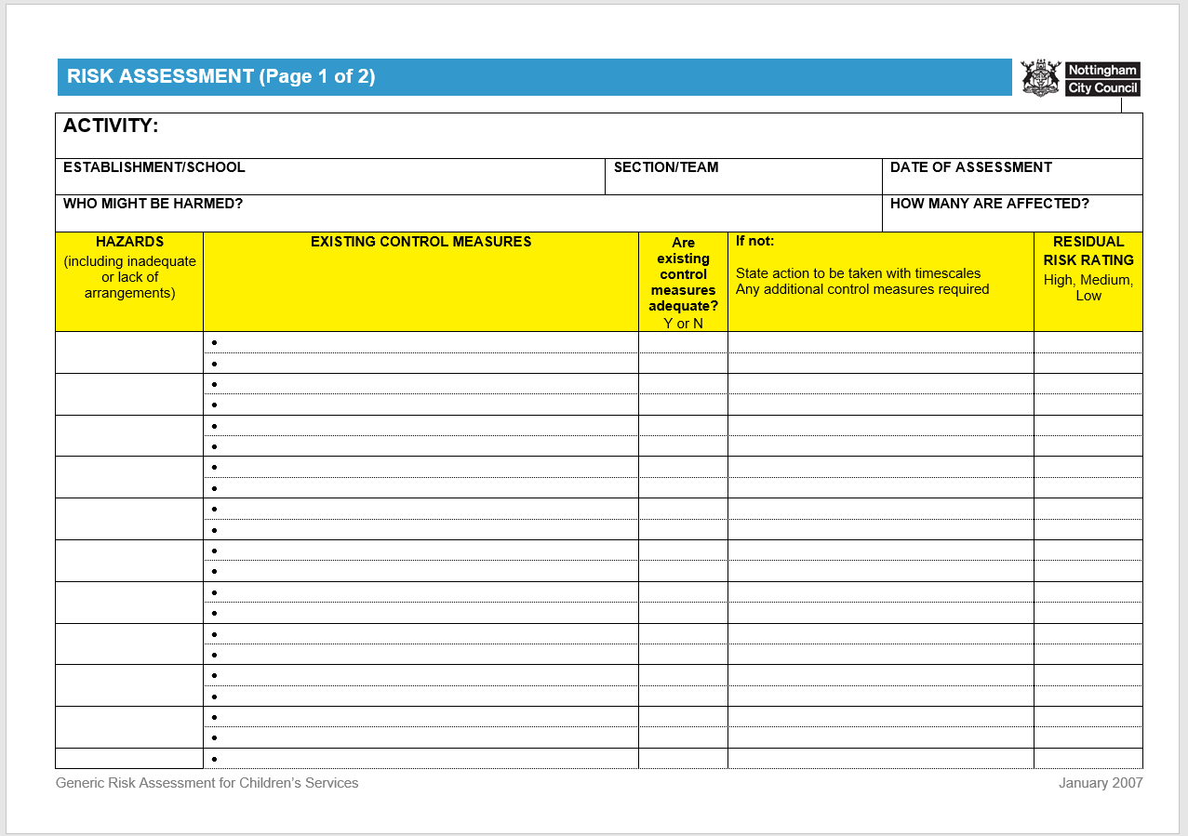
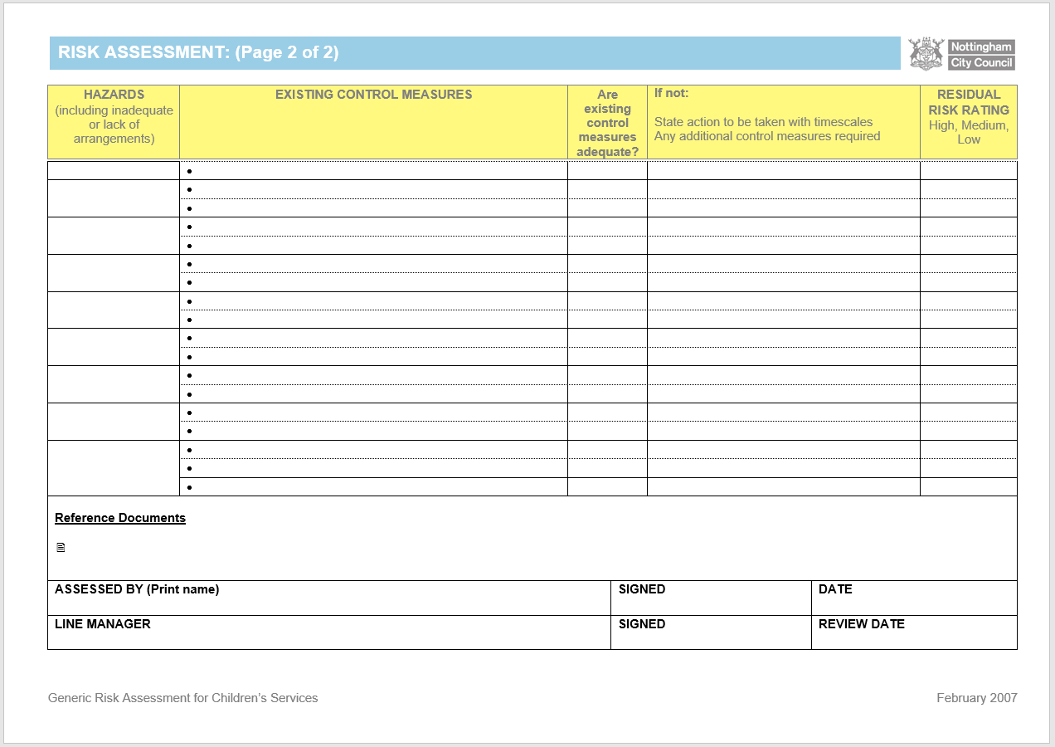
Whose responsibility is it to risk assess?
It’s everyone’s responsibility!
DYNAMIC

Slide 57
What to consider when using RPI Techniques?
Follow the policy, if there is one!
Assess the risks and take the safest option i.e. risk assessment led.
Do only what is necessary to make a situation safe.

Slide 58
Reducing risk-avoiding RPI
School ethos
flexible
empathetic
Inclusive
early intervention R2i
Willingness to
Review /self reflect
Consider and try alternatives
Support colleagues
Listen
Model apologizing
Use humour
Build skills
Empathy
De escalation
Active listening
Teacher self esteem
Assessing risk
Approach training techniques
Respect and relationships
SEND provision
Voice of CYP
Adaptation and reasonable adjustment
Restorative practice

Slide 59
Approach Training will always…
True or False
Allow the young person to take control of his or her behaviour as soon as it is safe to do so.
Use RPI techniques to deal with difficult pupils
Treat the young person with dignity and respect
Consider the quickest way to manage behaviour
Teach techniques that support and isolate but can cause pain
Expect all CYPs to comply with the same rules

Slide 60
Questions

Slide 61
Children Missing From Education – Referral Pathway for Schools/ attendance Officers

Slide 62
The Education (Pupil Registration) (England) Regulations 2006
(a) that he has ceased to attend the school, or, in the case of a boarder, that he has ceased to be a pupil of the school; (b) that he has been continuously absent from the school for a period of not less than twenty school days and —
(i) at no time was his absence during that period agreed by the proprietor; (ii) the proprietor does not have reasonable grounds to believe that the pupil is unable to attend the school by reason of sickness or any unavoidable cause; and (iii) the proprietor of the school has failed, after reasonable enquiry, to ascertain where the pupil is;
(c) that the pupil has died; (d) where the pupil has been admitted to the school to receive nursery education, he has not on completing such education transferred to a reception, or higher, class at the school; or (e) that he has been permanently excluded from the school.
Reasons for which a child may be removed from roll
Finally….
The final decision about removing a child from a school roll remains with the Head-teacher of the school after consultation with the Local Authority (CMFE). Ofsted will always look at removing children from a school roll primarily as a safeguarding issue and will expect that safeguarding comes before removal from roll. Ofsted expect that the child’s welfare is overseen by an independent body i.e. another school or there is a continued effort to ensure that the child is located and their welfare overseen before taking off roll. This means that unless a forwarding school is known by the leaving school all other children should be referred to CMFE for consultation before the child is removed from roll.

Slide 63
Children Missing From Education-Procedural flowchart for school referral
Information that is required for a referral to CMFE:
Name of Child / Date of Birth / gender
Address from which missing.
Parents Names
Any siblings known and school they attend if possible.
Language / nationality of family
Any known contacts / phone nos./ email
The circumstances under which they went missing i.e. what contact was there with the family before they left, have they overstayed a holiday or mercy visit, has there been any contact since they initially left. Has there been any response to letters written from the school?
Information that makes you a star:
The address they are going to.
The school they intend to attend.
The school they came from
The address they came from

Slide 64
the new Requirement for schools to do….
Following the implementation of The Education (Pupil Registration) (England) (Amendment) Regulations 2016, Schools not only have to refer all children who have left their school whether their destination school is known or not. They are also required to supply the Local Authority with details of all pupils who are taken on roll outside normal transition times i.e. Year 1 and Year 7. Thus when a pupil is taken on roll at any other time and when the local authority are not aware that the place has become taken because the school dealt with its own admissions, then the CMFE team must be informed within 5 school days of the child being placed on roll.
The CMFE team will need to know the Child’s name, Date of Birth, Address, Parental Names and contact details, previous address (whether in this country or abroad) and the previous School (whether in this country or abroad)
This information would be best forwarded via the CMFE referral form either on-line or via email as a password protected document.

