Slide 1

https://www.youtube.com/watch?v=N9V-QgfhIsw

Slide 3

What is it?
The MVP Programme is a started in Scotland as a partnership between Education Scotland and the Scottish Violence Reduction Unit.
After a successful pilot in 2011 and subsequent model development the programme is now being continued and developed by Education Scotland, with MVP is currently operating in 21 Scottish Local Authorities in over 100 schools.
Nottinghamshire Police, in partnership with Nottingham and Nottinghamshire VRU, are now conducting a local pilot in 12 local schools and alternative provisions. The pilot is running from September 2019 to March 2021.

Slide 4
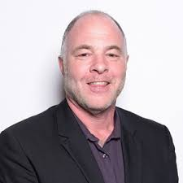
The MVP model
The Mentors in Violence Prevention Programme developed in the 1990’s by Dr Jackson Katz utilises a creative bystander approach to prevent all forms of bullying and gender based vio­lence. Males and females are not looked at as potential victims or perpetrators but as empowered bystanders with the ability to support and challenge peers. Within the MVP Programme a by­stander is defined as a friend, class-mate, team-mate, colleague or relative. In other words, it is someone they know.

Slide 5

MVP Playbook
The MVP Programme makes use of a simple playbook to provide discussion on a range of behaviours which include: Dating Abuse; Harassment; Bullying; Sexting; Control; and Alcohol and consent.
The playbook offers a consistent approach to delivery of MVP sessions. This consistency supports the following aims:
To raise awareness
To challenge attitudes
To open dialogue
To inspire leadership
THERE IS POTENTIAL HERE TO TWEAK / DEVELOP MORE SPECIFIC SCENARIOS AROUND ISSUES THAT ARE AFFECTING US HERE IN NOTTS - CSE / CCE / KNIVES AND TO INCLUDE OUR OWN LOGOS ON THE TRAINING MATERIAL.

Slide 6

The Peer to Peer Approach
The MVP Programme utilises the power of the role-model. Supported by teachers and community partners peer trainers are equipped with skills and knowledge that support them in working with younger people around the issues discussed in the playbook.
The development of leadership among young people is a key part of MVP. It is clear from experience that young people in these mentoring roles develop skills which support them in their wider educational and future lives.

Slide 7
Summary
MVP has potential to be a long lasting programme to support the promotion of healthy relationships in our secondary schools.
The outcomes for schools include: improved behaviour, better attendance and attainment.
The long term outcomes for police and other local partners include less violence and reduction on demand.
MVP is owned by a school and police and other partners support development.
Initial training involves training a team of teachers, other schools staff and partners (incl police). This two day training introduces and demonstrates the model and provides time to plan implementation.
The programme asks for 4-6 members of a school team from each school involved.

Slide 8

Results from Scotland and Nottingham/shire MVPs so far
The evidence from Scotland and has been positive.
Young people communicate that they have options to help others.
Schools are seeing less violence, less expulsions and a general feeling of safety is regular feedback.
The skills the Mentors are developing support them out of the school setting – assisting with University applications and job interviews post school.

Slide 9


Slide 10


Slide 11


Slide 12
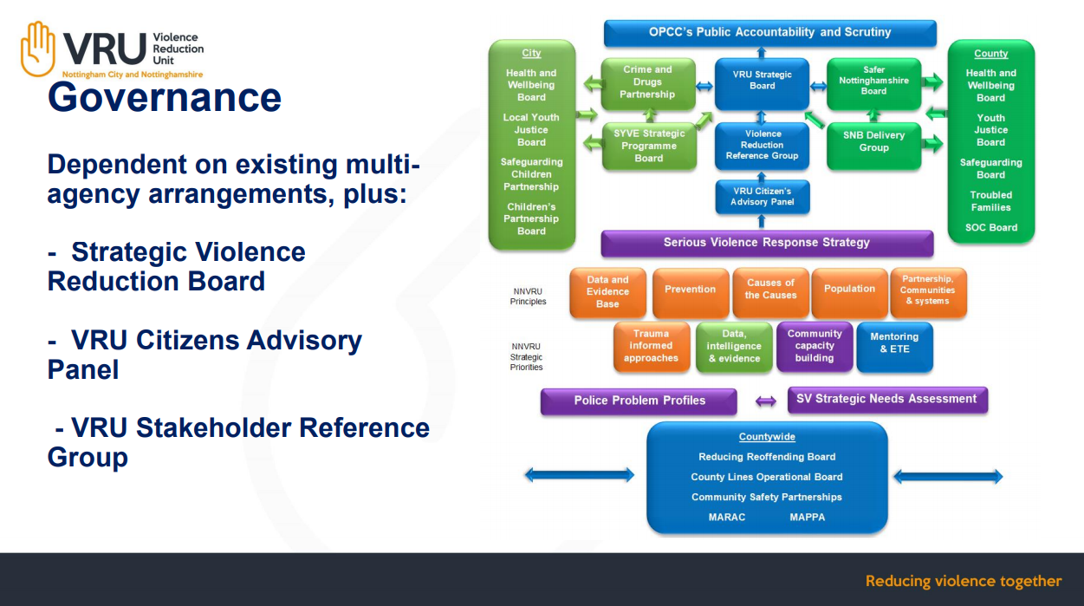

Slide 13
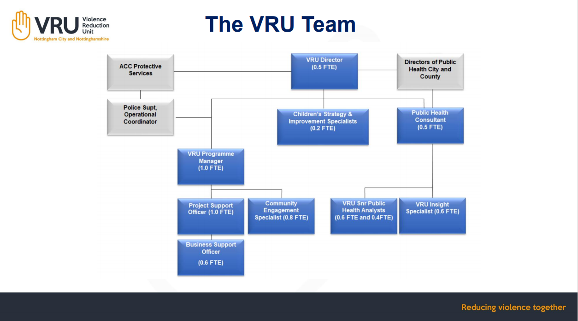

Slide 14
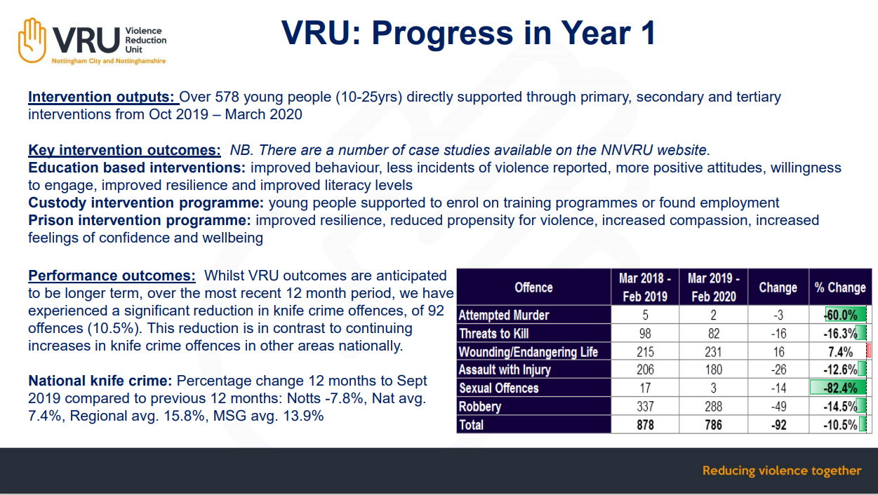

Slide 15


Slide 16
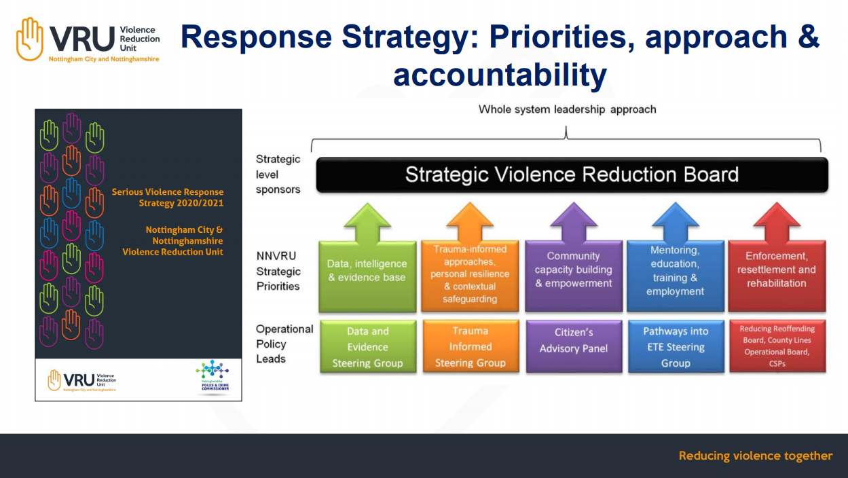

Slide 17
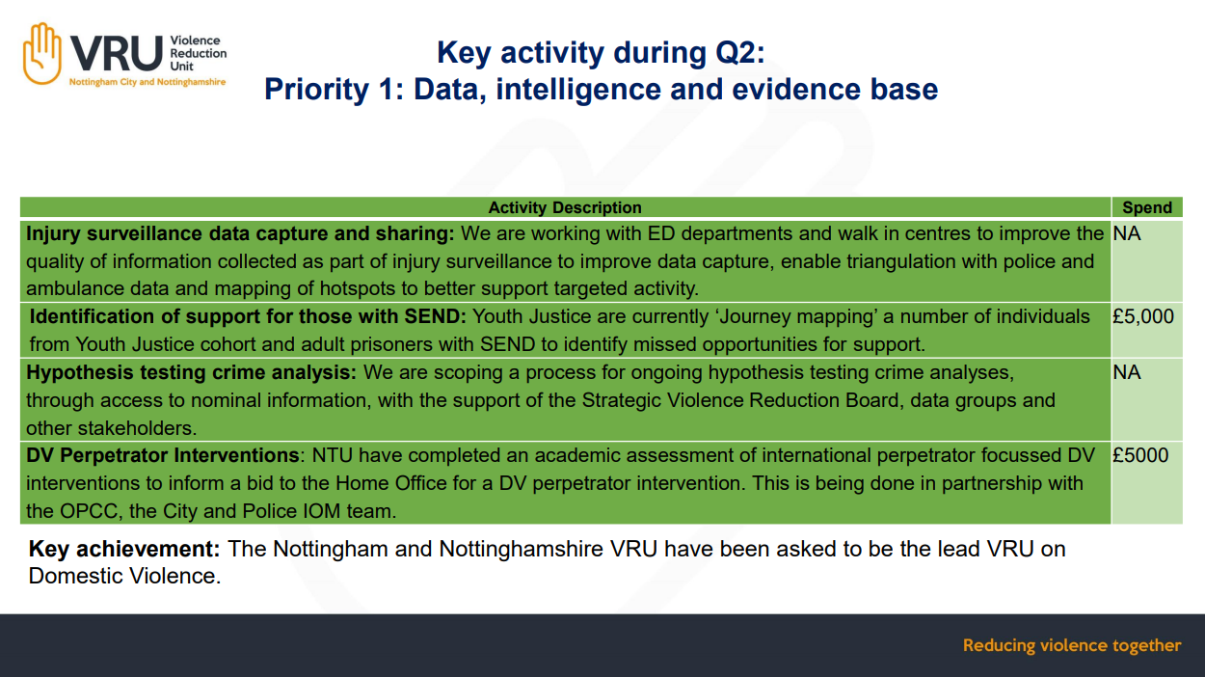

Slide 18
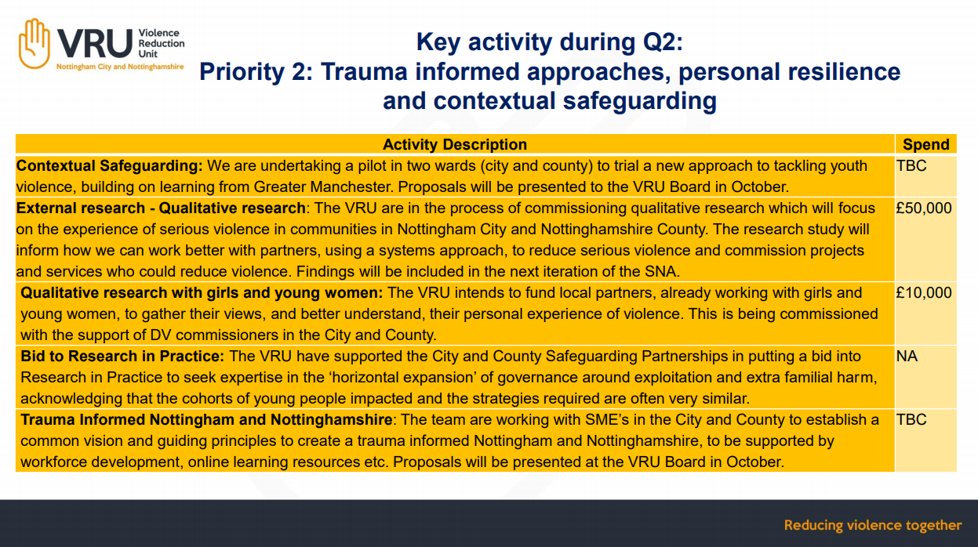

Slide 19
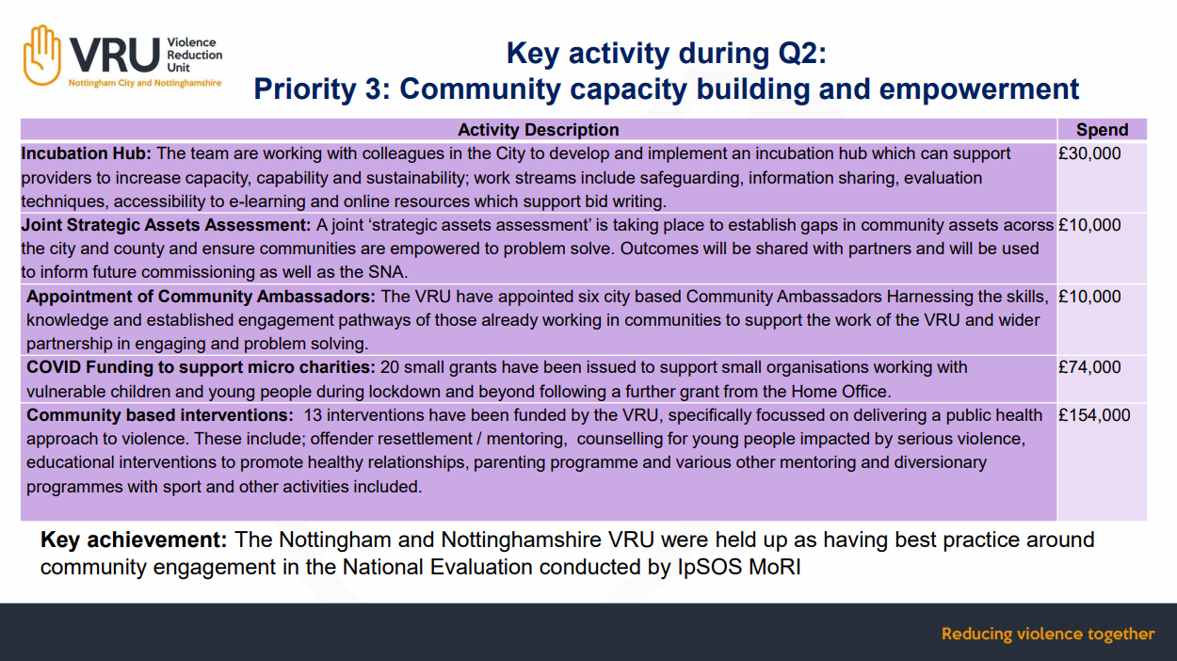

Slide 20
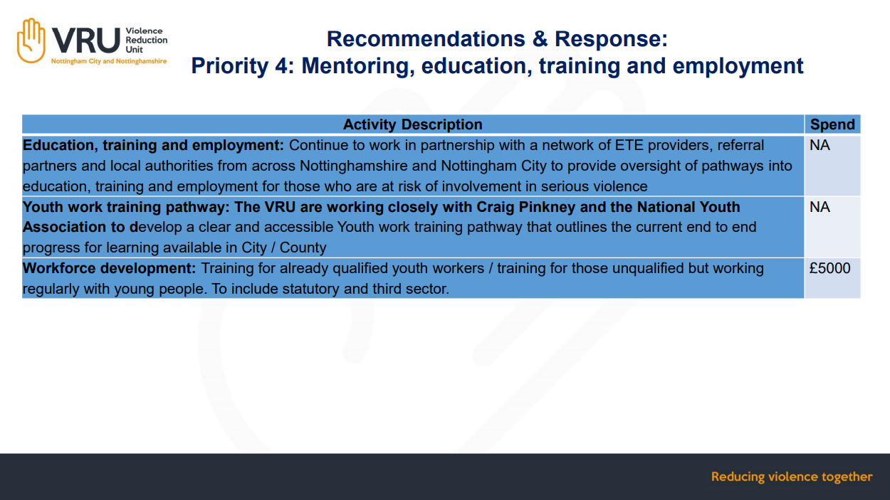

Slide 21
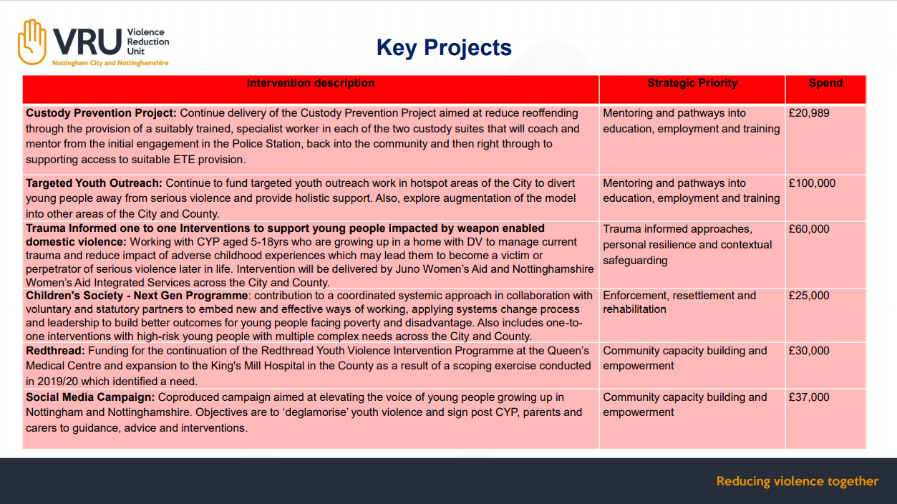

Slide 22


Slide 23


Slide 24
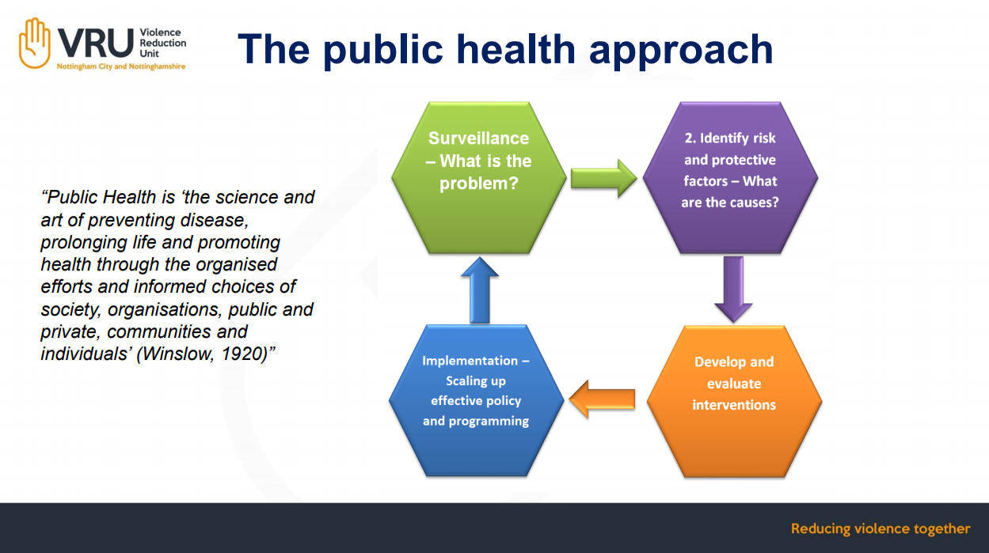

Slide 25
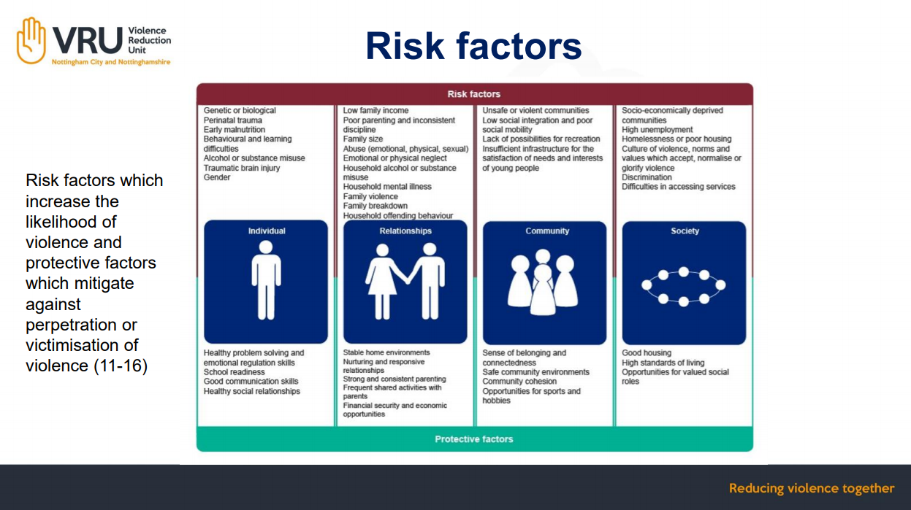

Slide 26
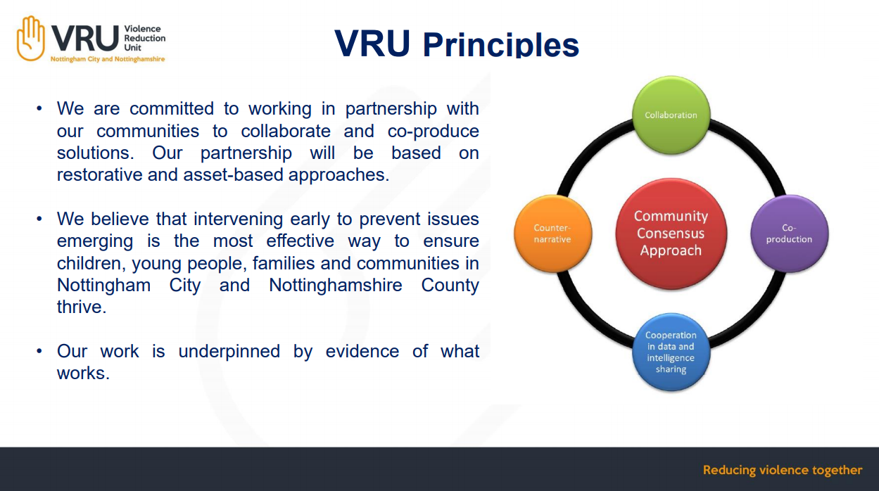

Slide 27
