Slide 1
Signs of Safety
Working in partnership with
Children and Families
Helen Watson
DSL Network, 14th October 2020
Notes:
Title slide Ask how many have already been on the 3 day sos training for those who haven’t direct them to this training. Todays session is about developing skills in danger statements and safety goals who can recall them from your sos training who is using them in practice? Ask group to introduce themselves and where they are from, scale how confident they feel in writing a danger statements and safety gaol- 0- no confidence 10 fully confident use them with every family you work with. Acknowledge the varying levels of confidence and experience in the room and ask that they remember they scale as we shall return to it at the end of session and hopefully that hopefully by the end of the session they will have moved up the scale. Danger statements and safety goals can be used for need as well as risks for example there may be a risk of family breakdown if the family do not receive respite care, and the child will have to live elsewhere, or a child is being bullied at school and you are worried that they will stop the child going to school and that they will fall behind in their lesson's

Slide 2

Background to Signs of Safety
Notes:
Created in Western Australia during the 1990s by Andrew Turnell and Steve Edwards
Based on the use of Strength Based interview techniques and draws upon techniques from Solution Focused Brief therapy (SFBT).
It aims to work collaboratively and in partnership with families and children to conduct risk assessments and produce action plans for increasing safety and reducing risk and danger by focusing on strengths, resources and networks that the family have.
NSPCC REPORT In 2012, (Key Findings)
Parents feel listened to and that they have a more active role in decisions. They like having their thoughts written on the board in meetings.
Signs of Safety methods are thought to increase participation, co-operation and the engagement of = parents/families
Signs of Safety meetings are thought to decrease anxiety and relax parents/families
Parents like having an insight into different perspectives and an understanding of what is expected of them
Parents like focusing on strengths and not just problems
–
In the Munro Interim report, the use of Signs of Safety by a local authority in the North East of England was highlighted as one example of “the type of systemic learning and adaptation that the review wishes to encourage. The [authority has] identified problems in the existing way of working and, drawing on theory and research, have formulated ways of improving practice” (Munro 2011a: 64).

Slide 3
Core principles
Three core principles:
  Establishing constructive working relationships.
  ii) Encourages critical thinking and maintains appreciative inquiry.
  iii) Staying grounded day to day work – from early help - child protection
Notes:
Signs of Safety recognised as a strengths based approach alongside an exploration of danger and risk.
i) Partnerships and working relationships
“it is difficult to build partnership and cooperation if the primary focus of the casework stays on the problem and all that is wrong with the family in question … the heart of the Signs of Safety approach is a focus on goals, namely, what the statutory agency needs to see to close the case as well as the family’s ideas and ways of creating safety.” (Turnell and Edwards 1999, p38)
ii) Engaging in critical thinking and maintaining a position of inquiry
The SOS Approach encourages all involved to have an open mind.
Find Exceptions To The Maltreatment:
Search for exceptions to the problem. This creates hope for the workers and families by proving that the problem does not always exist. Exceptions may also indicate solutions that have worked in the past. Where no exceptions exist, the worker may be alerted to a more serious problem.
iii) Staying grounded in the day to day work
“
NB 1 )WE ARE ALL SAFEGUARDING PRACTIONERS!
2)We are doing this in Nottingham – seeking views and evolving practice – eg guidance & particularly tools for children/yp
Relationships are the bedrock of human change and growth
The concern is that when a professional builds a positive relationship with abusive parents that professional will then begin to overlook or minimise the seriousness of the abuse.(Being self aware of potential collusive practice).
Focusing on successful, rather than problematic, behaviour is a powerful mechanism for generating change

Slide 4



Signs of Safety is …
  A way of using solution –focused
  approaches to safeguarding and early help
  Maintains a focus on child’s safety & wellbeing
  Organises our thoughts & maps information
  Collaborative planning- involves everyone
  Scales safety & progress
  Made up of a set of principles and some
  practical tools
  SOS is the City’s way of working with children &
  families
Notes:
4
Signs of safety is a recognised model, used all over the world and within the UK. A number of Local Authorities have already started to build this into frontline practice. It compliments the tools we are already familiar with….CAF, framework of assessment – a systematic and holistic approach to keeping children safe. In supervision it helps to establish a clearer understanding of the child/YP situation, it helps to look at values and beliefs, look at alternative solutions-not a one size fits all approach. It helps identify gaps in knowledge.
Munro in England in 2011
Desire to move away from an overuse of policy and procedure to on-the-ground human practice that makes a constructive difference for professionals and families, and creates meaningful safety for children in high-risk cases
A purposive, positive focus for child protection work that is energising and affirming for practitioners and agencies…

Slide 5
Assessment and Planning Form
When we think about the situation facing this young person, Carer or Family
What are we Worried About? | What’s Working Well? (Strengths & Safety) | What Needs to Happen?
On a scale of 0 to 10 where 0 means immediate response required from Children’s Social Care (0= no signs of safety)10 means no further action required (10 = high levels of safety )
0 10
Notes:
(9.10) SOS Assessment and Planning Form & 4 Key Questions
So this is the SOS assessment and planning tool that you should be familiar with. We shall just recap as some of you went on the sos training sometime ago. This is the SOS framework in it's basic form.
4 Key Questions
At its simplest this approach has four elements to explore:
What are we worried about? (Past harm, future danger and complicating factors)
What’s working well? (Existing strengths and safety)
What needs to happen? (Future safety)
On a scale of 0 to 10 where 0 means immediate response required from Children’s Social Care (0= no signs of safety)10 means no further action required (10 = high levels of safety )
It doesn’t replace the use of more complex assessment tools, but at some stages of your journey working with a family it can be a useful tool to simplify things and focus or drill down to the crux of the issues for this family.
We will be using the assessment and planning form to ‘map’ a case (explain).
But it is probably the best bit of the SoS training and provides the ‘Aha! Or lightbulb moment for most social worker / professionals. So in sense case ‘mapping’ has been a by-product of the SoS model. And case mapping is the foundation for this model of conferencing – but not the only influence.

Slide 6
Assessment and Planning Form
What Are We Worried About? Harm and Future Danger | What’s Working Well? Strengths & Demonstrated Safety | What Needs to Happen? Safety goals & next steps in working towards safety
Past harm: What has happened to these children, that worries us, or to other children in the care of these parents?) Future worries: What are we worried might happen to these children in the care of these parents in the future? Complicating factors: What makes building safety for the children and working with this family more complicated? Grey areas what things are we are unsure about or don’t know enough about? |  | Family View What does the family think they need to be doing in their care of the children for them to be safe & Children’s Social Care to end their involvement What are the agency’s & family’s ideas about what needs to happen next in working towards these goals (SAFETY PLAN)?
Safety Scale: On a scale of 0 to 10 where 0 means immediate response required from Children’s Social Care (0= no signs of safety)10 means no further action required (10 = high levels of safety )
EXISTING STRENGTHS SAFETY & PROTECTION
SAFETY GOAL STATEMENT:
WHAT EXACTLY DO WE NEED TO SEE FOR US TO BE CONFIDENT THAT THERE IS ENOUGH SAFETY FOR US TO CLOSE THE CASE
DANGER STATEMENT: FUTURE DANGER FOR CHILDREN /YP
NEXT STEPS (must directly relate to danger)
Notes:
(Finish slide by 9.15)
This slide provides the detail of what to include when mapping cases.
PAST HARM TO CHILDREN/YP
And behaviour by children/yp indicative of maltreatmentWe can worry about a lot of things in families.
There will be occasions where we don’t have information about the family (grey areas- e.g. not yet had the opportunity to gain the views of all family members) and there are complicating factors (things that make it difficult to work with a parent and for them to keep their child safe- the parent has a personality disorder). This information forms part of the mapping process and will inform how safe we believe the child to be at that time given what we currently know.
What Are We Worried About?
Past harm: What has happened to these children,
Future worries: What are we worried might happen to these children in the care of these parents in the future?
Complicating factors things that make the situation more complicated for the family members and s involved with the family – things that make it more difficult for the parents to achieve future safety i.e substance misuse, mental health, isolation or poverty. Or things that make it more difficult for the family, parents and professionals to work together such as disputes between parents and family , cultural misunderstanding. IN the analysis about the family it is critical that we distinguish between the past harm and the complicating factors.
Grey areas what things are we are unsure about or don’t know enough about?
PAST HARM TO CHILDREN/YP
And behaviour by children/yp indicative of maltreatment
There will be occasions where we don’t have information about the family (grey areas- e.g. not yet had the opportunity to gain the views of all family members) and there are complicating factors (things that make it difficult to work with a parent and for them to keep their child safe- the parent has a personality disorder). This information forms part of the mapping process and will inform how safe we believe the child to be at that time given what we currently know.
What’s Going Well? Column 2: What’s working well? Statements of existing safety describe when parent’s have taken actions or made decisions that led to the children being safe in relation to the dangers . Statements need to be specific and describe the actions and behavior by the parents that resulted in safety for the children.
Writing Safety Statements
These need to be simple, concise and need to address:
What is working well?
What strengths do the family have?
What positives can be drawn on?
What support can they get?
Statements of strengths describe the things happening in the family or recourses /capacities of parents that makes things better for the child, particularly in relation to what we are worried about. Strength statements need to be specific and describe actions and behaviors that contribute to the child’s safety and wellbeing.
This distinction between a strength and demonstrated protection (safety) is critical, because child death inquiries often find that professionals in serious cases of child abuse fall into the error of over-rating positive attributes and good intentions, particularly when the professional has formed a constructive relationship with the parent
(SAFETY FACTORS/STRENGTHS: (factors that help child to be safer)
• Strengths are the positive equivalent of ‘complicating factors’-- they help the situation to be safer but in themselves they do not bring about enough safety to counteract or address the ‘Danger/Harm’ factors.
• Strengths and safety aspects of parenting and environment –sw and other professionals, e.g.. consistent sobriety, where drunkenness has triggered the abuse or neglect previously.
• Successful completion of treatment programmes accompanied by prolonged absence of maltreatment and positive professional prognosis.
• ‘Seeds’ of future safety if they can be developed and brought to bear directly on the danger, e.g.. a positive relationship between a child who has been sexually abused and a trusted, nonabusing adult within their family network.
Example Safety Factor :
Mum told Sonja last month when she knew David’s friends were coming over and that people would be drinking she arranged for her friend (Carol) to look at Sam for the weekend . Sonja spoke to Carol who confirmed this happened and gave Sonja a date and described what she did with Sam that weekend.
Example Strength
Cindy says that she wants to stop using drugs and to be a better mum to Danny.

Slide 7
“What is CSC most worried will happen to the children if they are in the care of their parents and nothing else happens to mitigate the danger?”
What does CSC need to see the parents doing differently with their children so everyone will know the children are safe? (not services)
Danger Statement(s)
Safety Plan
Safety Goal(s)
Notes:
PURPOSE
To showcase the connection between danger statements and safety goals.
EXAMPLE
Here you can see how the questions line up with each other.
Do you notice how important these questions are?
It takes us back to the first exercise in this module but we can ask, “what happens if we don’t know the answers to these questions?”
What happens if the parents we are working with don’t know the answers to these questions?
What happens if the collaterals we are asking to work with the families don’t know the answers to these questions?

Slide 8
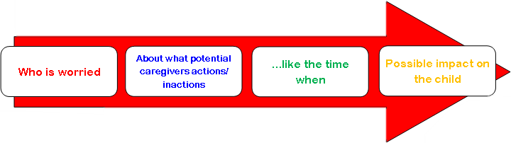
Danger Statement Uses
Danger statements clearly identify what the professionals are worried may happen if there are not enhanced actions of protection by the family and network.
Sharing danger statements with the family (and within the agency!) helps create a sharpened focus on the key issues that need to be addressed so the family can make changes and demonstrate actions of protection. This can also prevent “case drift.”
Notes:
PURPOSE
To reinforce the value of danger statements. PURPOSE
To provide additional suggestions for writing danger statements.
EXAMPLE
A couple of additional tips:
We mentioned that you may “raise the stakes.” If the harm was a bruise, we may worry that the child will be bruised again OR GET HURT MORE SERIOUSLY. Use this if there is already a notion of things escalating, e.g., maybe the thing that already happened wasn’t that bad, but it could get worse. Naming what could happen can be a wake-up call. Raise the stakes if you think the harm or danger is not being recognized or taken seriously by the caregivers or others. But avoid making such a leap that your worry seems unbelievable, i.e., “…Worried that dad could spank Adam and he gets bruised again or DIES!!!” would probably not sell the worry!
Just like harm statements, stick to facts. While there is a certain amount of speculation in danger statements by definition, keep it grounded in known facts. Don’t worry that mom will pass out from meth when she’s never used meth (even though she COULD one day!). Don’t worry that dad could get so depressed that he puts the baby in the car and drives around for hours, forgets to feed the baby, and then parks the car and doesn’t lock it, and the baby is kidnapped by terrorists and so on.
Sometimes there is danger, even if there was no harm. Can you think of a situation like this? (Examples would be a parent swung a board at a child’s head, but the child ducked; a parent left an infant unattended for hours, but other than a wet diaper and being hungry, the infant was not harmed.) Since you don’t have a harm statement to convert to a danger statement, think about what ALMOST happened, or what is a logical consequence of what the caregiver is doing, and base your danger statement on that.
It’s a good idea to look at the SDM safety item that was marked, if any, and look at the definition for clues about things we worry will happen. This is especially useful if there is no harm statement.
EXAMPLE
Danger statements keep us focused on what exactly we worry will happen if nothing changes.
This is helpful, but not if it only gets entered into a computer and is never looked at again.
The value of danger statements goes up exponentially as they become the currency we use to talk about why we are there and why we are worried.
Keeping our anchor in the danger helps everyone prevent the “drift” that can and does happen once a family enters child welfare systems.
It happens all the time: A family comes in for one thing, and years later, we keep finding one more thing to “fix” before we close the case.
If new DANGER truly emerges, we should incorporate that into our work. But what often keeps cases open is not danger, but complicating factors. Once you create a danger statement, post it prominently in the file (more on this later) and talk about it as you begin each conversation with and about the family.
Internally:
Enhanced clarity in our own thinking as we start to think about our cases.
Greater clarity as cases get moved from one unit to another.
Helps facilitate discussions between supervisor and worker, manager and supervisor, perhaps even legal and clinical!
A process, not an event, and can be refined over time.

Slide 9
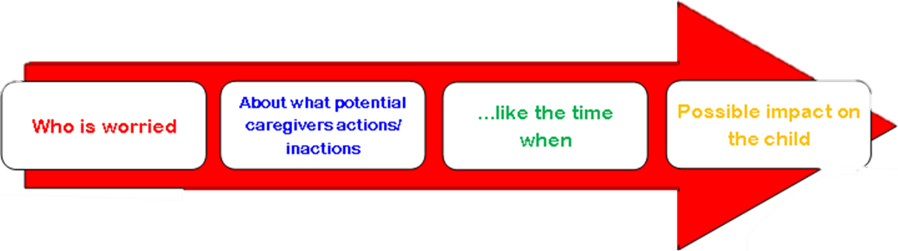
Danger Statement: Medical Neglect
Children’s Social Care, health and school are worried because Shirley is not taking Emily to dentist appointments. Like the time when Emily was not brought to the dentist in July, August and September.
If nothing changes they are very worried that Emily’s teeth could rot. This could make Emily very poorly, she could lose all her teeth and she might bullied about how she looks making her feel sad and unloved.

Slide 10
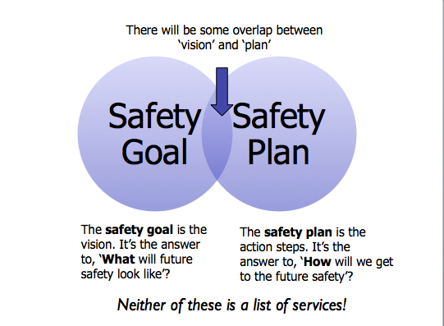

Slide 11
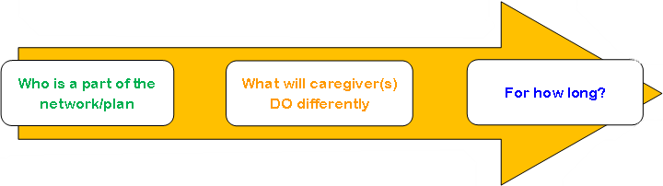
Safety Goals
Clear, simple statements about what the caregiver will DO that will convince everyone the child is safe now and into the future.
Notes:
Shouting less…….talking more
Fighting less……cooperating more
Less lively…….calmer
PURPOSE
To introduce topic. The Question That the Safety Goal Answers “What does CSC need to see the parents doing differently with their children so everyone will know the children are safe?” (not services)
TRAINER NOTE:
More details on this soon, but it is also important to make the distinction that this is not the same question as “what is the safety plan” or “what services are needed?”
This is a deceptively simple question that actually tries to help us do something very complex: to think about what behavioral changes the agency would need to see the parents make with their children in order to feel that the danger was addressed.
EXAMPLE
Now we will work on safety goals.
These will take us from the future we worry about to the future we want to create.

Slide 12
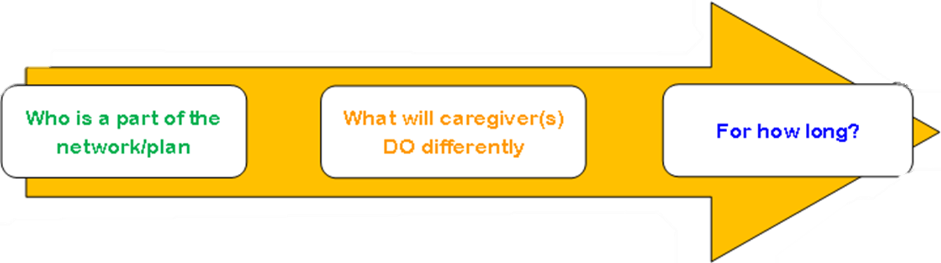
Safety Goal: Medical Neglect
Shirley, Children’s Social Care, health, school and a network of friends and family agree to work together so Shirley can show everyone that Emily is being taken to dentist appointments and her teeth are being looked after. Children’s Social Care and the network will need to see this working for a period of nine months so that everyone is confident that the safety plan will keep working once the case closes

