Slide 1


Nottingham City DSL Network
26th May 2021

Slide 2


Slide 3
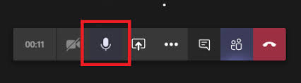
Guidance for Participation
Sign in on the chat with your name and school details.
Please use the chat for your questions or input.
To avoid background noise, please ensure your microphone is muted.
You can control volume from your keyboard.
Video Is optional but it would be nice to be able to see some of you.
The presentation and resources discussed during the network will be available on the DSL webpage shortly after the network.

Slide 4
Aims & Purpose
To promote connectivity with the Nottingham City Safeguarding Children Partnership.
Act as a conduit for policy updates.
A practice network which demonstrates professional behaviours and mutual support.

Slide 5


Slide 6
Prevent – content restricted cannot be shared
Mark O’Donnell

Slide 7
Local Updates

Slide 8
Family Support Pathway
Sara-Jane Brighouse

Slide 9

Nottingham City
Safeguarding Children Partnership
Designated Safeguarding Leads Network
Family Support Pathway
Sara-Jane Brighouse, Project Manager
Suzanne Scrivens, Business Change Manager
Children’s Integrated Services

Slide 10

Family Support Pathway (FSP)
Partnership document
Nottingham City’s Safeguarding Children Partnership threshold for support and safeguarding
It sets out the threshold for access to support and safeguarding services for professionals working with children and families
Improve safeguarding outcomes for children, young people and their families

Slide 11

Background - Family Support Pathway
Launched in 2011, guidance for practitioners, ‘earlier support, stronger families’
Created with multi-agency consultation through the Safeguarding Children Board
Framework & pathway to identify, assess, provide the right help at the right time
Refreshed 2014, 2016 and 2018 to account for new legislation, serious case reviews and local arrangements

Slide 12
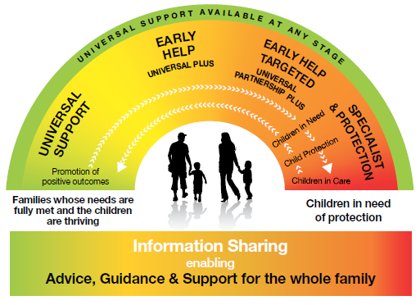
Nottingham City’s Model for Universal, Prevention, Early Help and Specialist Services

Slide 13
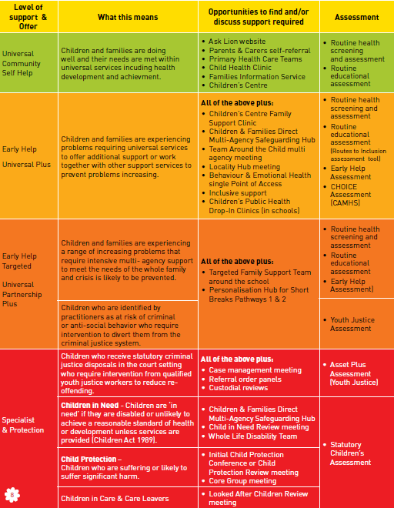
Access to Support and Decision Making

Slide 14
Priorities
NCSCP Business Plan Priorities (draft)
Child exploitation – CCE, CSE
Harmful Sexual Behaviour - IICSA
Neglect Strategy – Recognise, respond, reflect and review
Sudden Unexpected Death in Infants – Safer Sleeping
Diversity including BAME, SEND, LGBT+
Child at the centre, child’s voice - “Am I safe?”
Domestic abuse & violence – child & young person’s mental health COVID -19 recovery

Slide 15
Next steps
Refresh for Summer 2021
Review current format and information
Working with partners to co-produce next revision
How can you be involved?

Slide 16
What we want to know from a schools perspective?
What do you know about the Family Support Pathway?
How are you currently using it?
What information and sections are most useful and helpful?
Which parts do you think could be improved?
Who else could we consult with?
Ideas about it’s promotion?

Slide 17
We are consulting with colleagues in:
Schools
Early years settings
Education
Health
Children’s Integrated Services
Police
NCSCP business management group
Portfolio Holder Briefing

Slide 18
If you’re interested in being involved with the refresh of Family Support Pathway, please contact:
Suzanne.Scrivens@nottinghamcity.gov.uk
Sara-Jane.Brighouse@nottingahmcity.gov.uk

Slide 19
Cross Partnership Neglect Strategy
Uzma Moody

Slide 20

Partnership News
Update on some of the current work we are taking forward together
Tackling Child Exploitation (TCE) Programme – Bespoke Support Project
  Joint bid with Nottingham City & the Violence Reduction Unit
  Integration of responses to child exploitation and extra-familial harm
Interagency procedures
  Updated guidance published in January 2021 including a new section on strategy discussions
  Revised Harmful Sexual Behaviour Procedures being developed – NB. Brook Traffic Light Tool is now only available via individual licence
  A new chapter on Child Criminal Exploitation is being developed
Joint Child Death Overview Panel
Child Safeguarding Practice Review – flexible, shared processes
S.11 self assessments!
Notes:
John

Slide 21
Partnership News
Update on some of the current work we are taking forward together
Training initiatives
Welcome to Graham Cullen who has joined the NCSCP as Training Officer – plan for more collaborative working now
Planning underway to jointly develop Strategy Discussion Training
Joint Agency Response to Child Death Training
Joint Child Sexual Exploitation Training
Shared training QA arrangements & Competence Framework
L & WD Group- moving forward exploring if this could be cross partnership
Notes:
John
Joint Quality Assurance – Training Content Checklist re; Introductory Safeguarding Children Training
Joint Safeguarding Children Competence Framework – Guidance on staffs training levels in relation to their role

Slide 22
Neglect – setting the scene
Colin Pettigrew
Corporate Director for Children, Young People and Schools, Nottinghamshire County Council
Catherine Underwood
Corporate Director for People, Nottingham City Council
Notes:
Colin & Catherine

Slide 23
Why focus on Neglect?
Neglect is the most common reason for a child in Nottinghamshire and Nottingham City to be made the subject of a child protection plan.
Neglect is the form of abuse more likely to be repeated.
Neglect exposes children to other forms of abuse, e.g. exploitation/increased vulnerability.
Neglect can be difficult to identify, making it hard for professionals to take action to protect a child.
Neglect is an area where there can be drift and delay; professionals can become desensitised to a child’s living conditions and experiences of poor parenting.
Notes:
Colin Pettigrew

Slide 24
Neglect
Neglect can take many forms;
  Medical - minimising or denying children’s health needs and failing to seek appropriate medical attention or administer medication/treatments
  Nutritional - failure to thrive/childhood obesity
  Emotional - unresponsive to a child’s basic emotional needs
  Educational - failure to provide a stimulating environment, support learning or ensure school attendance
  Physical - not providing appropriate clothing, food, cleanliness and living conditions
  lack of supervision and guidance – failure to provide an adequate level of guidance and supervision
Notes:
Colin Pettigrew
Medical neglect – minimising or denying children’s health needs and failing to seek appropriate medical attention or administer medication/treatments
Nutritional neglect – failure to thrive/childhood obesity
Emotional neglect – unresponsive to a child’s basic emotional needs
Educational neglect – failure to provide a stimulating environment, support learning or ensure school attendance
Physical neglect – not providing appropriate clothing, food, cleanliness and living conditions
Lack of supervision and guidance – failure to provide an adequate level of
guidance and supervision

Slide 25
Neglect
Not just young children – adolescent children may also be vulnerable
  Local serious case review (MN15)
    Perry (15 yrs.) lived with her father and 4 siblings
    Perry and 2 of her siblings were reported to have a mild learning disability
    Originally from another Local Authority area
    Significant agency involvement
    History of poor home conditions and neglect of the children
    Child protection plan for 2 years, then a gap of 2 years then Child in Need
    Deteriorating presentation
    Resulted in admission to hospital and inpatient treatment
    Neglect can be life threatening or cause significant physical injury – urgent action may be needed
    Professionals are expected to form judgements about what is good enough care and this is different and distinct from being judgmental.
    Need to systematically collate evidence about risk, vulnerability and resilience
    Use of escalation – particularly when cases are not being moved forward effectively
Notes:
Colin Pettigrew
This review highlighted chronic neglect over a number of years.
4 girls living with father. 3 of the girls had learning difficulties. Chronic neglect over a number of years. Poor home conditions, smelly, constant head lice, physical presentation causing social isolation.
Impact of the girls level of mental functioning did not feature sufficiently in any assessments of risk. Girls thought to be old enough to get by themselves but were not functioning anywhere near their physical age.
In this case response from Schools very positive, providing support, liaising closely with CSC. When significant deterioration in weeks leading up to incident continued to raise concerns but did not escalate these concerns.

Slide 26
How / The Strategy
This strategy focuses on three key objectives and outlines the actions we have agreed to deliver as a partnership to make lives better for children experiencing neglect in Nottinghamshire and Nottingham City.
Notes:
Catherine Underwood

Slide 27
Neglect Strategy Priorities
Starting to look at how partners can support the priorities set out in new strategy
Recognise – ensuring that neglect and the impact of neglect on children is understood and identified.
Work with parents/carers & communities
Train and develop the workforce
Prioritise early identification and intervention
Respond – ensuring that good quality, multi-agency support and intervention is available and makes a difference for children experiencing neglect.
Embed strengths-based approaches
Develop and launch an Engagement Strategy
Raise awareness of trauma-informed practice/ACEs
Embed use of the Child Neglect toolkit
Support the workforce and parents to recognise the links between Sudden Unexpected Death in Infants (SUDI) and neglect
Reflect and Review – ensuring that we work together with children, families and communities to continue to monitor the impact of our work and continue to develop our partnership response.
Develop a shared performance framework to monitor the prevalence of neglect across the local area and to evidence the impact of our work across the partnership
Engage with children, young people, parents, carers and communities
Notes:
Steve

Slide 28
Neglect Strategy Priorities
Starting to look at how partners can support the priorities set out in new strategy
The purpose of this session is to start to think about how partner organisations can contribute towards implementing the new Neglect Strategy. Each group is asked to focus on one of the three key objectives of the strategy and consider how partner organisations can contribute to the shared priorities under that objective
Objective 1 - Recognise - Rooms 1, 2 & 3
Objective 2 - Respond - Rooms 4, 5 & 6
Objective 3 - Review and Reflect Rooms 7, 8 & 9
Refer to your copy of the Neglect Strategy & the Breakout Room Topics to find the priorities relating to your objective
Discuss as a group ways in which partner organisations can contribute to the priorities under your objective – add your thoughts to the breakout room chat
After the break we’ll have a feedback session to pick out some of the key points from your discussions
Following this event, representatives from partner organisations will be provided with a template so they can set out how their organisation is going to turn the strategy into a simple set of actions.
Notes:
Steve

Slide 29
Neglect Strategy Priorities
Starting to look at how partners can support the priorities set out in new strategy
Recognise – ensuring that neglect and the impact of neglect on children is understood and identified.
Work with parents/carers & communities
Train and develop the workforce
Prioritise early identification and intervention
Respond – ensuring that good quality, multi-agency support and intervention is available and makes a difference for children experiencing neglect.
Embed strengths-based approaches
Develop and launch an Engagement Strategy
Raise awareness of trauma-informed practice/ACEs
Embed use of the Child Neglect toolkit
Support the workforce and parents to recognise the links between Sudden Unexpected Death in Infants (SUDI) and neglect
Reflect and Review – ensuring that we work together with children, families and communities to continue to monitor the impact of our work and continue to develop our partnership response.
Develop a shared performance framework to monitor the prevalence of neglect across the local area and to evidence the impact of our work across the partnership
Engage with children, young people, parents, carers and communities
Notes:
Laurence

Slide 30
Next steps
We’ve made a good start broadening the discussion about the Partnerships response to the Neglect Strategy
We’ll pull out headline points from the break out groups and feedback discussion
A simple template will be sent to attendees to capture your organisations plans – please coordinate your organisations return through your lead representative
Further details will be provided in the email but we would like to maintain momentum and it would be helpful to have completed templates returned by 25th June
The cross Partnership Group will review and coordinate those plans and progress Partnership actions
Monitoring through the SAIG and BMG
Notes:
Laurence

Slide 31
Domestic Abuse Toolkit
Karen McAndrew

Slide 32
Domestic Abuse Act April 2021
Statutory Definition
The definition recognises that domestic abuse can take many forms. These include physical violence, emotional harm, coercive and controlling Behaviour and economic abuse. It sets out that the victim and perpetrator must be ‘personally connected’ but this captures different types of relationships e.g. ex-partners or family members. It is gender neutral to ensure that no victims are excluded from protection or access to services. Under the new act, threats to share intimate images as well as non-fatal strangulation have become specific criminal offences
Children as Victims
For the first time in law, any child who sees or hears, or experiences the effects of domestic abuse and is related to the person who is being abused or the perpetrator, is recognised to also be a victim.
Coercive Control
The offence of coercive and controlling behaviour has been extended. It is no longer a requirement that abusers and victims still be in a relationship or still reside together in order for this offence to be recognised as domestic abuse.
Local Authority Accommodation Duty
Part 4 of the act places a duty on local authorities in England to provide support to victims of domestic abuse and their children within refuges and other forms of safe accommodation. There has been government funding made available to support Local Authorities to fulfil this duty.

Slide 33
.
Homelessness eligibility
The Domestic Abuse Act amends homelessness legislation to give victims of domestic abuse automatic priority need status for settled housing, without needing to fulfil the vulnerability test.
Domestic Abuse Partnership Board
All Local Authorities must appoint a multiagency domestic abuse partnership board All Local Authorities will be responsible for reporting back to national government about this work. There will be a national oversight board chaired by a minister.
Domestic Abuse Commissioner:
The act creates the role of domestic abuse commissioner Nicole Jacobs,
Domestic Abuse Protection Orders (DAPO):
DAPOs will consolidate the various existing orders relating to domestic abuse (including domestic violence protection orders and non-molestation orders).
Domestic Abuse Disclosure Scheme (aka Claire’s Law)
The disclosure scheme allows police to disclose information about individuals with a history of violent or abusive behaviour to protect potential victims from harm. There are two ways that a person can request disclosure; either through the ‘right to ask’ or ‘right to know’ avenues.
Special Measures in Court:
Perpetrators will no longer be able to cross-examine victims and survivors in family and civil courts.
Survivors will be entitled to special measures such as screens/video links when giving evidence.
Management of Perpetrators:
The Act requires the government to introduce a national perpetrator strategy

Slide 34
Nottingham City Council Domestic Abuse Toolkit for Practitioners This will be sent out with the minutes from this DSL meeting
Further Information

Slide 35
Reducing Parental Conflict
Paul Martin

Slide 36
Reducing Parental Conflict Programme
Training update
Paul Martin
Operational Lead RPC
Nottingham City Council paul.martin@nottinghamcity.gov.uk
Mobile 07530 276382
Notes:
Photo credit: Adobe Stock Photos, Adobe.com

Slide 37
Reminder - evidence on the impact of parental conflict on children
___________________________________________________________________________________________________________________________________________________________________________________________________
Frequent, intense and poorly resolved conflict between parents can place children at risk of mental health issues, and behavioural, social and academic problems.
It can also have a significant effect on a child’s long-term outcomes.
Where there is domestic abuse, there will be an imbalance of power and one parent may feel fearful of the other.
The RPC programme is aimed at conflict below the threshold of domestic abuse.

Slide 38
Strong body of evidence to show how damaging inter-parental conflict can be:
___________________________________________________________________________________________________________________________________________________________________________________________________
  Harm children’s outcomes, even when parents manage to sustain positive parent-child relationships
Put children at more risk of:
Leading to risk of long-term life outcomes:
having problems with school and learning
negative peer relationships
physical health problems
smoking and substance misuse
mental health and wellbeing challenges
  poor future relationship chances
  reduced academic attainment
  lower employability
  heightened interpersonal violence
  depression and anxiety

Slide 39
RPC Training – continued rollout from September 2021 onwards
___________________________________________________________________________________________________________________________________________________________________________________________________
Recognising and Supporting Parents in Parental Conflict
  Awareness raising for staff who support children and families but do not undertake direct work with parents/carers
  i.e. Police, Housing, Schools etc.
2 hour workshop
2. Working with parents/carers in Conflict
  Provides guidance and tools for Practitioners who provide direct support ot parents/carers
  i.e. Social Workers, Family Support Workers.
4 hour workshop
3. Interventions with parents/carers
Awareness workshop for parents/carers
Triple P Family Transitions Programme
6 week programme for separated parents experiencing family conflict
2 hour workshop
6-week programme
Resources and Guidance to be published on Ask Lion

Slide 40
Way2Work
Paul Martin

Slide 41

Way2Work Targeted Family Support Team

Slide 42

Who are we?
TFST – WAY2WORK
Experienced skilled staff
ESF Funded
Target driven teams
Established Teams
Support offered
Age Range
Key Criteria/Wider Programme

Slide 43

What do we do?
Our skilled, experienced workers have a family support background and will work with individuals to help identify and draw on their strengths and then support them on their journey.
Support activities include:
CV writing
Interview skills
Budgeting, financial and debt planning
Health and emotional wellbeing
Self-care skills
Identifying the right employment or
educational route
Housing and accommodation issues
Support parents with finding childcare
and support with funded nursery places
Other barriers

Slide 44
When might I refer?
Individuals who are out of education and employment – W2W can support them to get back into employment and education to help improve outcomes for their growing families. Additionally, they can help with any issues with benefits whilst they are job searching and support with finding appropriate child care when they gain employment.
Take cases from CFD/Duty for whole family working on less entrenched/complex families
De-escalating cases from Social Care when TFST is being considered
Earlier closure of TFST cases
Co-work with TFST/Social Care
Way2work have high turnover case loads and deliver short term interventions (4-12 weeks)

Slide 45
How do I make a referral?
Referral criteria:
The individual has address within Nottingham City boundary
Legally able to reside and work in the UK
They are not currently in employment, education or training
The individual is age between 16+
If individual is 18 years+ there will need to be an under 18-year-old living at the same address
Successful referrals will be dependent on a participant check. This is a simple check to see if the participant has been on the project before or open elsewhere.
For more information please contact:
Referral Forms will be circulated
Please invite us to your Team Meetings (if we haven’t already been)
WAY2WORK
FIP Admin: 0115 8765964
Candiss Wapples: 07947 196745 candiss.Wapples@nottinghamcity.gov.uk
.

Slide 46
Domestic Abuse
Equation

Slide 47
Equation
Children and Young People
Grace Smith
CYP Coordinator
grace@equation.org,uk

Slide 48
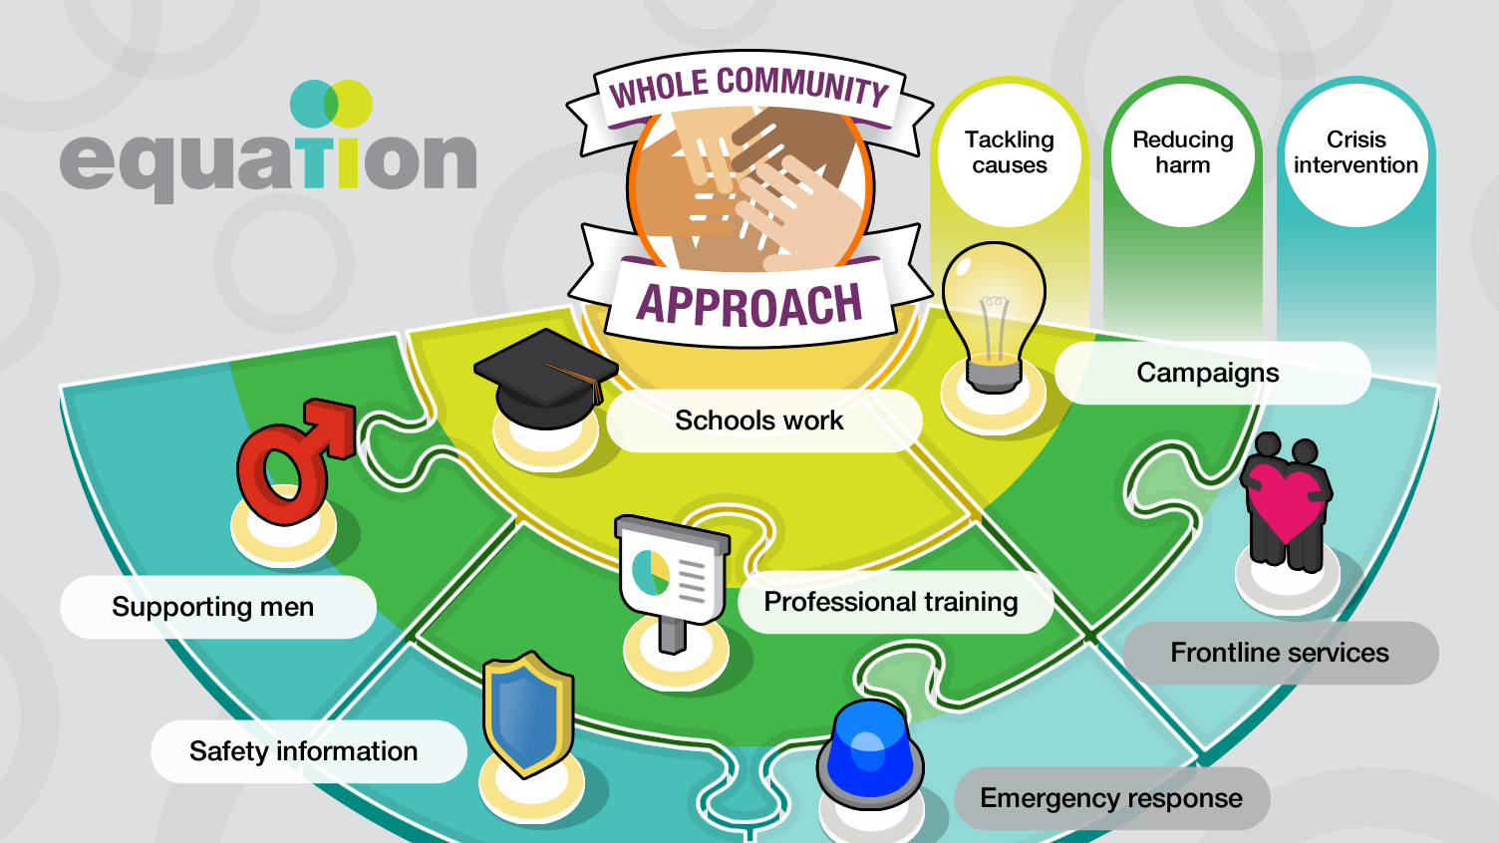

Slide 49
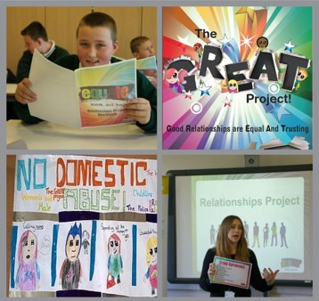

The Great Project
4-week healthy relationships course for children in year 5/6
60+ projects delivered across the City each academic year
Teacher twilight training included
Support resources provided for children living with domestic abuse

Slide 50
“This project is really valuable for our school. I think our children and wider community need this type of education. We have a lot of issues linked to domestic abuse and relationships with the children and between groups of parents. The children have thoroughly enjoyed the sessions and with a class full of children where over half of the children have experienced domestic abuse, it has been very effective in delivering clear and important messages. I will definitely be looking to take part in the project again next year as I feel it is so important for our children, school and wider community. Thank you so much.” Headteacher

Slide 51

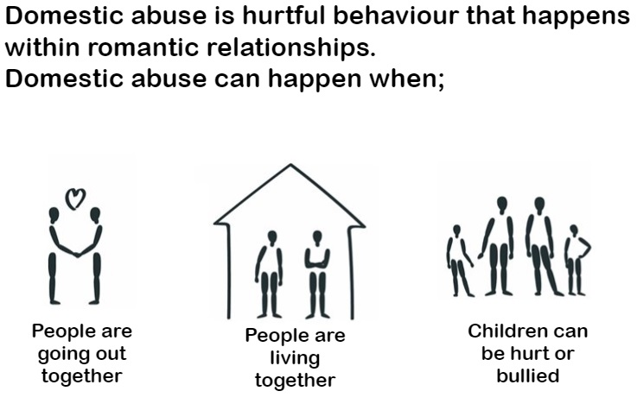
Equate
Workshops for Secondary Schools
  Healthy Relationships
  Teen Abuse
  Toxic Behaviors in Teen Relationships
  Consent
  Misogyny
  Digital Safety
  Gender Inequality

Slide 52
Teacher twilight training:
Domestic Abuse Awareness
Consent
Misogyny
Sexting/Internet Safety
Domestic Abuse in Teen Relationships
Coercive Control
Coming soon delivered in partnership with specialist organisations; CSE, FGM, Honour Based Abuse and Forced Marriage

Slide 53
Twilight Outcomes…
100% of staff stated that they agreed or strongly agreed that the training had increased their awareness of DVA
100% of staff stated that they agreed or strongly agreed that the training helped them to be more confident to talk about the DVA with pupils
93% of staff stated that they agreed or strongly agreed that the training increased awareness of support services and where to get help
100% of staff stated that they agreed or strongly agreed that the training will support staff with their roles

Slide 54
“I am the DSL of a large primary academy in highly deprived area with over 400 pupils. We have a high Child Protection Register and Looked after register. Sadly, we see domestic abuse incidents occurring regularly, and we access support from all the local services and run interventions in the academy. Your training for staff will really aid us in our work.”

Slide 55

Targeted Projects
Know More and Choices
Targeted projects for young people at risk
Small group work
8-10 weeks
Creative activities embedded throughout

Slide 56
Can I do this group next year, very week? As it has helped me feel good about myself…
Student
Choices Project

Slide 57


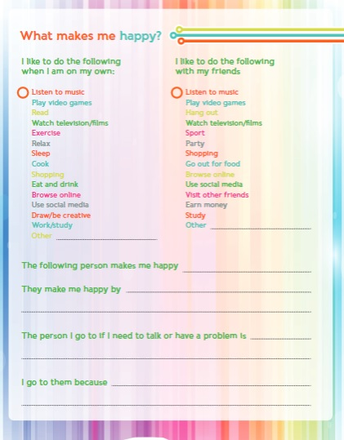
My Connections
Toolkits and resources for professionals working with young people
Aimed at those using harmful behaviours in their own relationships

Slide 58





Equation Support Resources
Order at www.equation.org.uk
Notes:
Explain that the booklets are designed to be completed by children/young people and a support worker together. Explain that as we know children and young people find it difficult to disclose. It is important that prior to completing the booklets we have thought about how we can encourage its completion.
Divide the group into four groups and ask each of the groups to consider the scenario card they have been given about a young person they are working with. How would they encourage the young person to complete the activity in the booklet? How could the activity be adapted? Would any resources other than the booklet be needed?
Ask each of the groups to come up with a plan of what they would do with their booklet and scenario. Remind them it needs to be thorough as they will all be feeding back to the rest of the group.
Bring the group together for feedback

Slide 59
Questions?

Slide 60

Equation.org.uk

Slide 61


Slide 62
Please note the national and local updates, listed below, will be sent via email in a separate PowerPoint week beginning May 31st.
National Updates:
Everyone’s Invited
National Panel – key learning
Local Updates:
Reducing Parental conflict
Way2Work Team
Domestic Abuse Bill & Encompass
Safeguarding Partnership Priorities
Safeguarding Partnership Training Officer Update
CGL
Visiting Professionals Guidance

Slide 63
Next DSL Network
13th October 2021

Slide 64


