Slide 1


DSL Network
Tuesday 15th October 2024
Notes:
Background Music for Presentations, Speeches, Lectures and Videos | 12 min (youtube.com)

Slide 2


Slide 3

DSL Network Aims and Purpose
To promote connectivity with the Nottingham City Safeguarding Children Partnership, other key local authority departments and Designated Safeguarding Leads across the city
Act as a conduit for policy updates
A network which demonstrates professional behaviours and mutual support
Sharing of pertinent local and national updates focusing on safeguarding priorities and emerging trends across the city of Nottingham
Today’s objective:
To raise awareness and understanding of the strategy discussion process and the responsibility alongside expectations of statutory agencies including educational professionals.

Slide 4
Network content-agenda
No |  | Agenda Items | Speaker
1 | 09:30-09:45 | Welcome and Outline | John Matravers, Head of Safeguarding Children’s Integrated Services-Nottingham City Council and Nicholas Lee, Director of Education Services
2 | 09:45- 10:10 | National and Local Updates | Ben Osifo, NCSCP Business Manager and Claire Maclean, School and Education Safeguarding Coordinator
4 | 10:10- 10:30 | Break
5 | 10:30-11:50 | Strategy Discussions | A Revill, Detective Inspector, R Eltoft-Prest, Acting Safeguarding Service Manager (MASH Health) and R McCrea, Acting Duty Service Manager
6 | 11:50-12:00 | Close

Slide 5

Notes:
The work we all do in safeguarding children and their families can often be very complex, difficult and impact on our wellbeing. Please ensure to take a moment if anything covered today impacts you. Please ensure that you are looking after yourself by accessing support from within your setting eg line management, supervision and by accessing external support where required.

Slide 6
National and Local Safeguarding Updates
Ben Osifo
Business Manager NCSCP
@NottinghamCSCP
Notes:
JM

Slide 7
National Safeguarding Updates
Child abuse linked to faith or belief. - Abuse linked to faith or belief is where concerns for a child’s welfare have been identified, and could be caused by, a belief in witchcraft, spirit or demonic possession, ritual or satanic abuse features; or when practices linked to faith or belief are harmful to a child.
Ritual Abuse - The term ritual abuse refers to abuse that occurs in a context where symbols or activities have superstitious, supernatural, or religious connotations
Support
The Nottingham City MASH receives referrals in respect of children where there are worries about their welfare. Multi Agency Safeguarding Children Hub (MASH) - Nottingham City Council
These Local Inter Agency Child Protection Procedures set out how organisations and individuals should work together to safeguard and promote the welfare of children and young people. Recognising Abuse and Neglect (trixonline.co.uk) see also So-Called 'Honour' Based Abuse (trixonline.co.uk)
The Guidance for Schools and Colleges created by the Metropolitan Police: Safeguarding Children from Sexual Violence, CSE and Harmful Practices has a chapter on CALFB. Guidance-for-Schools_A4_Digital.pdf (nationalfgmcentre.org.uk)
This Schools Charter encourages the delivery of high quality, safeguarding focused inputs on harmful practices. Schools-Charter_A4_Digital.pdf (nationalfgmcentre.org.uk)
How to report honour-based abuse | Nottinghamshire Police

Slide 8
National Safeguarding Updates
Children’s Commissioner – 2024 School Survey –
This survey of all schools and colleges in England aims to drive improvements in the support available to children. It asks about the support your school offers to pupils and their families, your staff roles and responsibilities, and the characteristics and vulnerabilities of your pupils.
Children Missing Education Report - these children are more likely to have a special educational need, more likely to have a social worker, and more likely to be from a deprived neighbourhood.
UKHSA warns of back to school measles surge -

Slide 9


Notes:
The 2021 census identified 66,000 children under the age of eighteen live in the City of Nottingham, this is 20.3% of the total population. Of those children aged under 18, 34.2% are affected by income deprivation. Nottingham City’s children face a number of challenges including income deprivation and poverty. 42.7% of Nottingham’s population are from Black or Other Minority Ethnic groups, an increase since 2011 when the percentage was 34.6%. 59.1% of school age pupils are classed as BME, this was 57.2% in 2022.

Slide 11
RAPID REVIEW: Case Summary & Learning Points
SIN (Serious Incident Notification)
Police were called to an address following concerns raised by a neighbour reporting flies on the window and a smell coming from the house and that the inhabitants had not been seen for some time. Officers attending the address forced entry into the property after no reply was given and having looked through an upstairs window saw a person believed collapsed.
Once in the property it was evident that both child and mother were deceased. Inside the property it was apparent that both had been deceased for some time with a view that this may have been for several weeks.
Deceased child was a seventeen-year-old girl who lived with her mother. The family had moved to the UK in 2016. The child had Down Syndrome with severe intellectual disability, which meant she required ongoing support to meet her basic needs. She was very much reliant on family and service support to meet her basic needs, keep her safe and to allow her to thrive.
Summary of concerns highlighted in the review:
All professionals involved with the family were aware of some concerns in relation to neglect; these concerns particularly related to home conditions, lack of access to essential services such as education and health appointments. Child was subject to a child protection plan due to the concerns about neglect.
The pattern of non-engagement and limited access to the property meant the concerns in relation the home conditions were not addressed although on occasion when police and social care were able to access the home, the conditions were observed to be ‘good enough.’
In relation to health care, there had been an improvement in child being brought to appointments and it was felt her basic health needs were being met.
Child’s education needs were not being met and this followed a long pattern of poor school attendance which did not improve despite intervention from Children’s Social Care and Education Welfare services. By the time the child had opened for her most recent period of social care intervention she was past the age of statutory school attendance and while it was recognised as a concern, professionals were unable to take more decisive action in this area.
Next Steps:
Following a completed Rapid Review the recommendations developed have been turned into a smart action plan. The national panel supporting the RR decision to undertake a LCSPR (Local Childrens Safeguarding Practice Review). An Independent Reviewer has been recruited to lead on this with a report due in December 2024
Notes:
When her mother died unexpectedly at home, she did not know how to call for help or feed herself properly. It is presumed (subject to coroner findings) that she died close to three weeks later, possibly of dehydration and starvation. It was not clear if the child was an adult or a child at the time of death, although current evidence suggests that she was most likely a child. Therefore, due to her vulnerabilities and estimated date of death the partnership agreed that the case reached the threshold for a Rapid Review through the lens of children’s services.

Slide 12

Some Highlights
Started a quarterly publication of the partnership Newsletter.
Set up our social media pages on YouTube and X
Launched our refreshed Threshold of Need guidance.
Launched a revised Neglect guidance and toolkit.
Launched Neglect animation videos.
Launched our Early Help website alongside an Early Help Strategy
Established a dedicated Education Subgroup
Launched Professional Curiosity animation linked to Domestic Homicide Reviews

Slide 13
Local updates
Statutory Guidance/ Updates
Common Transfer File
Safeguarding in Education training programme 2024-2025
Local Safeguarding Partnership Audit- Section 175/157
LADO
Social Care Cluster meetings
Community Safety
Safety planning- Education and Youth Justice Service (YJS)

Slide 14
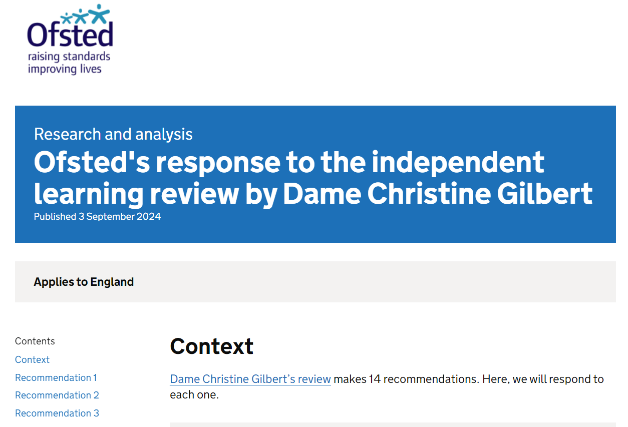
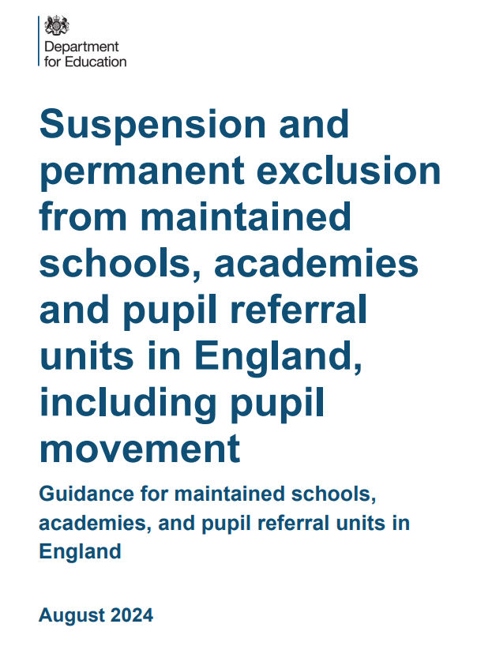

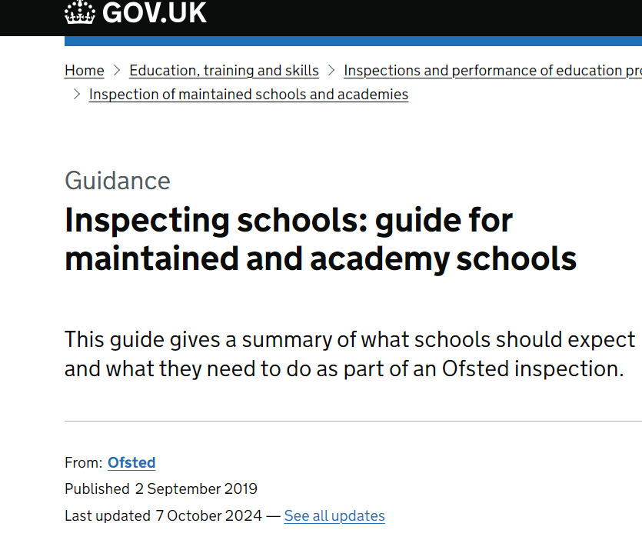
Keeping Children Safe in Education 2024 does not contain major systemic changes – these have been deferred to next year. Ministers decided this year’s guidance should contain only “technical changes… with a view to providing a more substantively updated document, encompassing wider changes, to be delivered in 2025".
Notes:
Lots of material under review and released that is of relevance to our safeguarding functions eg gender questioning- possibly expected updates late spring/summer 2025.
JAY review - The Jay Review of Criminally Exploited Children | Action For Children

Slide 15
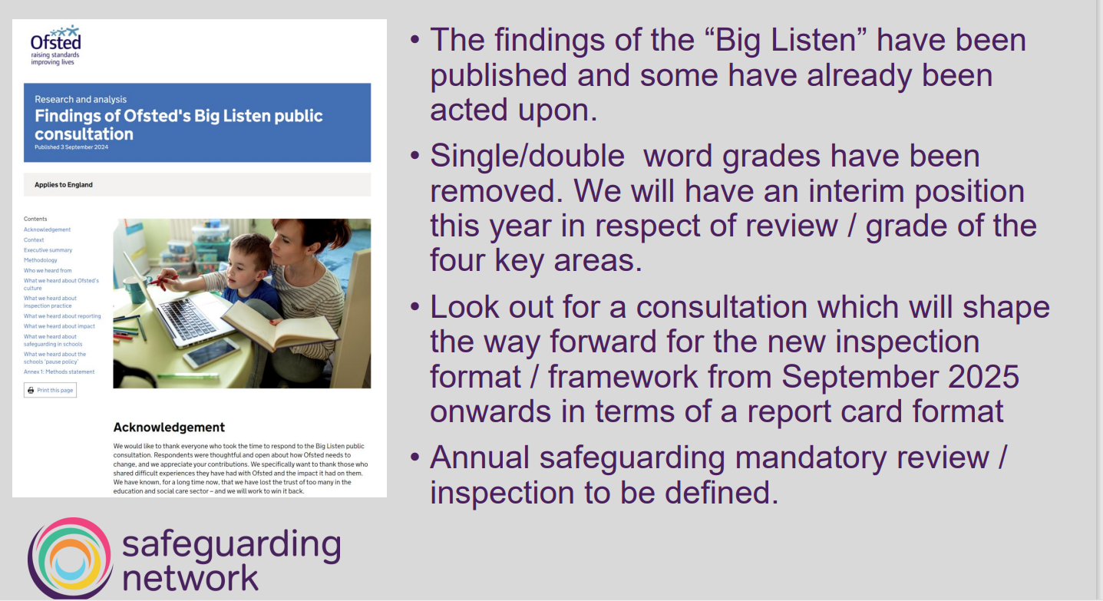

Slide 16
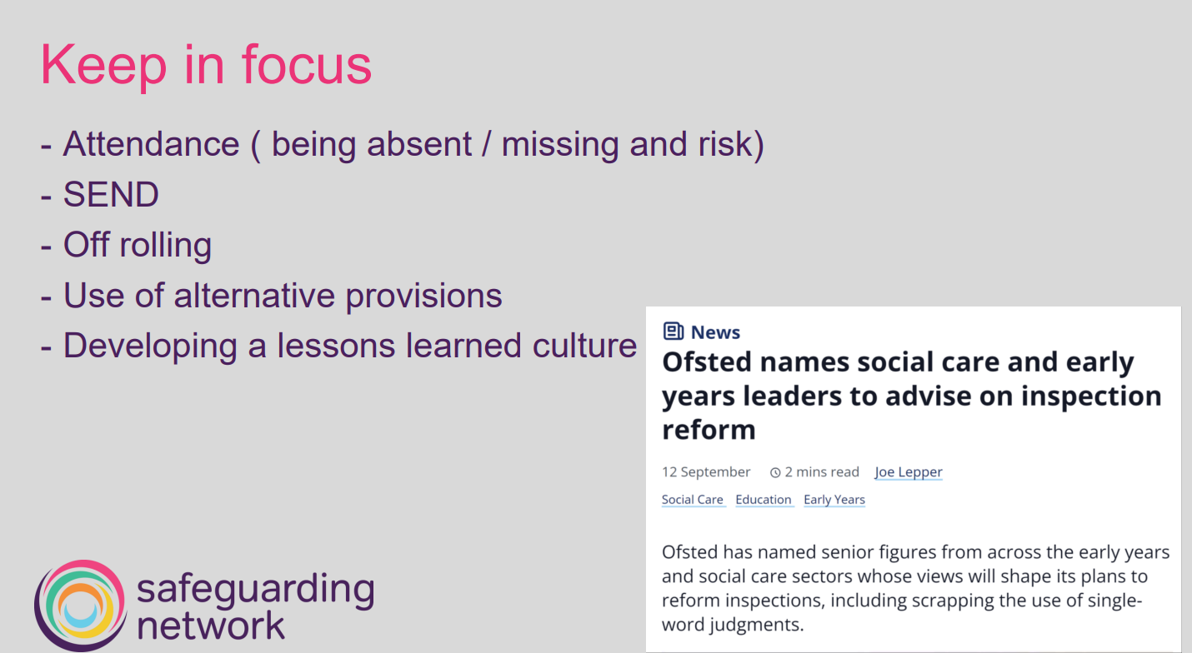

Slide 17
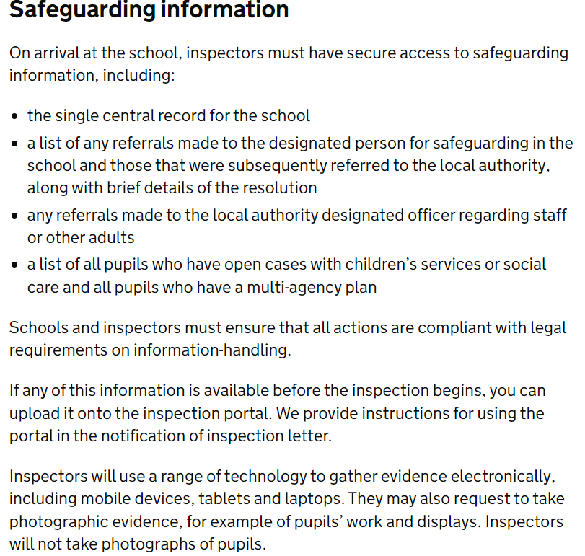
Statutory guidance and Updates
Keeping children safe in education - GOV.UK (www.gov.uk)
Working together to improve school attendance - GOV.UK (www.gov.uk)
Children missing education - GOV.UK (www.gov.uk)
Elective home education - GOV.UK (www.gov.uk)
Inspecting schools: guide for maintained and academy schools - GOV.UK (www.gov.uk)
The Jay Review of Criminally Exploited Children | Action For Children
Findings of Ofsted's Big Listen public consultation - GOV.UK (www.gov.uk)
Ofsted's response to the independent learning review by Dame Christine Gilbert - GOV.UK (www.gov.uk)
Notes:
There is a wealth of updates made to statutory guidance impacting the work of the DSL- please ensure you are working with the latest guidance.
The Inspecting Schools guidance was released on 07th October 2024- ensure all are aware of the safeguarding section specifically.
Inspecting schools: guide for maintained and academy schools - GOV.UK (www.gov.uk)

Slide 18
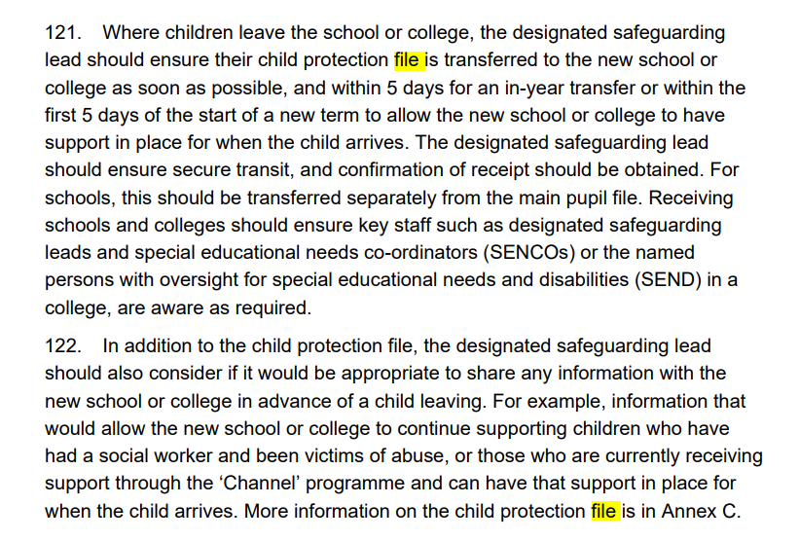
Common Transfer File
Notes:
Please ensure that you have chased all files required and read, actioned where required. It is imperative to ensure that the child has consistent care and needs to be met by this transfer process as part of an inclusive safeguarding function where any child new to your setting arrives whether that be at the start of a new year/term or in year admission. Challenge where required as not acceptable to not have all files within the specified 5-day timeframe.

Slide 19
Safeguarding in Education training offer
We have a range of courses available through the partnership safeguarding in education training programme including Introduction to Safeguarding and Child Protection and a 2-day Designated Safeguarding Lead course also for all professionals new to the DSL role or requiring renewal of their previous validation(DSL Update course- half day).
Please do visit our website for all course dates and be sure to book in advance as courses fill up very fast. All courses are free and available to staff working within our city settings only.
Safeguarding Training - Nottingham City Council
*A reminder that it is the staff/settings responsibility to maintain an accurate training record for all staff and ensure that it is in date
**We offer a Train the Trainer course which we recommend a minimum of 2 professionals from each setting complete to receive annual training material from the partnership for internal delivery/use only by the professional completing the course- see our programme for further information
Notes:
The Safeguarding in Education training programme can be found on the Nottingham Schools website – it is the school's responsibility to maintain an accurate training record and ensure all staff’s training is maintained and kept up to date
Where a delegate does not meet the course prerequisite we cannot allow onto the course
Where DSL training certification has expired we cannot allow completion of any relevant DSL Update and professionals will have to complete full DSL training again
Please do contact safeguardingineducation@nottinghamcity.gov.uk for any queries re training and certificates

Slide 20
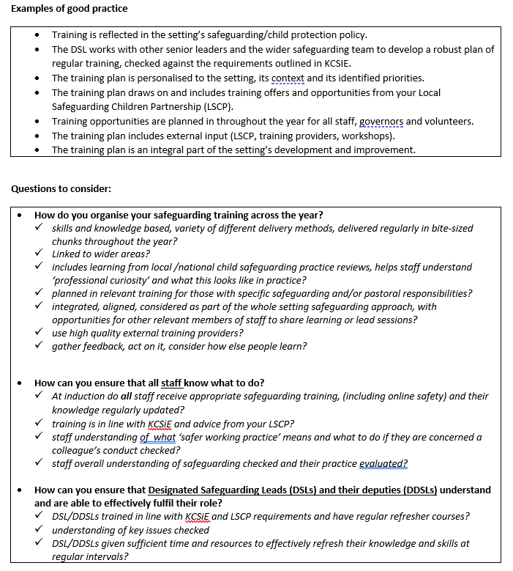
Safeguarding training
Please ensure that your whole staff safeguarding training needs are mapped out for the year ahead. This includes a review of:
How often your whole body of staff including governors and trustees access Introduction to Safeguarding (we recommend every 3 years)
Dates of all DDSL’s and DSL training expiration and advance booking of relevant course to ensure training is in date and maintained (DSL 1 and 2 valid for 2 years however advisory to complete this course in full after several years, according to need)
How and where is safeguarding training recorded?
KCSIE annual update- how do you gain assurance that all staff have read and understood their responsibilities?
What does safeguarding training look like within your setting e.g. who accesses what, contextual themes etc
Notes:
Nottingham Schools - Nottingham City Council- NCSCP training programme can be found on the Nottingham Schools website.

Slide 21

Local Safeguarding Partnership Audit
Thank you to all schools that completed the audit.
Some common themes/asks that are currently being reviewed are:
Allegations Management training
Development of safety planning support in collaboration with the Youth Justice Service
FGM training
Exploitation- review of referral process (toolkit) and training for statutory partners including education
Notes:
Work is now being undertaken to analyse the data input from our schools and review the current Safeguarding in Education offer to schools- annual report to follow in due course alongside new training offers.

Slide 22
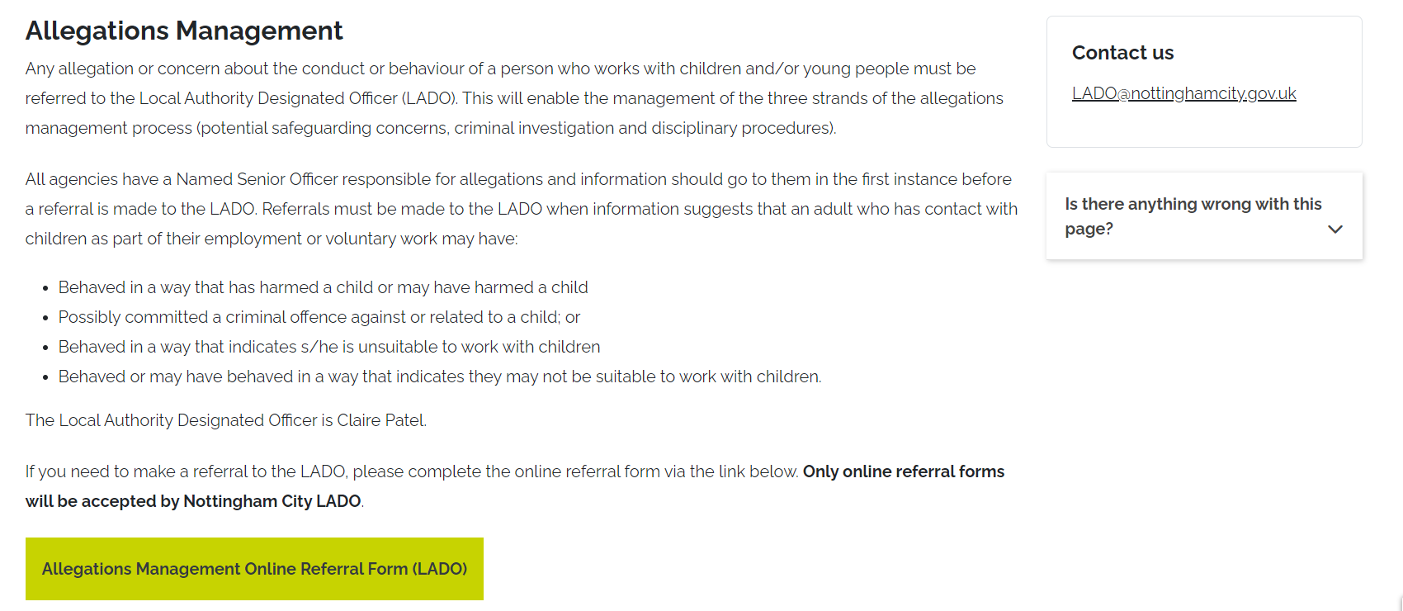
LADO
Notes:
A reminder that all allegations are to be reported via the online referral form. Low level concerns should be recorded In line with your settings policy and process. The referral form can be accessed by visiting the Nottingham City Safeguarding Children Partnership website under the ‘LADO’ tab.

Slide 23
Cluster meetings
Nicole Harris – Head of Service
John Carter Service Manager Central | Caroline Vallelly Service Manager North | Tracy Hayden Service Manager South
Michelle Frost Radford/Arboretum/Park | Thomas Beesley Basford/Berridge/Sherwood (b) | Ian Joddrell St Anns
Jodie Stephanou Bilborough | Lisa Statham Basford/Berridge/Sherwood (a) | Nicky Lee Sneinton/Mapperley Dales
Julie French LCS - Aspley/Leen Valley (a) | Sophie Gilby Bulwell | Carol Glaister Clifton
Kate Tolentino Aspley/Leen Valley (b) | Laura Cresci Bulwell Forest
 | Shared between the above teams. Meadows/Bridge Lenton and Wollaton East
Purpose of meeting:
The primary function of the meeting is to improve communication between schools and Social Care and review and monitor complex and high profile cases.
*Please note that all cluster meetings are currently held online via MS Teams- link to be sent by each lead professional named on the chart displayed on this slide. If you need to contact for meeting invite please use one of the contacts under the relevant locality Service Manager.

Slide 24
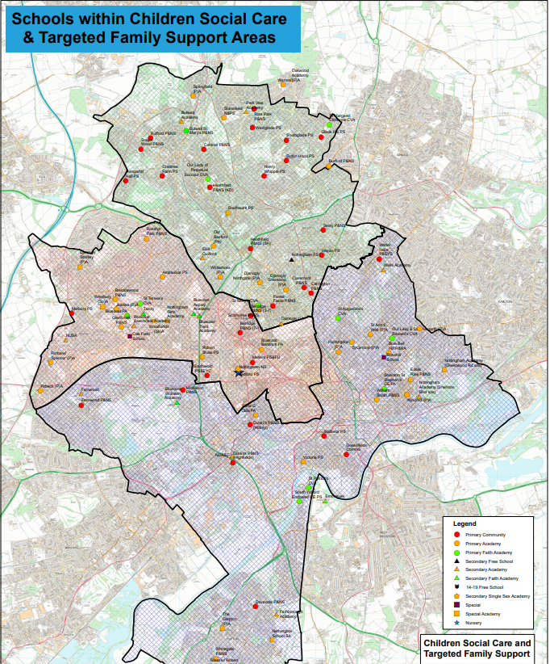
Cluster meetings
Central cluster dates:
November 26th 2024- 09.30-11am
February 04th 2025 09.30-11am
April 29th 2025 09.30-11am
North cluster dates:
Wednesday 06th November 1.30-3pm
South cluster dates:
Clifton and Meadows
29/01/25 - 10-11am
30/04/25 – 10-11am
23/07/25 – 10-11am
St Anns and Sneinton
22/01/25 - 10-11am
23/04/25 – 10-11am
16/07/25 – 10-11am
A reminder that the map identifying school location in each cluster region can be found by visiting Cluster map

Slide 25
Community Safety guidance
Community safety
We occasionally see and hear of safeguarding and road safety incidents near some of our schools. More specifically incidents where strange vans hover and unknown adults behave badly including what appears to be trying to tempt children into cars etc. These are clearly a significant concern to your school especially if they are arising on the way to and from school. In terms of sharing information, we would hope you can follow these steps in the rare event this happens.
Please try and get as much information about the incident and report directly to the police. Please do not rely on any rumours, we have seen sometimes parents posting something on Facebook which becomes embellished and has little or no evidence. However please let the police know of your concerns. (Call 999 or 101 or call your community officer)
Please also let NCC know about the incident, email into CP.BDU@nottinghamcity.gov.uk and copy in Claire Maclean, School and Education Safeguarding Coordinator
NCC will ensure that Community Protection, Education and Children’s services are aware of the incident and they will discuss your case with the police to get best advice and actions in place. That discussion will look at how to improve protection and manage the situation, maybe increase patrols etc. They may contact you directly. Education will then let you know anything further that you might need to know or actions for your school to take. They will also send out any wider information to help inform heads in nearby local schools and what needs to be communicated to the parents and carers. This might be for example
  A letter to send out to families in all schools in the City from the Police
  A letter to send out to families in the local area via schools ( from the police or NCC)
  Information about incidents for Senior staff to know about but suggesting no further dissemination
  Simply no further action
It is often difficult to balance reassurances and the necessary alarm, but this way we hope to tread that path sensibly and give you confidence in the action and information you pass on to families and ensure proper protection of children, young people and their families in the City.
Notes:
Many of you will be aware of the above guidance sent out previously. Please can we remind all settings that any single incidences of concern (step 1 above) should be managed at a local policing level initially via your school-based police officer. Should there be ongoing/increased risk and concern then please do follow step 2 as additional action, detailed above.

Slide 26
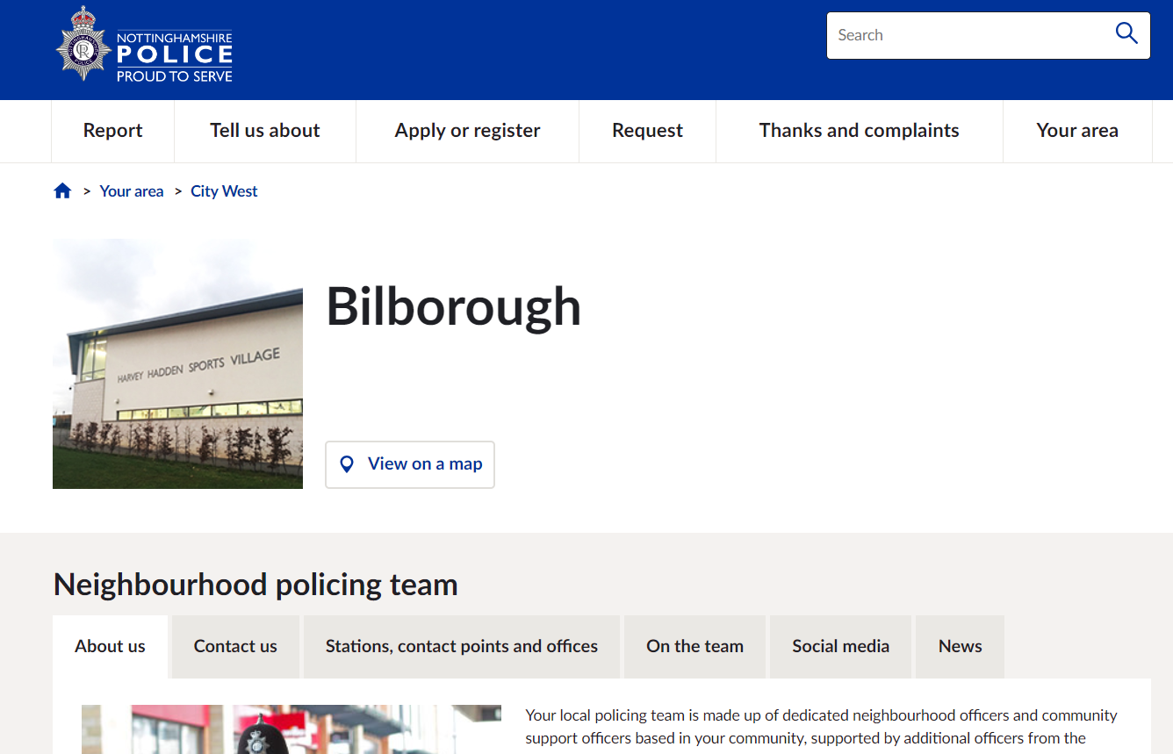
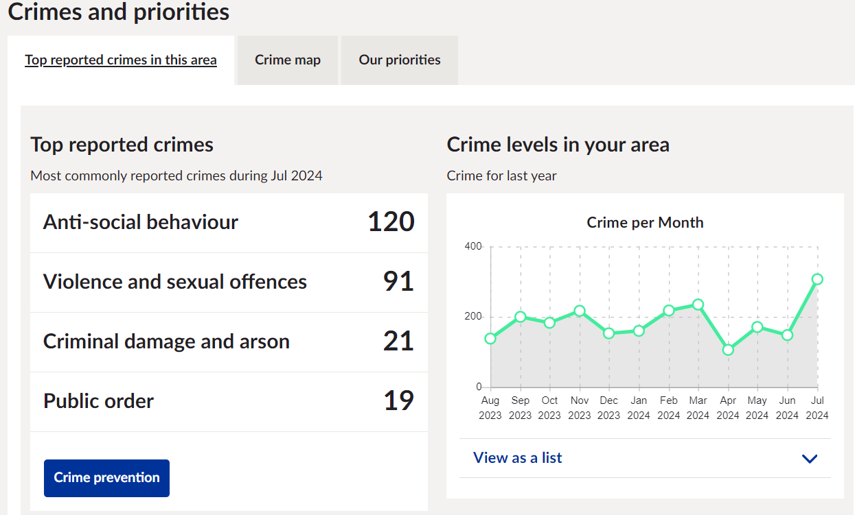
Community Safety
Your area | Nottinghamshire Police
Notes:
Access link on slide and type your school postcode to source local contacts for officers in your area- pro-active contact where you feel support is required unless emergency where relevant agency should be contacted without delay.

Slide 27
Serious Violence in Schools Assessment – City Focus
Following consultation with partners, the scope of the original ‘knife crime in schools’ assessment was widened to encompass a broader scope of serious violence.
As well as looking at knife crime and possession, the assessment also looked to find hotspots for assault with injury and sexual assault that occurred and involved a victim and an offender aged between 11 and 17.
Key findings relating to Nottingham City included:
Nottingham City overall accounted for the majority of ‘youth’ knife possession, with hotspots in Bulwell and Market Square. Bulwell Forest had the highest proportion of knife possession that involved an offender aged 11-17, at 48%, compared to 21% across the whole of Nottinghamshire.
Bilborough was a hotspot for assaults with injury between young people within education settings.
Of the 36 Nottingham City schools, 21 had a knife possession, 6 had a knife enabled crime, 29 had assaults and 13 sexual assault, involving a victim and offender aged between 11 and 17, within 400m of the school.
The top 2 schools across the whole of Nottinghamshire that had the highest volumes of serious violence within a 400m radius of the school were both in Nottingham City Centre.
Of note, anecdotal insight from partners has highlighted an emerging trend of young girls meeting in the City Centre, with conflict and assaults occurring between groups. Many of the girls had previous experiences as a witness or victim of violence, and cannabis use and associated ASB was also found to be a linking factor.

Slide 28
Website update
There are two main websites held by the local authority that will be key to supporting the role of the DSL-
1- Nottingham City Safeguarding Children Partnership- www.nottinghamcity.gov.uk/ncscp
2- Nottingham Schools- www.nottinghamschools.org.uk
Notes:
The Nottingham Schools website is where you can find key resources including the Nottingham City template Safeguarding and Child Protection Policy, training programme, DBS letter for all Nottingham City employees to allow access to your setting as well as the DSL Network booking page.
The NCSCP website will provide lots of vital information for the DSL on partnership policy and procedures documents including escalation process, threshold of need document, LADO threshold and City MASH e-form.

Slide 29
Education Subgroup
Purpose and Activity
The Education Subgroup is responsible for working on behalf of the Safeguarding Partnership to promote good safeguarding practice and keeping children safe across the education sector. The primary objectives of the Education Subgroup will be to help:
Co-ordinate what is done across the education sector for the purposes of safeguarding and promoting the welfare of children; and
Ensure the effectiveness of what is done, through quality assurance of local safeguarding arrangements in education settings.
Ensuring education voice and views are heard at SLG & BMG and included with respect to priority setting and strategic decision making.
Ensure education is represented and engaged in all areas of safeguarding including sub-groups and task finish groups
To promote education engagement within the safeguarding partnership
Notes:
Formed late last academic year and seen a very prompt and productive start from all members. The DfE have approached us to act as a case study for other LA’s as they look to create policy and guidance to support LA’s where they have yet to set up an education subgroup.
There is a clear Terms of Reference ad purpose of the group – summary on slide above.

Slide 30



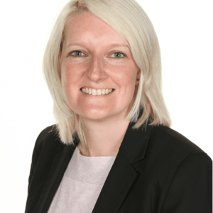

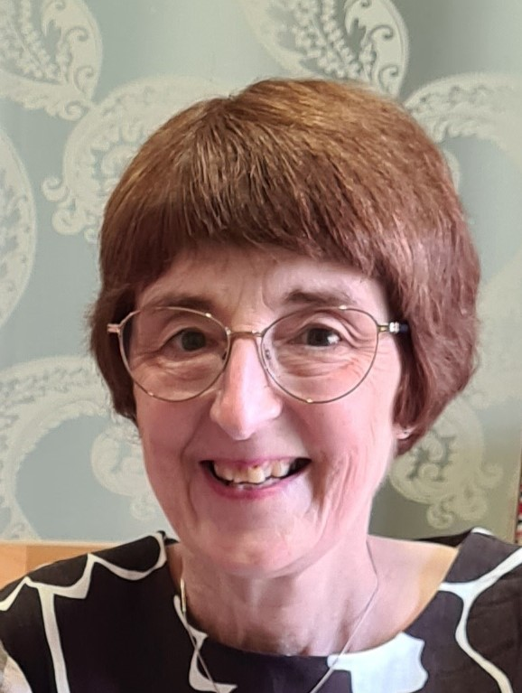
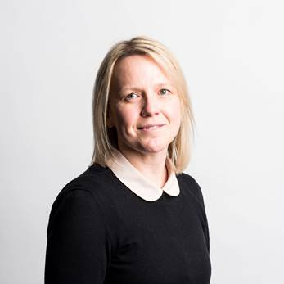
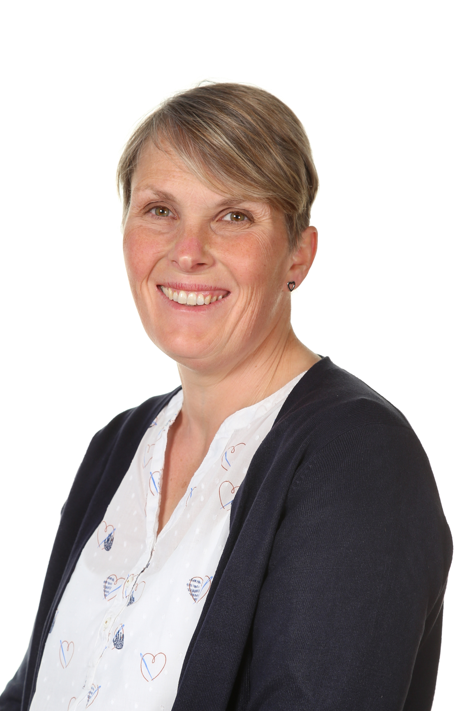
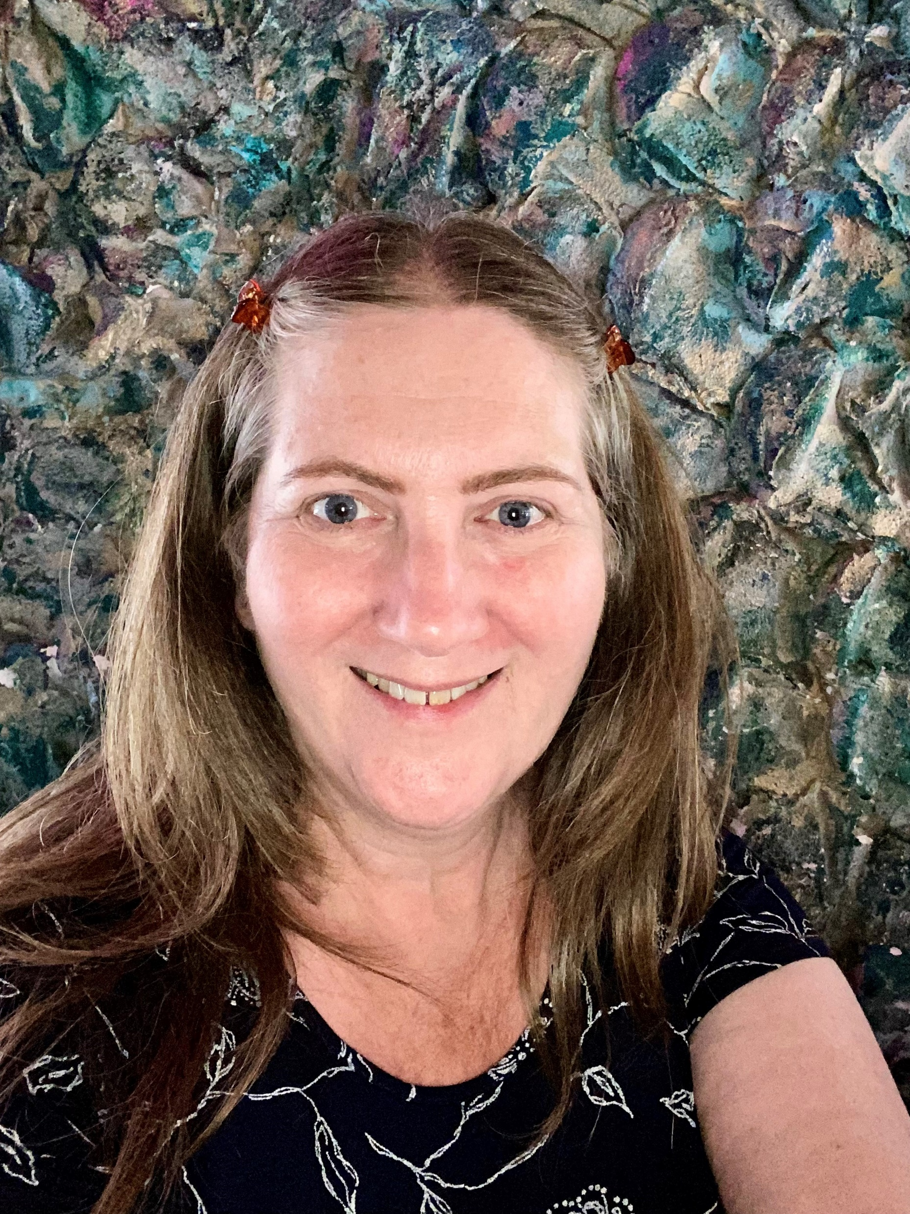

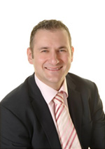
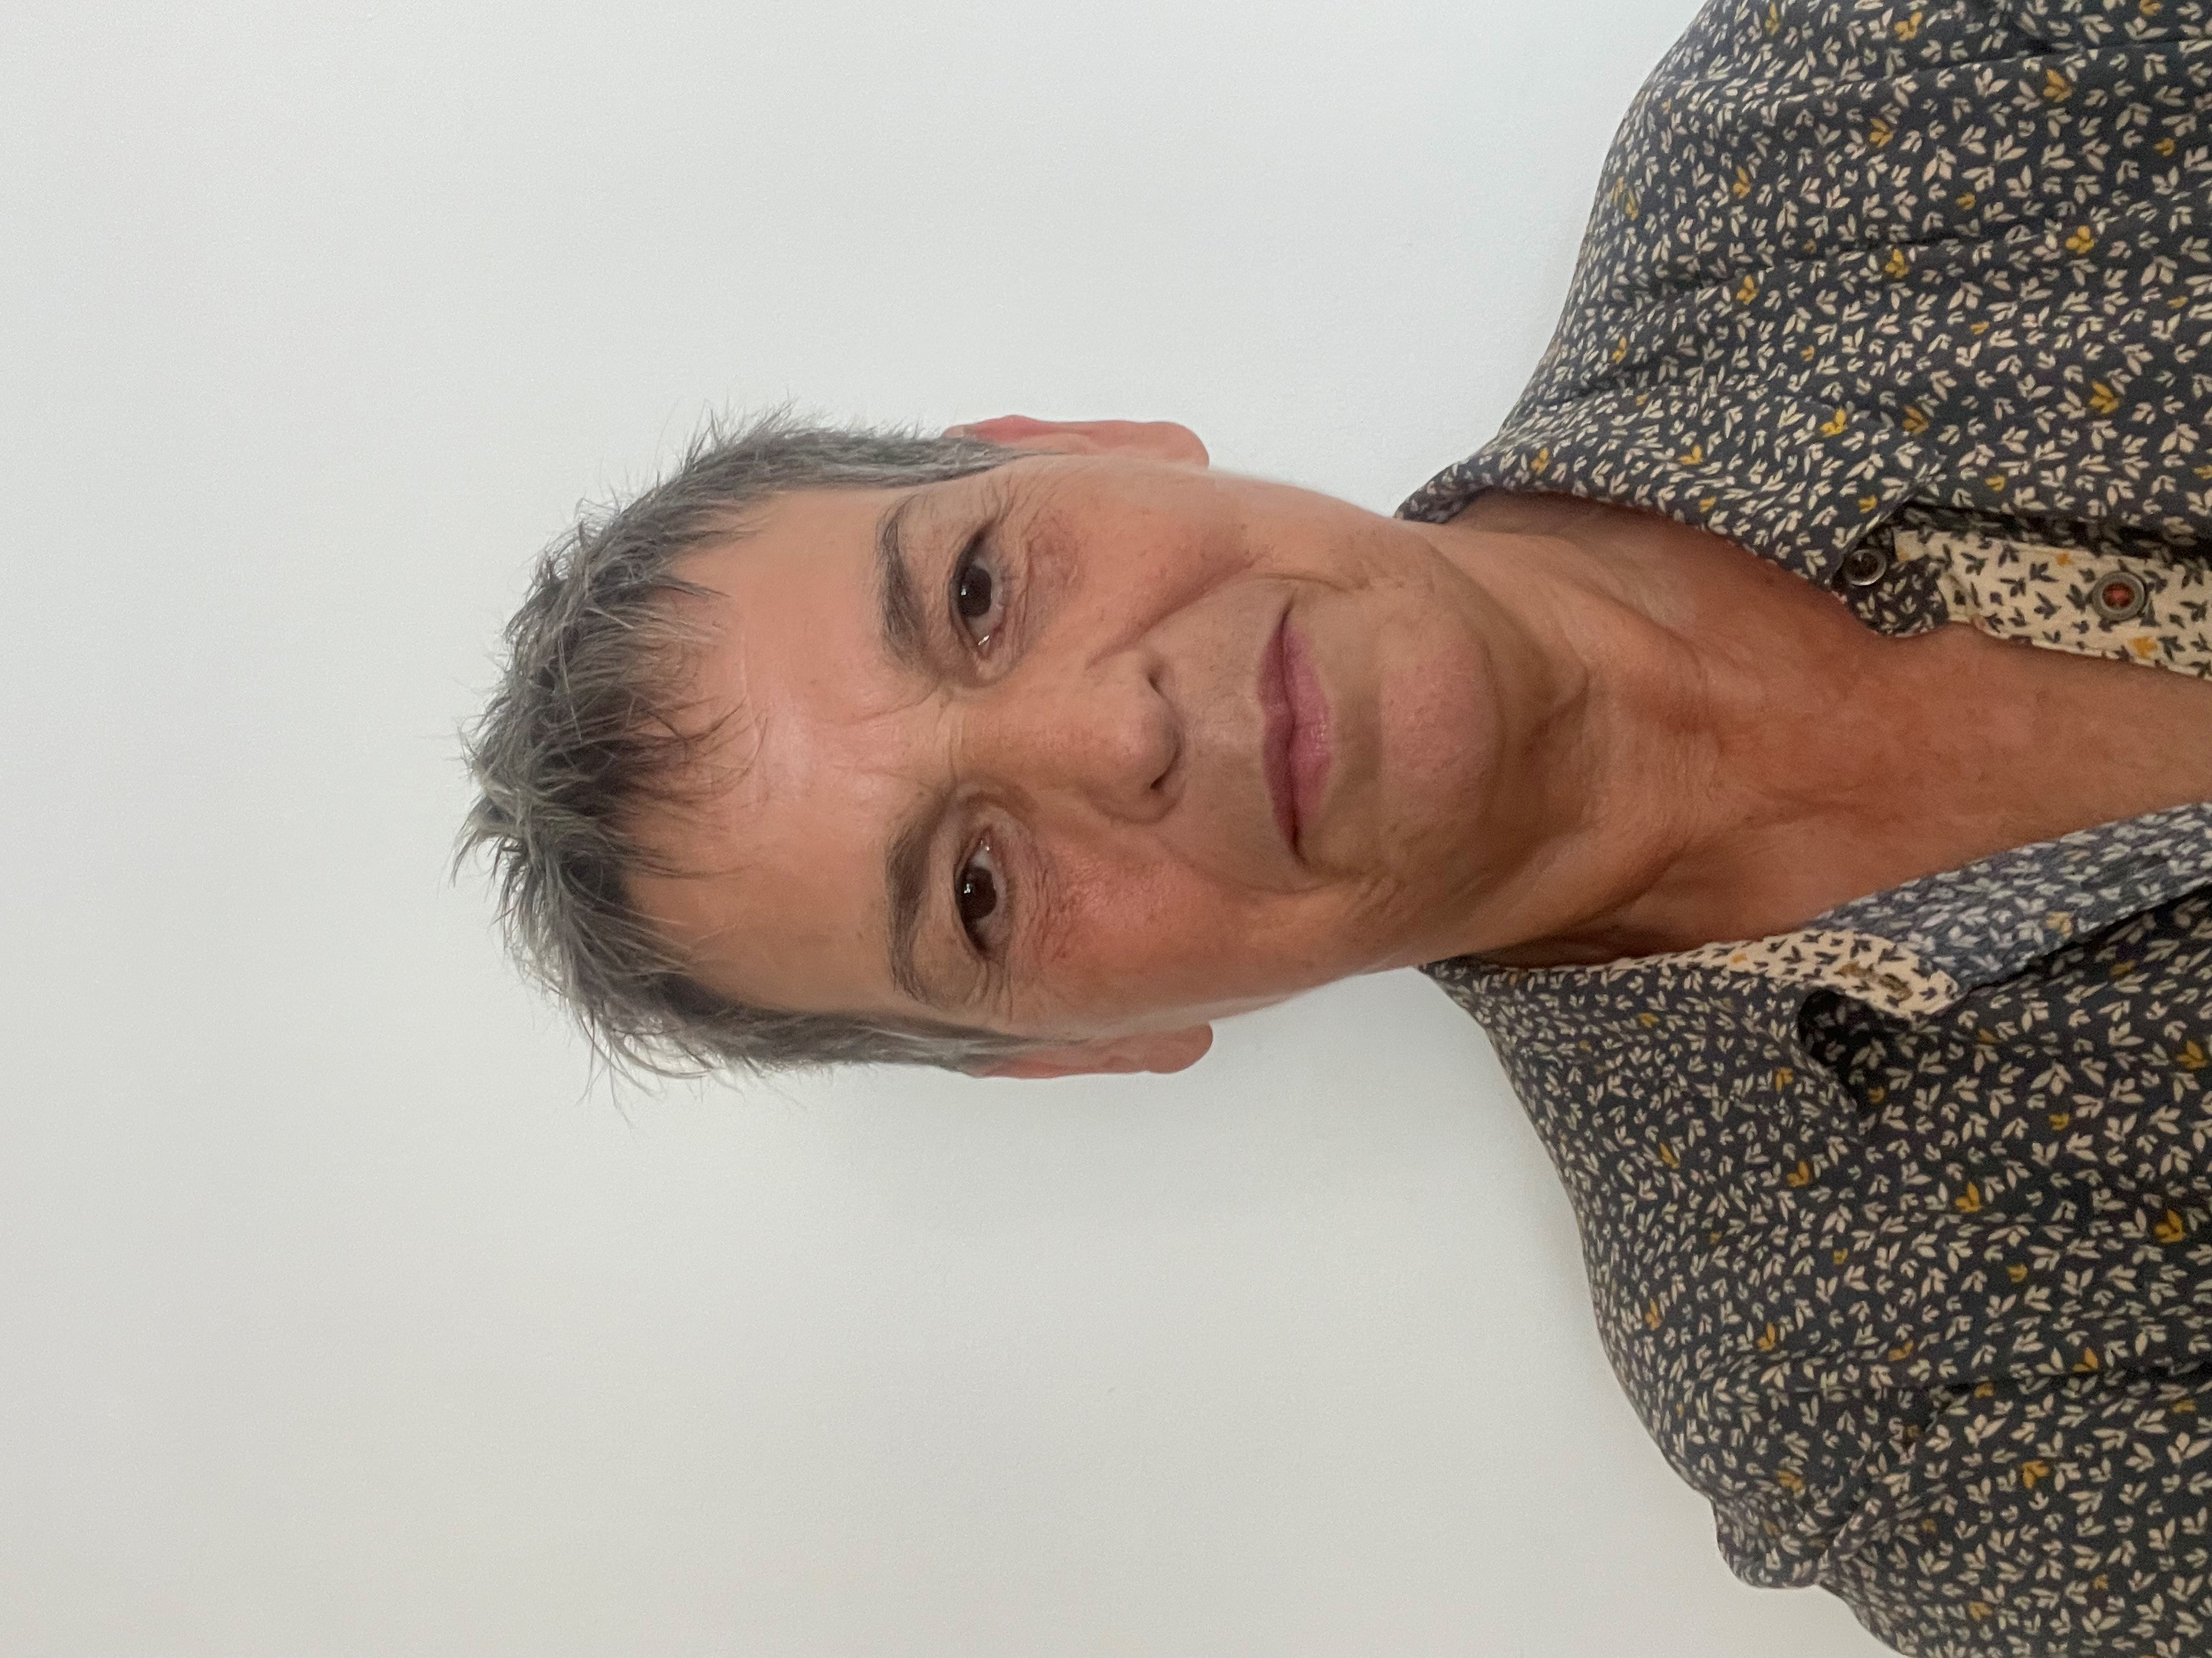
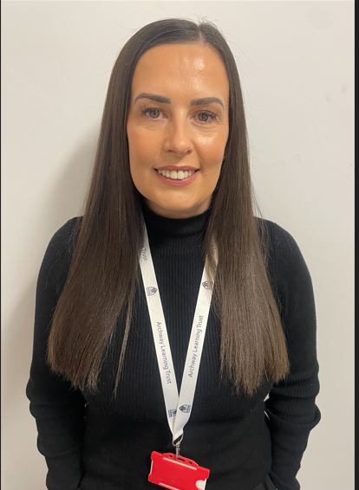
Education Subgroup members
There are over 25 subgroup members which cover the depth and breadth of the education sector including post 16 expertise. The subgroup are wanting further input from the education sector to shape what we explore as a group dedicated to enhancing safeguarding across the city- please contact us if you have any ideas!
Notes:
Currently there are 28 subgroup members covering the primary, secondary and early years sector, housing, community safety, CGL, police, public health, ICB and Futures post 16 support.
Task and Finish work already started includes work on strengthening process of information sharing between health and education eg where a Health Care Plan is required and Education Neglect policy development by the local authority.
If you have any thoughts, ideas about agenda items that you believe the subgroup should be exploring then please do contact Claire Maclean or Jo Rowlett, Education Subgroup Vice Chairs.

Slide 31
Education updates
New Head of SEND has joined Nottingham City Council – Mark Joshi, mark.joshi@nottinghamcity.gov.uk
Former Education Welfare Service Manager has left and the new Service Manager will be Sophie Coldrick. However, Sophie is currently on maternity leave so the role is being covered by the management team in that service area plus the Head of Service – Jennifer Hardy, Jennifer.hardy@nottinghamcity.gov.uk
A weekly complex case panel meeting is held in Education every Monday and this panel considers children at risk of non attendance, permanent exclusion or SEN placement breakdown. When the panel is fully up and running, schools will be able to refer to this panel and the enquiry will be triaged as appropriate. Currently, the first referral route is for children not attending school due to their health needs and cases can be referred through the ‘Section 19’ form which has been shared with schools. The complex case process is managed by Anna Glozier and the referral email address is educationcomplexcase@nottinghamcity.gov.uk
Education and Children’s colleagues are working with schools and the Education Sub Group of the Safeguarding Partnership to develop an Educational Neglect policy – which will be shared with schools this term.

Slide 32

Youth Justice Service (YJS)
More structured and consistent communication process informed by Working together to safeguard children 2023
Proforma template to be sent to schools as soon as the child becomes known to YJS to support provision of key information:
  Reason for YJS involvement
  School knowledge of:
  - attendance - behaviour - academic abilities
  - SEND - pastoral support - exclusions
  - Timetable - relationships with peers/adults
Joint approach to safety planning and risk management including 3-way meetings
Develop better understanding of roles and responsibilities across YJS/education
Notes:
The Youth Justice Service (YJS) and education rep have been working together to enhance ways that they support children known to their services. A key focus has been on reviewing how information Is shared between both agencies to allow for a more structured and consistent communication process where a child is known to both parties and information sharing is required to safeguarding the child effectively.
The process of sharing information already exists however not all schools contact YJS for information in the same way and therefore a proforma has been devised to help with information sharing between both agencies and support schools with safety planning where a child may require this to keep them/others safe and address any potential barriers/risks posed.
Section 1 of the attached is to be filled in by YJS and sent to the education provider.
DSL will then fill in section 2 and send back to the YJS.
YJS then fill in section 3 and 4 via a 3 way meeting where any concerns or queries can be discussed to support and compliment the work of both agencies with the child involved.

Slide 33

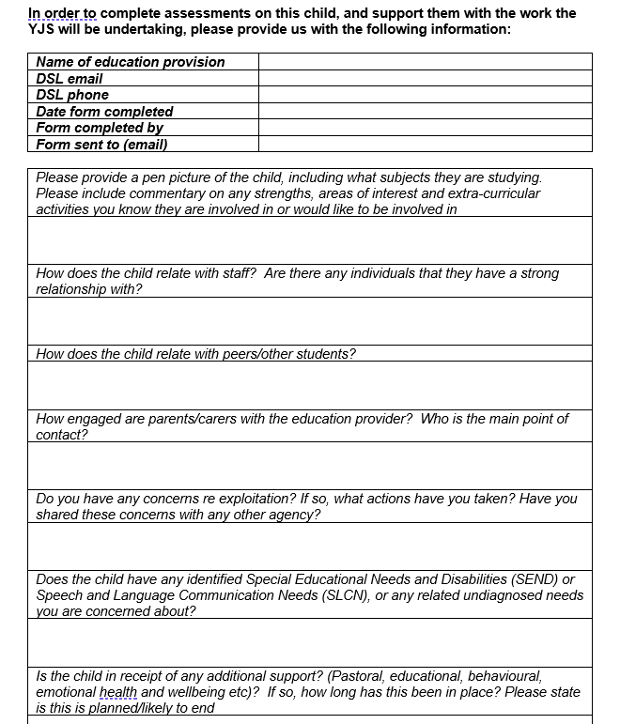

Slide 34
YJS contacts and referrals
For enquiries about this process, a specific child, or for information advice and guidance:
  Look at our website https://www.nottinghamcity.gov.uk/information-for-residents/children-and-families/welcome-to-the-youth-justice-service/
  Email Thomas.Cullen@nottinghamcity.gov.uk or call 07432 721245
To enquire about, or make a referral to the YJS Prevention service (Targeted Youth Support):
  Email EVRHub@nottinghamcity.gov.uk or call 0115 9159400 to speak to Kirsty Davison
For other queries:
  Email YJS@Nottinghamcity.gov.uk or call to speak to our Duty officer/Business support on 0115 9159400
Notes:
Treat Thomas Cullen as your single point of contact at City YJS
Referrals to TYS are usually via a MARF and referred on to YJS by City MASH, or come direct from the Police. However, you may wish to check if a child has been referred on to YJS, or you may have additional information that may support a referral. In this case please do contact @EVR mailbox or ring Kirsty directly.

Slide 35

Questions

Slide 36
BREAK

Slide 37

Strategy Discussions

Slide 38
Detective Inspector Amy Revill
Multi-Agency Safeguarding Hub (MASH) and Internet Child Exploitation Team (ICET)
Rachel Eltoft-Prest
Acting Safeguarding Service Manager (MASH Health)
Richard McCrea
Interim Service Management Duty and Assessment

Slide 39
Learning Objectives
What is a strategy discussion?
How can Education assist to achieve the best outcomes?
The life of a referral to social care?

Slide 40
Nottingham City Multi Agency Safeguarding Hub (MASH)
Overview of City MASH
  Integrated service focused on safeguarding children and young people
  Comines information sharing to identify risks and strengths in families
  Ensures timely and proportionate interventions to enhance safety
  Key Partner Agencies: Co-located team includes: Police, Health Services, Children’s Integrated Services and Probation
Benefits of Integrated Approach
Enhances communication between agencies.
Promotes a comprehensive understanding of each child's situation.
Maximizes the effectiveness of interventions to ensure child safety.
Notes:
Nottingham City Multi Agency Safeguarding (Children) Hub is a service where, through integrated information sharing, risk/harm is identified alongside mitigating the family’s strengths, and timely, proportionate interventions are made which keep children and young people safe.
City MASH is a team of co-located Safeguarding Partner Agencies, these being the Police, Health and Children’s Integrated Services, Probation, with support from CGL (Young Person Drug Service), Juno (Women’s Aid) and several virtual partners to include Youth Justice Service, Housing Aid. The City MASH will accept referrals about Children and Young People where there are worries about their welfare
The purpose of City MASH is to ensure that all referrals in respect of children and young people into Nottingham City Council Children Services are responded to in a timely and consistent manner so that children and their families receive high quality information/advice and, where necessary, support and protection from children’s services and other agencies/professionals.
City MASH plays a crucial role in safeguarding and promoting the welfare of children and young people in Nottingham.
Collaborative efforts lead to better outcomes for families and communities.

Slide 41
Working Together 2023: Strategy Discussion
Where information gathered during an assessment result in the lead practitioner and social work qualified practice supervisor or manager suspecting that the child is suffering or likely to suffer significant harm, the local authority should hold a strategy discussion to enable it to decide, with other agencies, whether it must initiate enquiries under section 47 of the Children Act 1989. (Working Together to Safeguard Children 2023)
This might take the form of a multi-agency meeting or phone calls and more than one discussion may be necessary.
A strategy discussion can take place following a referral or at any other time, including during the assessment process and when new information is received on an already open case.

Slide 42
When to convene a Strategy Discussion
Where the is reasonable cause to suspect that a child or unborn child is suffering, or is likely to suffer, significant harm
A strategy discussion is co-ordinated and chaired by a Children’s Social Care Team Manager – this can be from the Emergency Duty Team, Assessment Service, Fieldwork Services, Looked after Team and Children’s Disability Team

Slide 43
What is the purpose of a Strategy Discussion?
The purpose is to share relevant information on the child/family, in order to achieve a multi-agency decision regarding threshold for S.47 Enquiries and to co-ordinate a timely response.
Section 47 of the Children Act 1989 in the UK allows local authorities to investigate when there's reasonable cause to suspect that a child is suffering, or is likely to suffer, significant harm.
Threshold of needs document details level’s of need, it is not a definative list but provides examples.
Agree to undertake either a single or joint Social Care/Police investigation (S.47 Enquiries)
Notes:
Significant harm refers to the level of maltreatment or neglect that justifies intervention to protect a child, indicating that the child's health or development is severely impaired or at serious risk. It encompasses physical, emotional, or sexual abuse, as well as chronic neglect.
Physical Abuse: Injuries such as bruises, burns, or fractures resulting from violence or aggressive behavior towards the child.
Emotional Abuse: Persistent criticism, threats, or rejection that severely impacts the child's self-esteem and emotional well-being.
Sexual Abuse: Inappropriate sexual behavior or exploitation of a child, such as molestation or exposure to sexual acts.
Neglect: Failing to provide basic needs such as food, shelter, medical care, or supervision, leading to severe physical or developmental harm.

Slide 44
Role of Social care in Strategy Discussion
Current involvement
Previous assessment undertaken
Previous social care history with consideration of CIN planning, CP planning or Legal Planning
Assessments on Exploitation pathways such as Child Sexual Exploitation (CSE) /Child Criminal Exploitation (CCE)

Slide 45
Role of police in Strategy Discussion
To share the recent and relevant information held by the Police to determine the level of risk and inform the agencies present so informed decisions can be made National data

Slide 46
Role of Health in Strategy Discussion
Health often hold key information about CYP and families which will impact on risk assessment and decision-making. For example:
  family health,
  maternity health,
  school health,
  mental health,
  specialist services
  domestic abuse and violence
  substance misuse
Can support with understanding about the appropriateness or otherwise of medical assessments, and explain the benefits that arise from assessing previously unmanaged health matters that may be further evidence of neglect or maltreatment

Slide 47
How can education support in Strategy Discussions
Breakout discussion:
In small groups discuss the type of information that school may hold that may be useful during social care intervention and a strategy discussion.

Slide 48
Role of education
Shares insights on individual behavior, academic performance, and social interactions.
Assists in identifying risks and protective factors based on students' behaviors and needs.
Support in engagement with parents and families, and help families understand.
Shares information about incidents or concerns that may require police or social care intervention.
Share Special Education needs

Slide 49
Strategy Discussion Performance
In 23/24 financial year 1114 strategy discussions were held
In 23/24 financial year, 65% of Strategy Discussions were attended by Education
Our aim is to improve this attendance, as presence and input from an educational representative is vital to inform decision making for children deemed to be at risk of significant harm.
Alongside Strategy Discussions, a DSL or suitable representative are expected to attend social care led/ multiagency meetings on all occasions eg CIN reviews and ICPC’s.
Notes:
It is imperative that an education representative is invited to a strategy discussion. Please ensure that the DSL or a suitable representative attends regardless of the notice given. This is to any social care led meeting- where someone cannot attend due to ot being out of hours or term time then please ensure to complete a report.

Slide 50
Signs of Safety
Signs of Safety is the overarching practice framework for all our work with children and families. It describes a purposeful and collaborative way of working with families to secure the best outcomes for children and young people.

Slide 51
Key features of Signs of Safety
Danger Statements
Safety Goal
Safety Planning
Scaling
Notes:
DANGER STATEMENTS Danger statements are simple behavioural statements of the specific worry we have about this child now and into the future. They are aimed at breaking down the concern in a way that we can use to explain to a child or family what it is we’re worried about and why. They are made up of 4 parts; who is worried, about what, like the time when and possible impact
SAFETY GOAL Safety goals are statements on what needs to be different to know that the child is safe from dangers identified. They are aimed at explaining to children or families what needs needs to happen to stop us being worried. This is more about a preferred future than a list of actions or services. They are made up of 3 parts; who is part of the network/plan, what will caregiver(s) do differently and for how long.
SAFETY PLANNING A safety plan or safety planning is what actions are going to happen or need to happen to improve safety for the child or keep them safe. It will typically be created by or with the family and their network (network is a group of people the family have identified that can help keep the child safe whether that be professionals such as school or family and friends). The plan should contain actions with timeframes and who will be responsible for the actions.
SCALING Scaling is used in many different ways but one of the most common ways of seeing this is to gauge people’s perception and thoughts on how safe a child may be. It can be a key tool in encouraging more change in the person or to identify how important, confident and ready they feel regarding the change. It can also be used to measure how concerned they are

Slide 52
Meet the Family
• Chloe: An 11-year-old girl who resides with her mother, her mother’s partner (stepfather), and her 15-year-old brother, Alex
• Alex: A 15-year-old boy, Chloe’s older brother.
• Janine: Mother for Alex and Chloe. She is in a new relationship with her partner, Nick
• Nick: Recently moved in with the family. He is not the biological father of Alex and Chloe
• Den: Father to both Alex and Chloe. His contact with the children is sporadic and inconsistent.

Slide 53
Young person shares….
Chloe attended primary school this morning and was seen by her class teacher. Upon arrival to school, she was noted to be more quiet than usual. She answered her name to the register but did not look at her teacher. In the afternoon, whilst getting changed for PE, it was noticed that Chloe had an injury including skin discolouration to her back. She was reluctant to talk about what happened and stated that everything was fine at home.
During a telephone call to mother, it was shared that Chloe bruises easily, she has seen the GP, and concerns were minimised.
Her attendance at school is good at 92% but parents can be difficult to engage. It is noted that her brother, Alex, has permission to pick her up from school.

Slide 54
What are your considerations at this point?
Breakout discussion:
What are your considerations at this point?
What questions can be asked at this point to strengthen a referral to social care?
What should happen next?

Slide 55
When would school contact Police directly?
Do you need an immediate response?
If not, please report through the MASH this ensures the most appropriately trained resource will be allocated.
Reporting via the Police Control Room and MASH creates a duplicated response

Slide 56
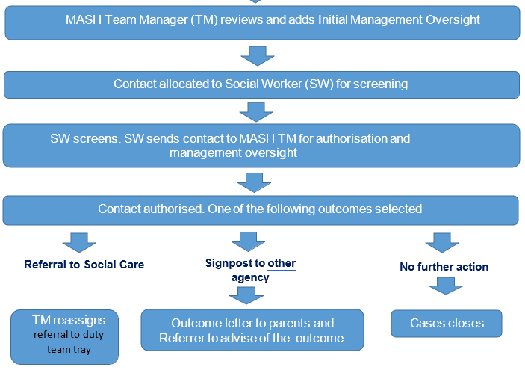
What happens to a Referral?

Slide 57
Organising a Strategy Discussion
Strategy Discussion convened how would this happen?
Health representatives, does a paediatrician need to attend?
Police
Education representative

Slide 58
Health Representatives
MASH Health – provide an overview of available health information
- signpost to relevant health professionals
- share information with relevant services
GP and Community Services
Paediatrician – suspected abusive injury, concerns around CSA, or the child has a health condition where immediate advice is required.
Out of hours: access to health information is limited but a senior paediatrician is always available.
EMCYPSAS
Notes:
MASH Health in the city is a small team of health professionals who are highly experienced in child health with knowledge and skills to collate, analyse and share health information in relation to safeguarding and child protection.
MASH Health are not specialists in every medical or health condition therefore they will not interpret specialist health information or provide medical opinion or agree to medical assessments, but they will signpost to the relevant professional.
They will assist in getting information to the appropriate health service where it is deemed necessary and share urgent health actions which require immediate action to safeguard a CYP.
GP and CS (0-19, Continence, SLT, CAMHS etc…) – not routinely present unless open to fieldwork and part of core group, but in MASH only attend if they have completed the referral or have had significant relevant involvement.
Paediatrician – should always be consulted when suspected abusive injury, CSA or health condition where immediate advice is required.
Out of hours, access to health info is limited, a senior paed is always available but it may be that other medical professionals may be present such as an ED Consultant or intensive care consultant dependent upon the contact the child has had which has led to the out of hours strategy discussion. What this means for education, is that although there has been a strat with a health rep, not all health history or concern may be known. There will be a request for a health check through the MASH but if health needs are known by other agencies, ensure that information is shared at the earliest opportunity.
EMCYPSAS - East Midlands Children & Young People Sexual Assault Service – Lead Consultant Paediatrician Dr. James Fildes.
Referral criteria
All CYP who allege a sexual assault/abuse
Adults up to 25 years with significant learning disability
Staff
24 hr crisis support worker helpline
Paediatric nurses in working hours
24 hr on-call doctor
Role
Collection of samples, documentation of injuries, emergency contraception, reassurance, historical information gathering, onward referrals for therapeutic support, support from CHISVA, sexual health and health.

Slide 59
Child Protection Medicals
A child protection (CP) medical assessment is a comprehensive assessment.
Strategy Discussions must consider, in consultation with the Consultant Paediatrician, the appropriateness and the timing of a CP medical assessment.
CP medical clinic operates between 1-5pm.
The CP medical investigation is only a part of the overall multi-agency assessment to assess the safety and well-being of a CYP.
Only doctors who have gained appropriate informed consent may physically examine the whole child. All other staff should only note any visible marks or injuries on a body map and record, date and sign details in the child's file.
Notes:
A child protection medical assessment is a comprehensive assessment which includes the clinical history, examination, and detailed documentation including the use of line drawings and photographs. Potentially a traumatic experience if not managed sensitively. Additionally, the assessment includes obtaining any investigations and forensic samples if necessary, arranging any necessary aftercare and writing a report with an opinion. It should be conducted with the same degree of thoroughness and attention to detail as an examination for any potentially life-threatening medical condition.
Aims:
To identify the child's health needs;
To consider the physical and psychological sequel of such abuse;
To give an opinion from the medical perspective on the likelihood of child abuse on the balance of probability;
To facilitate the police investigation of a possible crime by documentation of clinical findings, including injuries and taking samples that may be used as forensic evidence in a police investigation relevant to all types of abuse;
To contribute to the multi-agency assessment through sharing of information
Referrals for CP medicals are taken between 9-5 but the NAI clinic operates between 1-5pm, early referrals ensure a discussion and medical can take place the same day if it is in the child’s best interests to do so. Otherwise CSC need to determine a safety plan until the medical can take place
A child protection medical assessment cannot provide a detailed assessment of the child or young person's mental health or cognitive ability. If it is felt that this is required, this will need to be organised with the appropriate specialist service.
Consent – Child over 16, child of sufficient age and understanding may refuse some or all, can potentially be overridden by a court; a person with PR; a court direction; LA if has PR through a court order.

Slide 60
Preparing for a Strategy Discussion
All professionals attending a strategy discussion should consider the following questions prior to the Strategy Discussion:
What is the contextual information relevant to the concern?
Is there evidence to suggest the child is suffering or is likely to suffer from significant harm? If so, please state the nature of harm.
Is there evidence that this harm is attributable to anything the parents/carers have done?
Is there evidence that this harm will be ongoing?
What outcomes do we want the Strategy Discussion to achieve?
If it is not possible to attend, all invitees should provide relevant information considering the questions above

Slide 61
How is the strategy discussion structured?
Chair to outline reason for strategy discussion including why there is reasonable cause to suspect the child is suffering or is likely to suffer significant harm.
If known, what has the child/children communicated/told us they would like to happen? This is about setting a context, provide a narrative but be clear regarding the risks. It is important to list them and give reasons, all attendees views should be clearly recorded

Slide 62
Case Study
Chair to ask each attending professional whether they believe there are sufficient grounds to initiate enquiries under s47 Children Act 1989 and to consider, in their view:
• Is there evidence to suggest the child is suffering or is likely to suffer from significant harm? If so, please state the nature of harm.
• Is there evidence that this harm is substantial/significant/severe?
• Is there evidence that this harm is attributable to anything the parents/carers have done or not done?
• Is there evidence that this harm will be ongoing?
The chair should also ask all attendees for the Signs of Safety Score.

Slide 63
What would be your views for the outcome?
Breakout discussion: In small groups please discuss the information that has been shared and consider what your view would be towards s.47?
Please consider the worries and any strengths
Signs of Safety scoring and rationale- why?

Slide 64
Information from Alternative Provision
Alex’s grades have been inconsistent, with recent reports indicating a drop in performance in English and Maths.
Alex sometimes resorts to disruptive behaviour in class, possibly as a way to gain attention
He finds enjoyment in sports, and physical activity help improve his mood and engagement.
Alex speaks highly of his little sister.
Alex has been observed with some bruising, but has shared that this was from play fighting with a friend

Slide 65
Agreeing Outcomes
Meeting attendees to agree a multiagency action plan based on the needs of the child (under s17 or s47 of the Children Act 1989). Chair to invite professionals present to identify support from their services to contribute to the multi-disciplinary plan.
Where there is not unanimous agreement amongst the professionals present about the need to initiate enquiries under s47 this should be clearly recorded. The rationale for the strategy discussion outcome should also be clearly recorded.

Slide 66
School support during Section 47 enquiry
Breakout discussion:
How education can support during the section 47 enquiry with consideration to the assessment and investigations from Children Social Care, Police and or health and how best to support the child(ren) and family?

Slide 67
How education can support
Family and Friends relationships: Understanding the family network can guide professionals in developing interventions that involve not just the child but the entire family system.
Communication: Maintain open lines of communication with social services and relevant agencies to ensure collaboration and information sharing.
Supportive Environment: Create a safe and supportive atmosphere for the child, offering emotional support and reassurance. Maintaining a constant of education in their life.
Involvement of Designated Safeguarding Lead (DSL): Ensure the DSL is actively involved in the inquiry. Schools can offer emotional and psychological support to children, helping them feel safe and understood during a stressful time.

Slide 68
DSL network dates 2024-2025
Tuesday 11th February 2025 9.30-12pm
Tuesday 20th May 2025 9.30-12pm
Must book online in advance- Nottingham Schools website
Expectation is that you take back learning, updates and any requests back to the wider team in your setting
Attendance at two or more networks constitutes DSL Update training (certificates issued in summer term)
Notes:
Nottingham Schools - Nottingham City Council

Slide 69
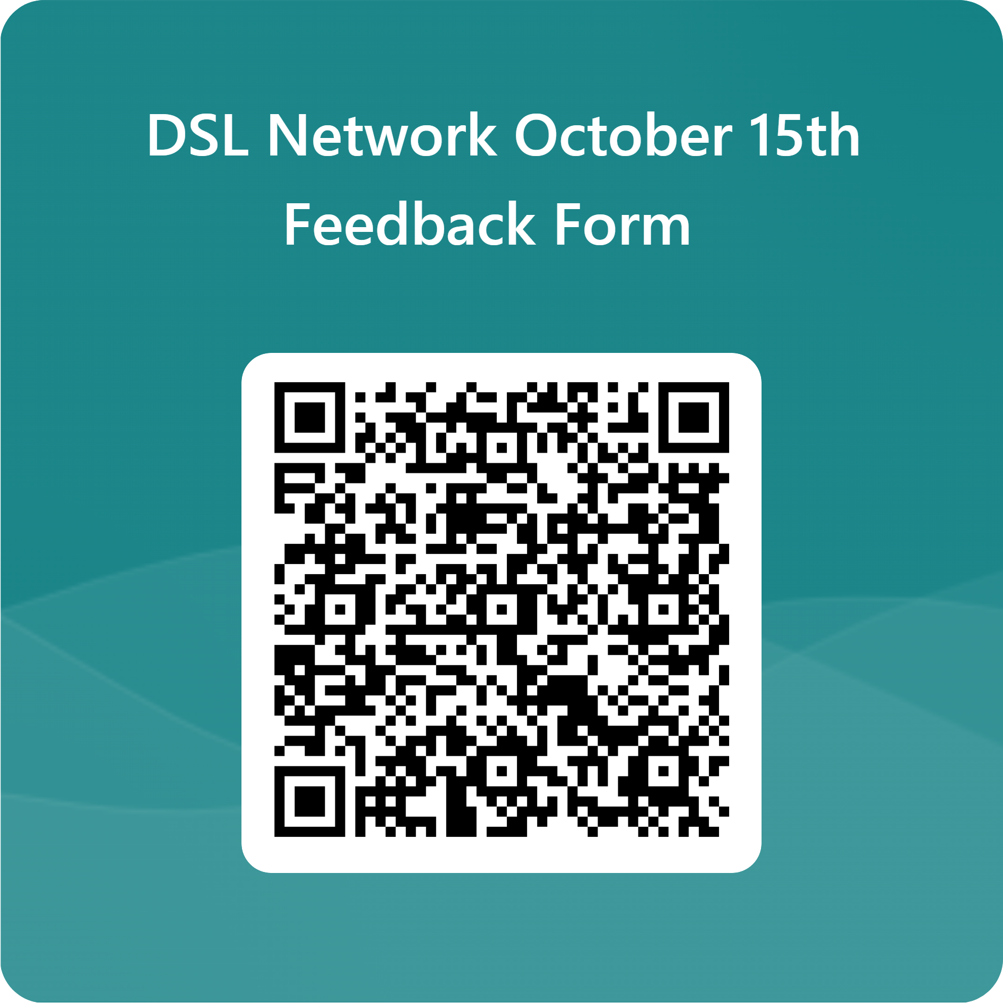
Feedback
We’d really appreciate your feedback from today in response to the content covered alongside any other thoughts on topics you may like to see included at future network events- thank you!
Notes:
Please provide feedback using the QR code above or alternatively email safeguardingineducation@nottinghamcity.gov.uk

