Slide 1
Understanding CyberCrime
and Computer Misuse

Slide 2
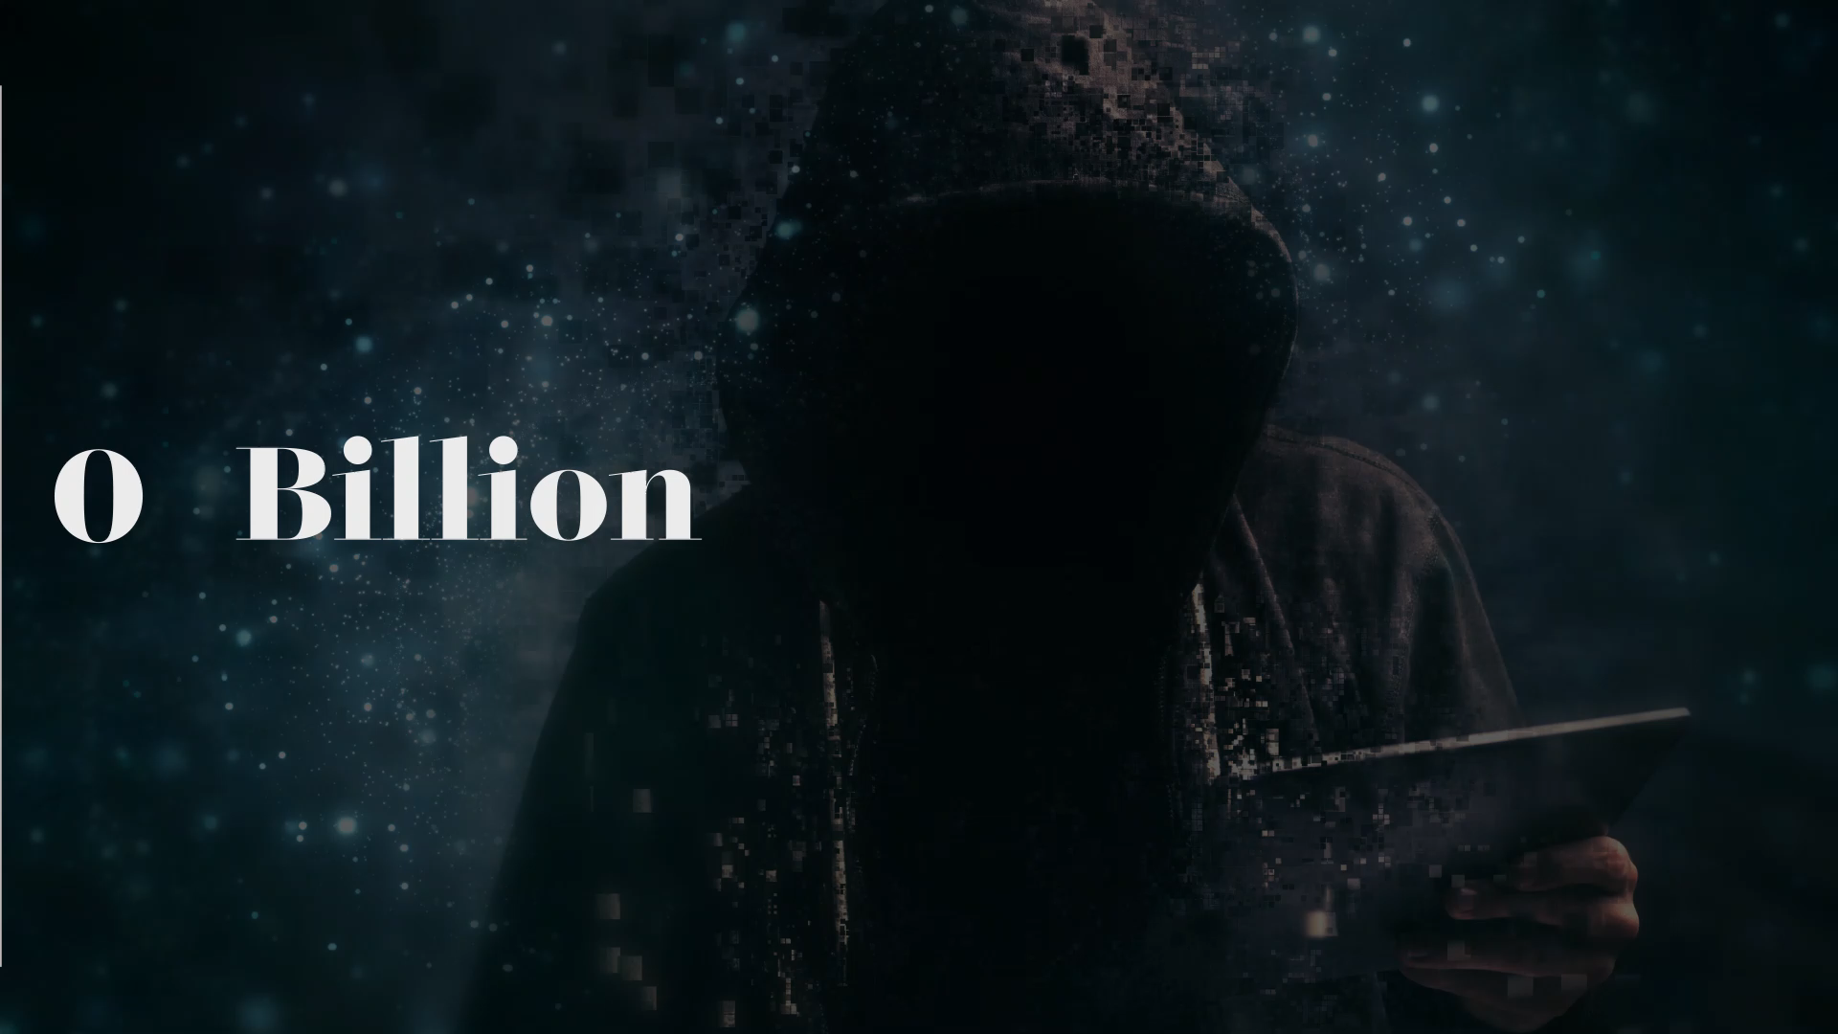
THE RISE IN CRIME
£27 Billion is
  £27,000,000,000 (9 zeros)
  The entire GDP of Bolivia
  5,400,000,000 £5 notes
  12,258,000 tonnes of cash
  2,739,726.3 /day for 27 years
Notes:
Ask the students how much they think cybercrime costs the country each year.
By show of hands, do they think it costs e.g. 3 million, 8 million, 42 million, 7 billion, 15 billion . . ..
[CLICK MOUSE x 6 reading each bullet point as you do]
NB: You may need to explain that GDP is the market value of all the good and services produced by a country in 1 year.
NB: You may wish to edit the slide to show 2,739,726.3 depending on the age of the audience

Slide 3

What Is Cyber Crime?
Accessing stuff without permission
Accessing stuff without permission & intending to do something bad
Doing something bad
Doing something so bad you cause a lot of damage
Helping someone else to do bad stuff.
PS you use a computer to any of the above
Notes:
Cybercrime is covered by an important piece of legislation called the Computer Misuse Act.
This legislation has 5 key parts that I need you to understand. They are:
[CLICK MOUSE x 5 reading each bullet point as you do]
Of course, it doesn’t just have to be a computer, it could be a laptop, a phone, an IPAD, anything electronic or digital.

Slide 4

Accessing stuff without permission
You log into their:
  Computer
  Phone
  Facebook Account
  SnapChat Account etc.
Log into your own computer but access:
  Files that aren’t yours
  Software which isn’t there for you.
Notes:
So lets take the first part, ‘accessing stuff without permission’ and look at what this might mean.
It could mean that you know your friend’s password so you [CLICK MOUSE to reveal 1st bullet point] log into their
[CLICK MOUSE x 4 to reveal each bullet point, reading each one & adding emphasis where appropriate e.g. its not just Snap Chat, its ‘all the juicy gossip on Snap Chat’]
Perhaps it is not about accessing your friends phone or laptop. Perhaps you just [CLICK MOUSE to reveal 2nd white bullet point and read]
[CLICK MOUSE to reveal ‘Files that aren’t yours’] such as student grades so that you might change them.
Perhaps you log into your own computer but [CLICK MOUSE to reveal last point] find software which isn’t there for you. Perhaps you access SIMS, which is what the teachers use to run the school and keep track of what you do and how you do it.

Slide 5


Guess the punishment(!)
What’s the maximum punishment :
A letter from the police saying we know what you did so stop it
A £500 fine
A £5000 fine
6 months hard time
1 years imprisonment and a £5,000 fine
2 years imprisonment and/or a £5,000 fine
Notes:
So, what do you think?
[CLICK MOUSE to reveal ‘What’s the maximum punishment.’] What would be the maximum . . . the maximum punishment . . . if you were over 18? Is it . . .
[CLICK MOUSE X6 to reveal each bullet point and read as you go along adding emphasis to each for dramatic effect]
NB: You may wish to swap hard time to imprisonment.
Give students 30 seconds to discuss with the person they are sat next to.
By show of hands, collect the responses.
The answer is 2 year’s imprisonment. You may also get a fine that cannot exceed £5,000
Many of you might be be shocked by this – 2 years just for accessing stuff that’s not yours!!! What you have to bear in mind, however, is how you gained access to the computer and what computer you accessed.
For example, a police officer that abuses his position of trust to access a database with sensitive data on it - such as national security - might well get a 2 year sentence.
However, if you’re just accessing your best friends account because you wanted to see if you could hack his password then you might only get a cease and desist letter from the police in the first instance.
Now don’t get me wrong, this is not a nice letter to receive - for anyone. Trust me, I know – I’ve seen them.

Slide 6

Accessing Stuff Without Permission & Planning on Being dead naughty!
Perhaps you intend to
  Delete stuff
  Change stuff
  Make the software do something weird
  Take over the web cam
  Kick your best mate off a gaming platform
  Transfer money to your account
Notes:
So the second part of the Computer Misuse Act is about [Read Slide Title]
Perhaps you intend to
[CLICK MOUSE X 2 to show ‘Delete’ and ‘Change’ bullet points]
Perhaps you want to [CLICK MOUSE & read] such as open and close it repeatedly. Now, I’m not saying you know how to do this, only that you want to.
Perhaps you also want to, [CLICK MOUSE x 3 & read. Make sure pupils understand that kicking friends of a gaming platform is actually a very common problem we have to deal with]

Slide 7

Guess the punishment(!)
What’s the maximum punishment :
1 year doing time and a £5,000 fine
2 years
3 years
5 years
7 years
THINK : it depends on how awful the crime is that you want to commit NOT if you can actually do it
WHY IS it rare to see prosecution here?
Notes:
So, what do you think this time?
Is the maximum punishment. . .
[CLICK MOUSE x5 reading each bullet point]
You might say something along the lines of ‘5 years – you naughty boy’ – if only to add effect and emphasise the point that most of these crimes are actually committed by teenage boys rather than girls
Give students 30 seconds to discuss with the person they are sat next to.
By show of hands, collect the responses.
The answer is up to 5 years and, or, a penalty that cannot exceed £5,000.
Again, this might seem rather shocking. After all, you can get 5 years even if you didn’t actually commit the crime – you just intended/meant to do it.
What you have to remember, however, is that a judge has to consider how serious the crime you wanted to commit is.
If you wanted to disrupt traffic lights to cause an accident, then that would be treated more seriously then accessing someone’s phone with the intention of downloading all their images, or downloading indecent images to bribe them.
Can anyone guess why we never actually prosecute people under this part of the Computer Misuse Act?
It is hard to prove what someone ‘intends’ to do. You might ‘intend’ to do something, but never actually do it – in which case, should you be punished??

Slide 8

Doing stuff without permission & Being Reckless
I actually did the bad stuff
I didn’t think about the consequences
  Planted malware (sick software)
  Encrypted data
  Got personal stuff & blackmailed someone
  Boot someone off an online game
It’s A Fair Cop Governor!!
Notes:
Ok, lets look at the next bit [Read Slide Title & CLICK MOUSE]
Now this time we actually did the bad stuff. We might have done the ‘bad stuff’ because we’re not a very nice person or it could be that we just didn’t think about the consequences of what we were doing.
[CLICK MOUSE and read bullet points]
Any guesses what the maximum punishment?
Take a few suggestions from the students
The answer is a maximum of 10 years.
Think - if you encrypted the school’s network, what would happen to all the work you’ve done? What about your coursework? What about all the grades and reports teachers have written about you? Scrub that . . . what about all the lesson plans and PowerPoints teachers use?? Or the medical data they store about you on Sims? What about the finance department and all the other departments that keep the school running on a daily basis? All gone!
In fact, what is true of schools is also true of business.
When a company loses data about its customers they face fines and penalties that cost 1000s if not millions of pounds.
And if that doesn’t finish them off, what about all the customers that no longer want to do business with them? Who wants to use a company that can’t keep your credit card details safe?
Either way, when a business goes under, people find themselves unemployed and one day you might appreciate how stressful unemployment is when you have a family to feed and bills to pay
Cyber crime in not victimless.

Slide 9

Intentionally or accidentally causing serious harm
Damage to human welfare
  You risked life
  You injured someone
  You stopped people getting food, water, gas or electric
  You disrupted transport – roads, railways, flights
  You messed about with the NHS
  You affected the economy
  You affected national security
3ZA – 14 Years or life & / OR £5,000
Notes:
And finally, the last section of the Computer Misuse Act deals with those crimes that are super serious.
[CLICK MOUSE X & read bullet points]
Remember, launching the wrong type of attack against the wrong type of server - even accidentally - can carry a life sentence if you risk human welfare.
Think - if you murder someone by being careless what would happen to you?? The same rules apply here

Slide 10

& just In Case you think you are exempt
If you make . . .
If you give someone else . . .
If you download . . .
If you buy . . .
Malware - even if you don’t use it
You can get
  1 year to 2 years and / or a fine to the maximum value of £5,000
Notes:
And finally – just in case you thought they’d missed something out. . .

Slide 11
Don’t cross the line
https://www.youtube.com/watch?v=PJ0KddbbxrE&t=6s
Do you need help?
Want to talk to someone?
Cyber4schools.net
Notes:
Please Wait Whilst Video Loads
The video can be found here: https://www.youtube.com/watch?v=PJ0KddbbxrE&t=6s
The thing is, even the police want people to be interested in cyber security because of the job opportunities - and the salaries that come with them.
We are crying out for specialist and we are also desperate to teach people how to protect themselves against cyber crime.
This however, is the subject of another Assembly.
Thank you for your time and patience.

Slide 12





Cyber 4 schools
What Can EMSOU Do For Your Organisation
East Midlands Special Operations Unit
Notes:
Key References :
‘Business Continuity Management’ NORMIT & Norfolk County Council Resilience Team (www.normit.org )
‘The Eleventh Hour CISSP’ Eric Conrad et all. 2016
‘Certified Information Systems Security Professional’ 8th Edition. Mike Chapple, James Stewart, Darril Gibson. 2018

Slide 13
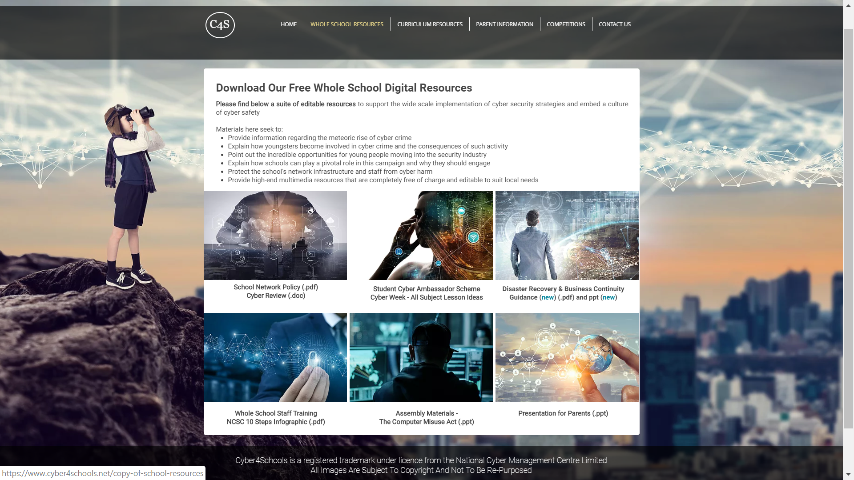
Notes:
We are offering a plethora of free services & resources to both primary and secondary schools.
All of which, are available on our website, cyber4schools.net

Slide 14
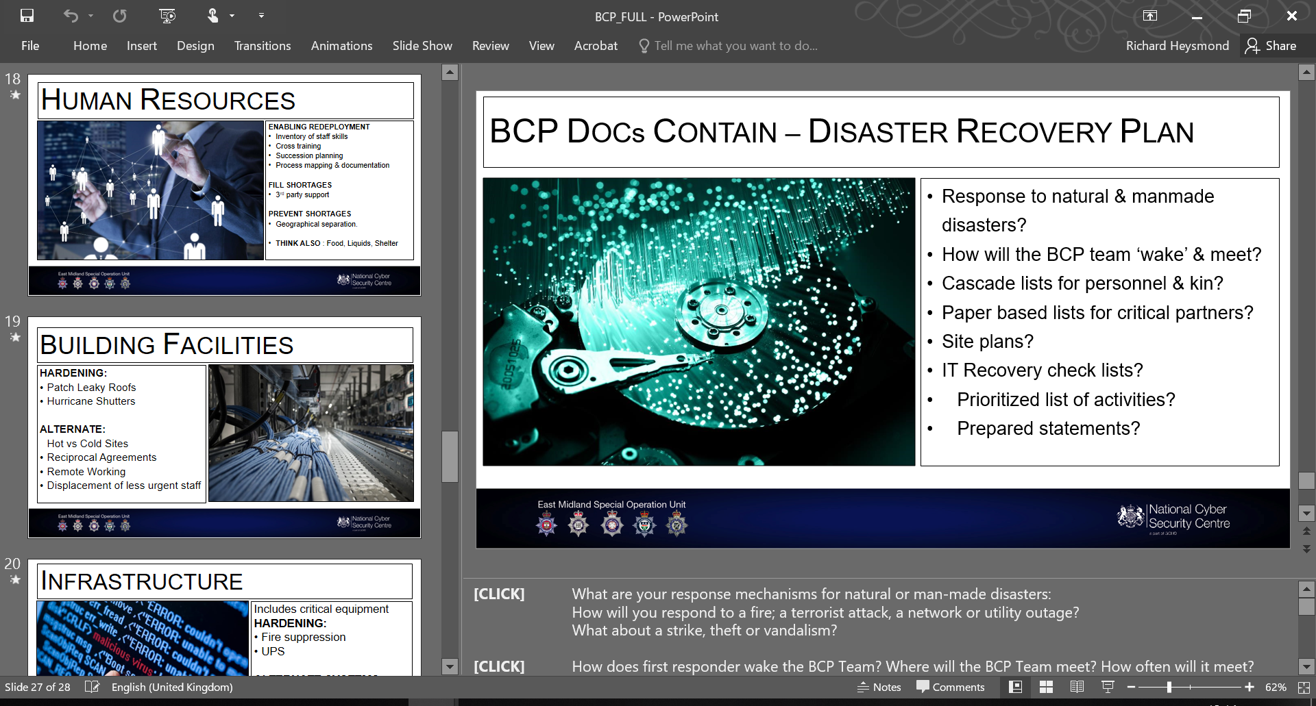
Notes:
For example, we have any number of whole school, editable documents such as
IT security policy - if yours is looking rather old and dusty.
High end presentation that make you think carefully about what you’d if you suffered a complete loss of IT services . . We’ve spent a lot of time helping schools that have been hit ransomware, for example, and its much better to be ready for an incident then to deal with them retrospectively.

Slide 15
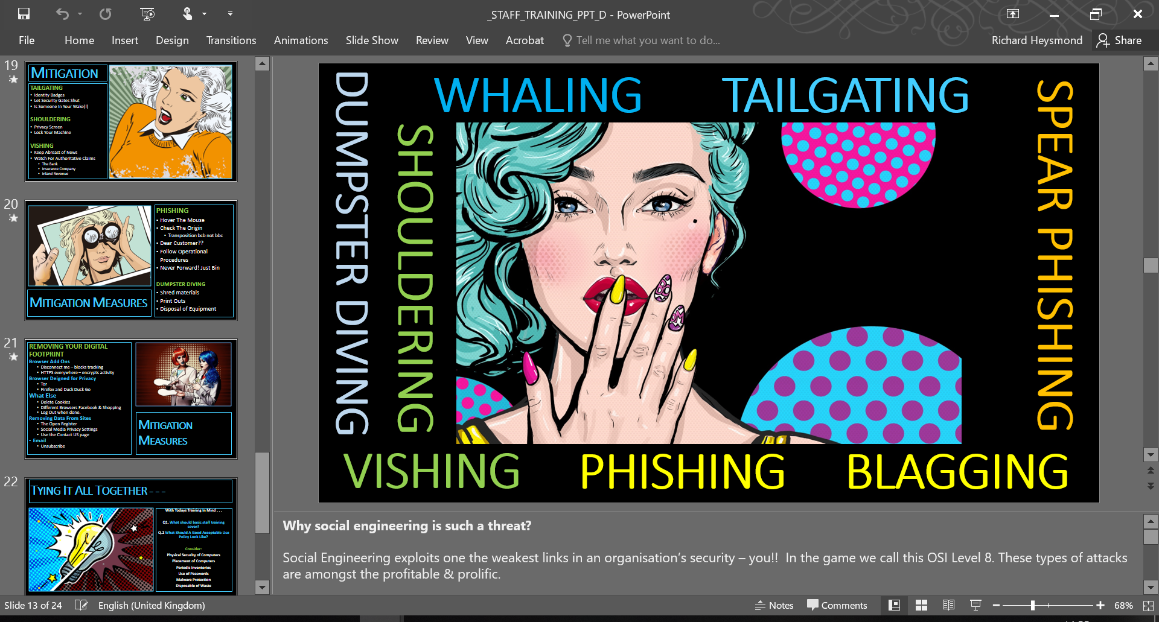
Notes:
One of our most popular services is staff training.
We can come into your schools and help staff to recognise common security threats, so that they can not only protect themselves, but also the school infrastructure.

Slide 16
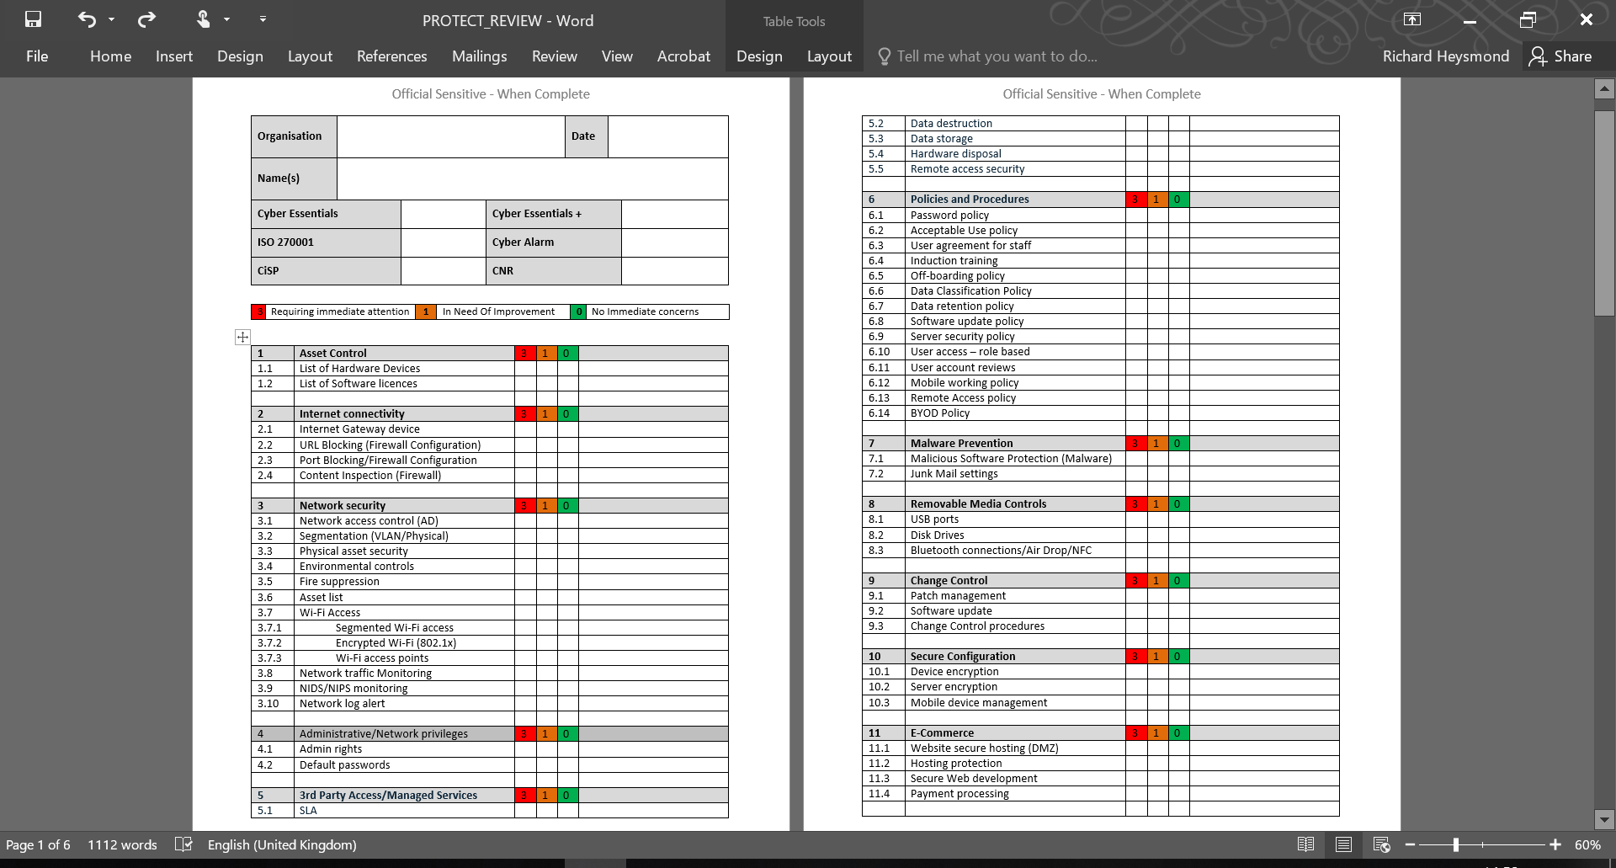

Notes:
We are happy to visit your school & have a friendly chat with your network team about how the school approaches security. What policies , procedures and technical controls are in place, and how they might be strengthened.
These reviews are critical in demonstrating due care & diligence and also the school’s commitment to protecting sensitive data.

Slide 17
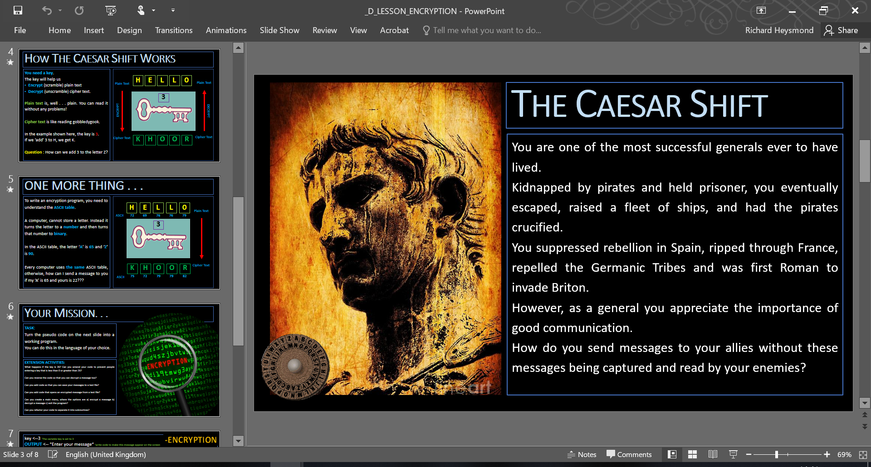
Notes:
We have lesson materials for teachers that integrate perfectly with Key Stage 2, 3 and 4 specifications
They include:
Cyber Ethics
Cyber Careers
Cyber Threats and Solutions in modern day society.
They even have programming tasks written in 3 different languages.
These resources include Lesson Objectives, Differentiated Activities and Speakers Notes written by yours truly.

Slide 18
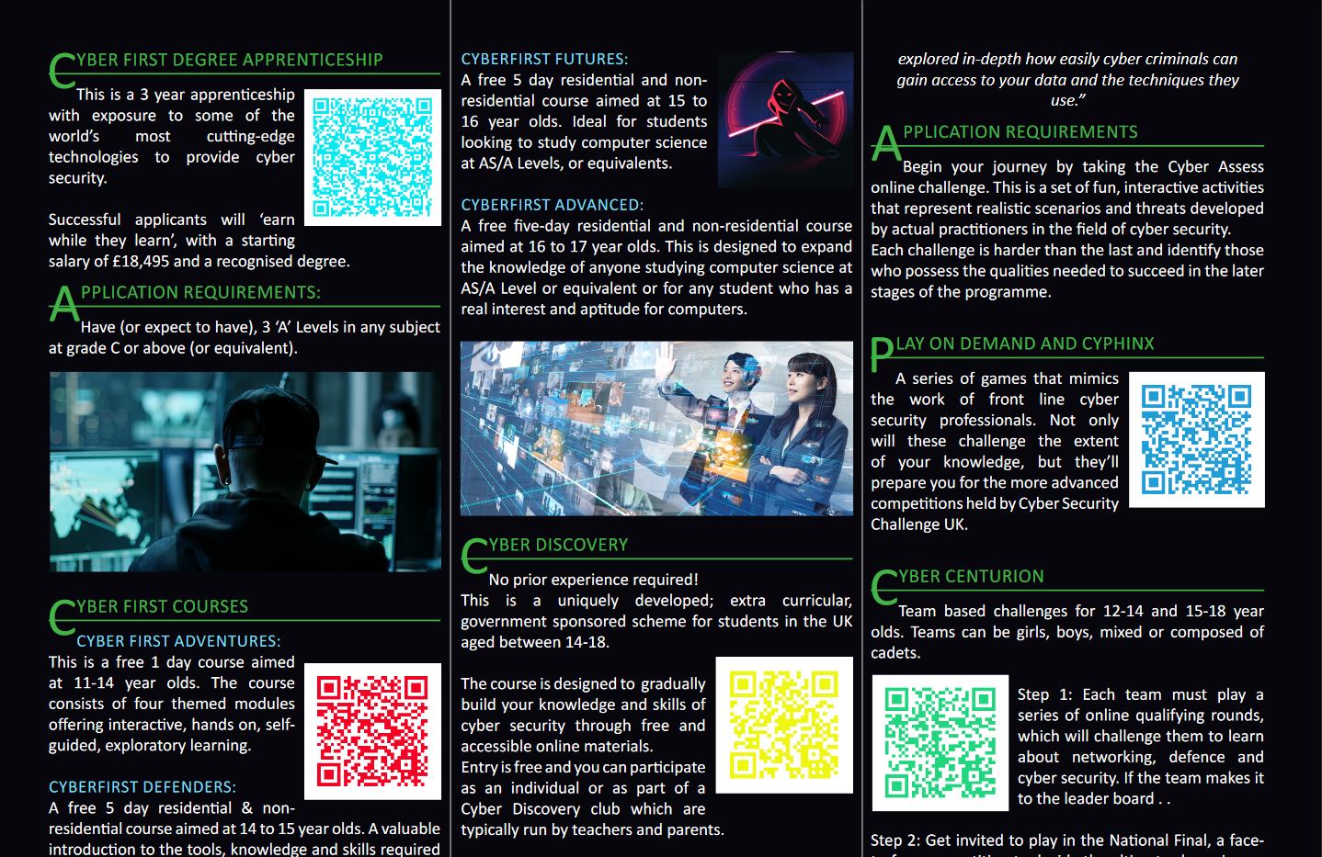
Notes:
We have handouts on career opportunities for students.
For example, did you know that
Secondary schools are able to send students to free, residential ethical hacking courses.
Or that they are bursaries worth £18,500 / yr to study cyber security full time if you achieve 3 Cs at A Level?

Slide 19
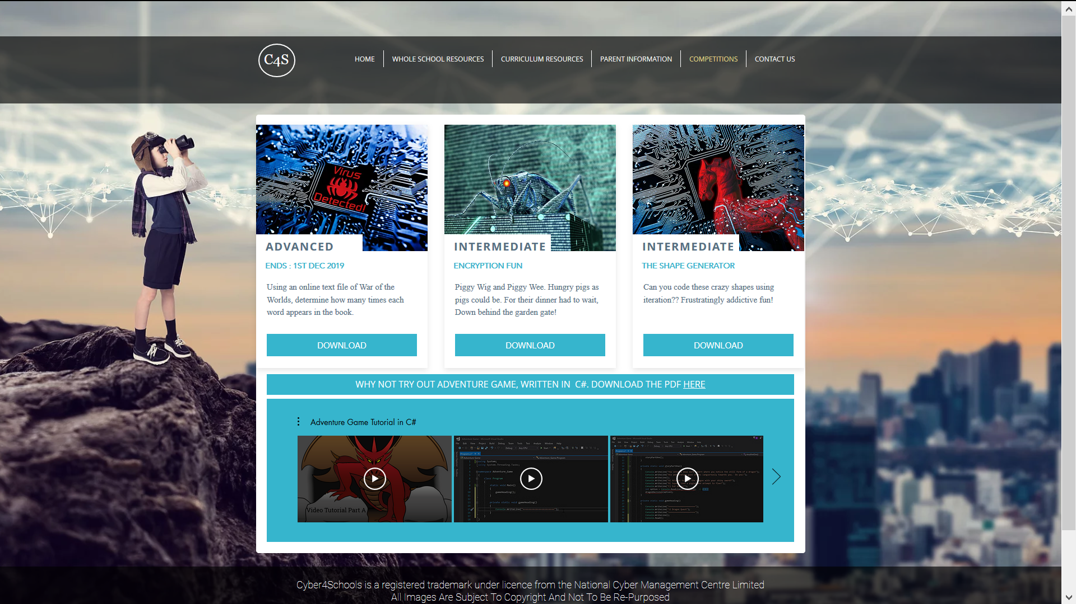
Notes:
Our website also has a number of cyber competitions, with 3 different levels of challenge.
We have even added video tutorials to help students program an adventure – dungeons and dragons - style game in C#.
A great project for a coding club!

Slide 20
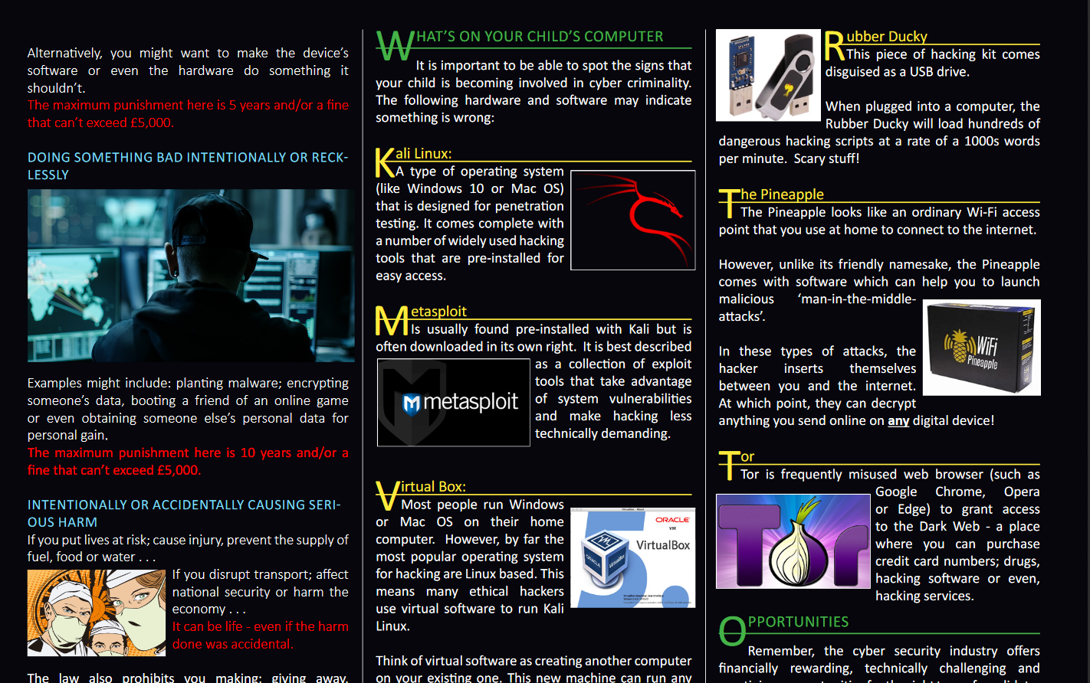
Notes:
Finally, we have materials that can be given to parents in order to help them understand if their child is falling foul to the Computer Misuse Act and what sorts of things to keep an eye out for at home.
In our experience, many parents have absolutely no idea whatsoever what little Jimmy is doing upstairs on the computer.

Slide 21
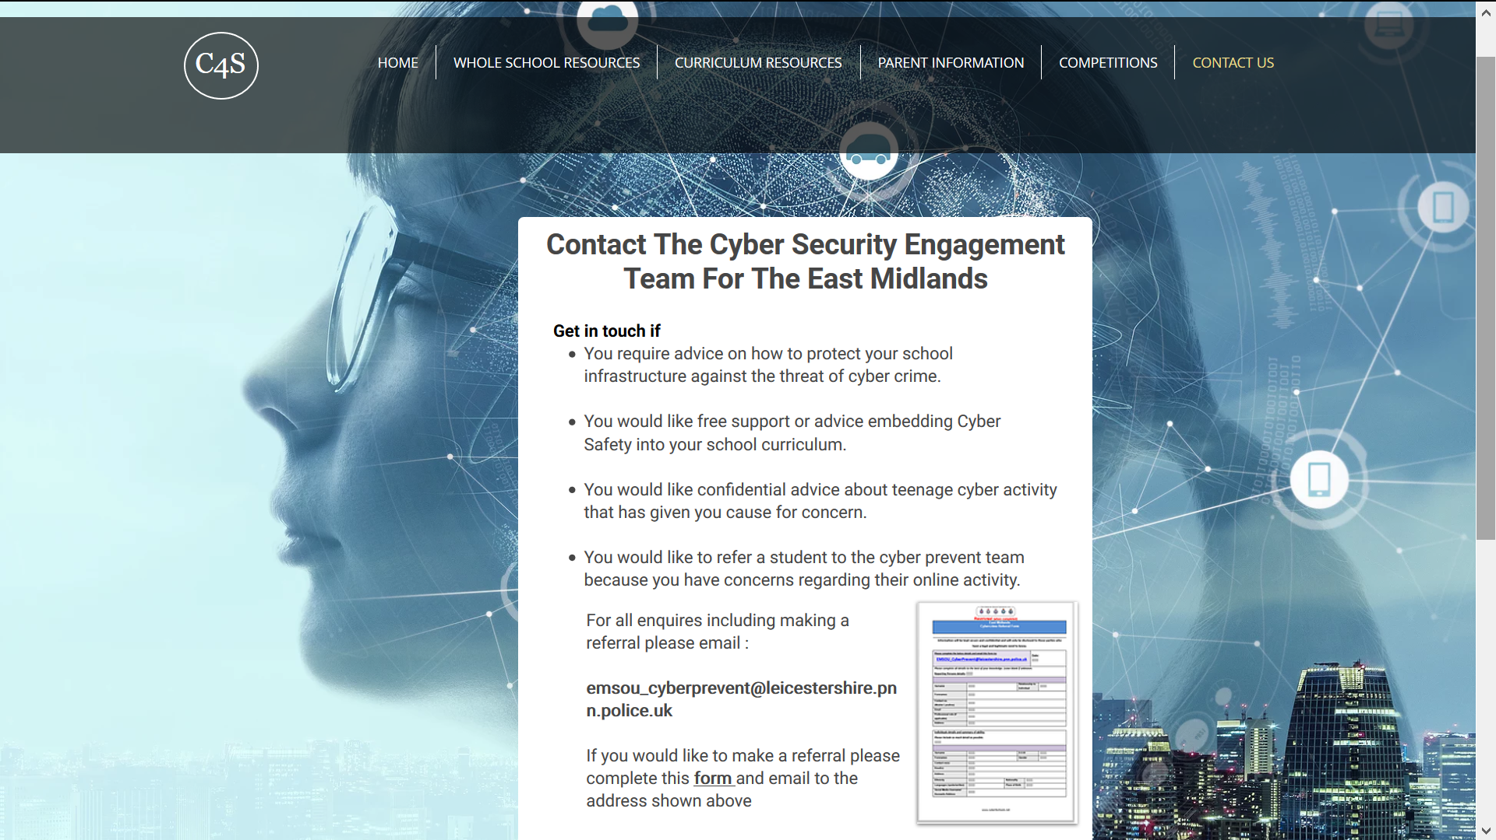
Notes:
Of course, if there are students within your school that are highly likely to enter the murky waters of cyber crime, or have already done so, then we have a referral process and policies that can help you deal with these individuals in a proportionate manner that does not harm their future.

